Slide 1
DSC40B:
Theoretical Foundations of Data Science II
Lecture 1: Welcome, introduction and examples
Instructor: Yusu Wang

Slide 2
Prelude

Slide 3
Course Information
Course webpage:
  http://dsc40b.com
Office hours:
  My office hour: Tue@ 9:30am – 10:20am in person at HDSI 446 (my office)
  See website for office hours of TA/Tutors
  always feel free to send me emails with questions / concerns
    yusuwang@ucsd.edu
  using Campuswire message board may be faster to get an answer
Discussion session:
  Fri@ 12:00pm – 12:50pm
  Discussion sessions are very important!

Slide 4
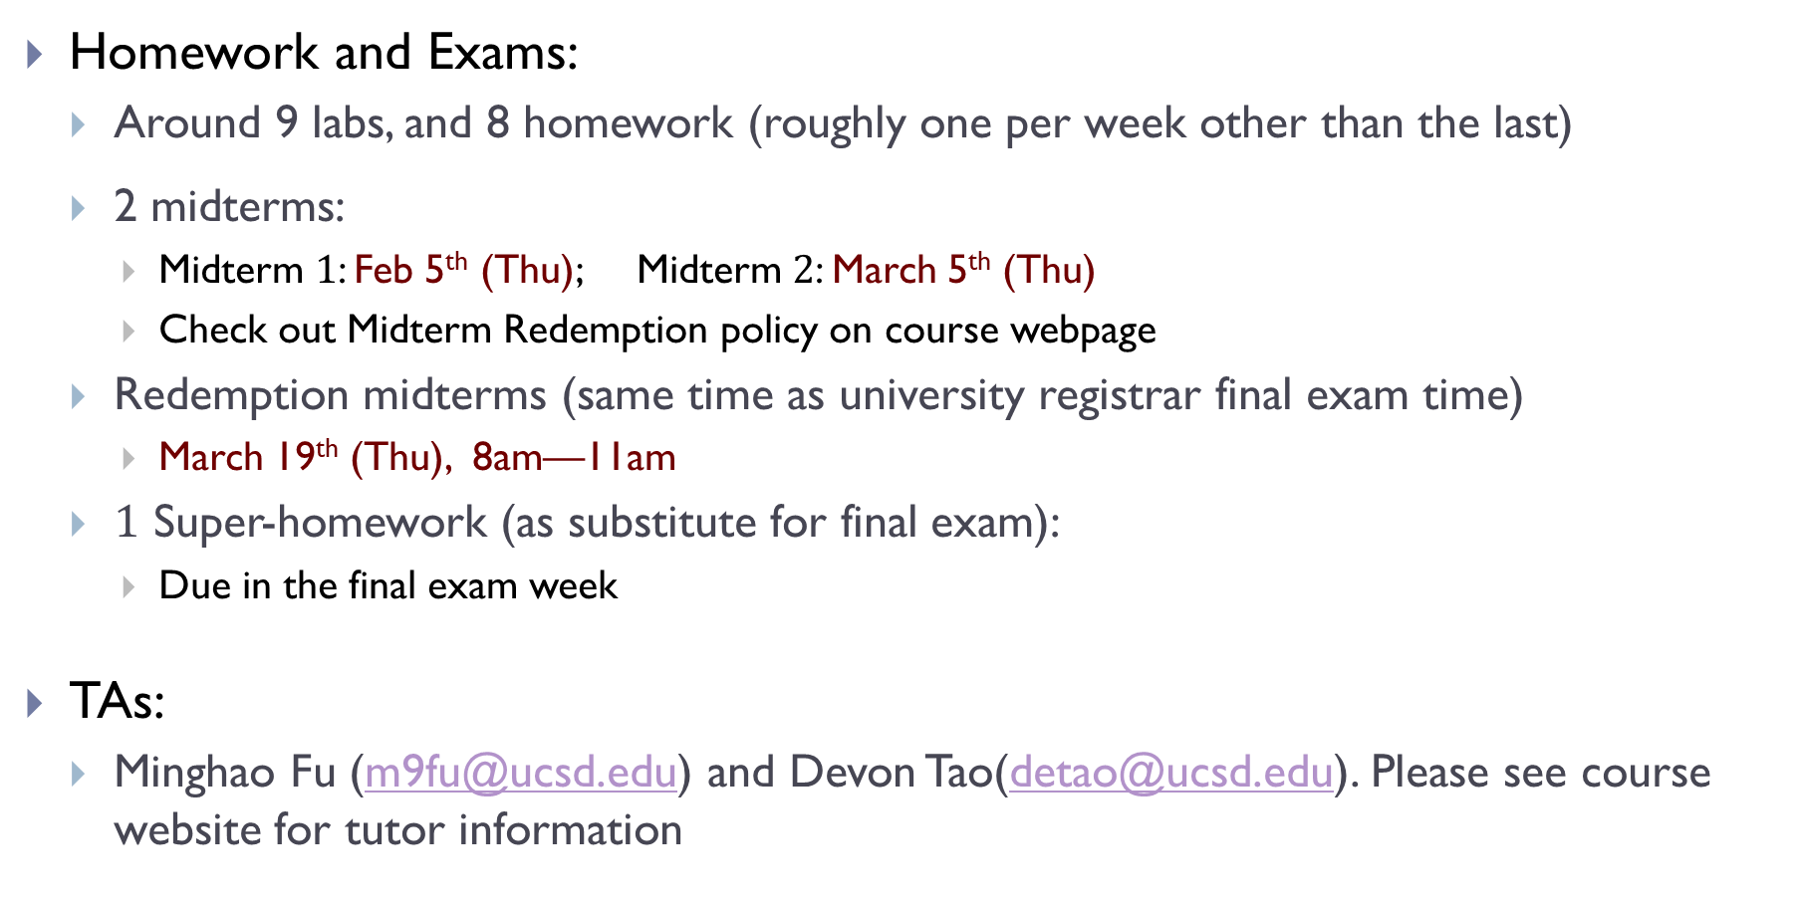
Course Information
Homework and Exams:
  Around 9 labs, and 8 homework (roughly one per week other than the last)
  2 midterms:
    Midterm $1$: Feb 5th (Thu); Midterm $2$: March 5th (Thu)
    Check out Midterm Redemption policy on course webpage
  Redemption midterms (same time as university registrar final exam time)
    March 19th (Thu), 8am—11am
  $1$ Super-homework (as substitute for final exam):
    Due in the final exam week
TAs:
  Minghao Fu (m9fu@ucsd.edu) and Devon Tao(detao@ucsd.edu). Please see course website for tutor information

Slide 5
Course Information
Grading:
  9%: Labs
  16%: Homework Assignments
  5%: Final super-homework
  35%: Midterm 01
    (or Redemption Midterm 01, whichever is larger)
  35%: Midterm 02
    (or Redemption Midterm 02, whichever is larger)
  Passing threshold: ≥60% average in two midterm in order to pass!

Slide 6
Course Information
Slip Days
  You have 5 "slip days" to use throughout the quarter. A slip day extends the deadline of any one homework by 24 hours. Slip days cannot be "stacked“. Slip days are applied automatically at the end of the quarter, but it's your responsibility to keep track of how many you have left.
    Slips days cannot be used for the homework prior to the two midterms, nor for the final Super homework.
    If you used more than 5, your last few additional usage of slip days will be invalid automatically.
Homework collaboration
  You may discuss homework with your classmates, or use AI (e.g, ChatGPT). It is very important that you write up your solutions individually. Check course website for more discussions on this.

Slide 7
Course Materials
Couse note by Justin Eldridge (JE)
  https://dsc40b.com/materials/default/notes/book.pdf
Other optional textbooks:
  Cormen, Leiserson, Rivest, Stein (CLRS), Intruction to Algorithms
  Dasgupta, Papadimitriou, Vazirani, Algorithms

Slide 8
Introduction to the course

Slide 9
Recall in DSC 40 A
How do we formalize learning from data
How do we model it in a precise way so that a computer could potentially tackle it

Slide 10
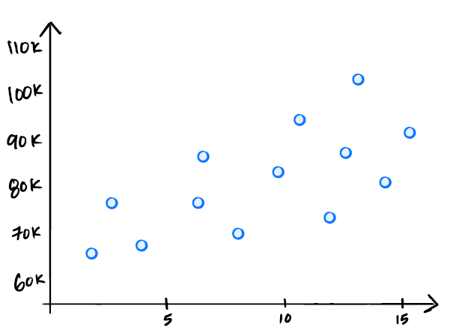
A simple example
Salary prediction from existing data
salary
years of experience

Slide 11
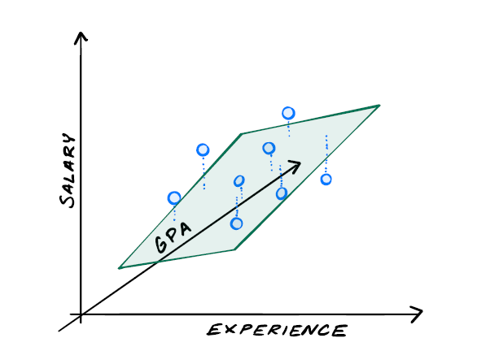

A simple example
Salary prediction from existing data
Formulation (linear regression):
  Find the best (hyper-)plane fitting these points with least total error (sum-square distances)
  $X^{T}X \vec{ω}=X^{T} \vec{b}$

Slide 12
Is that the end?

Slide 13
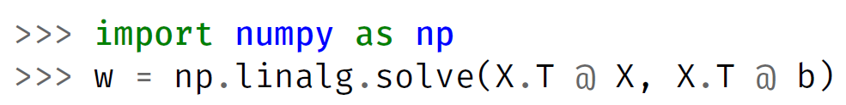
But ….
How do we really compute it?
How do we ask the computer to compute it for us?
This is an algorithm
  a sequence of steps / operations to achieve a goal
How do we know this is a “good” algorithm?
  How fast does it run on 1,000 points?
  How does it scale to 1,000,000 points?
  What if the feature dimension increases to 100,000?
  Can we come up with better algorithms for this?

Slide 14
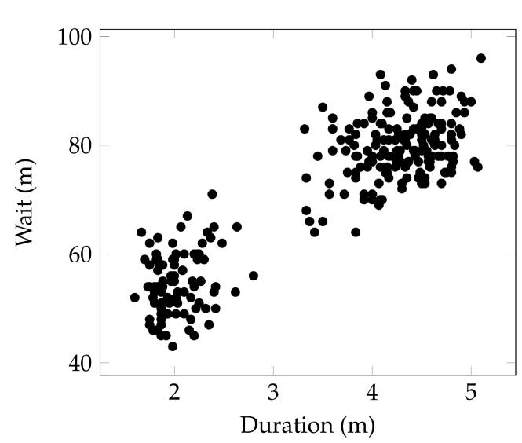
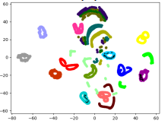
A second example
Clustering
  Given a set of data, identify “groups” (clusters) such that “similar” data points are grouped together
  Ubiquitous across science and engineering
Notes:
How many different types of specific cancer cells – targeting with different treatments?
How many groups of opinions are there within a population?
For different type of problems, the measurement of “similarity” is different, and the objective could be different.

Slide 15
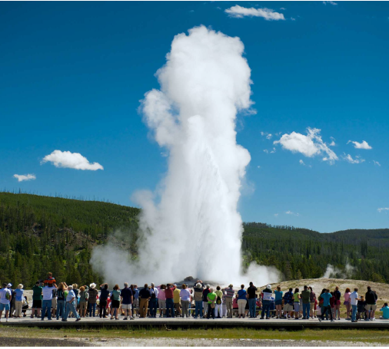
Old Faithful Geyser
What’s the pattern behind its eruption?
How to define as well as find the two clusters?

Slide 16
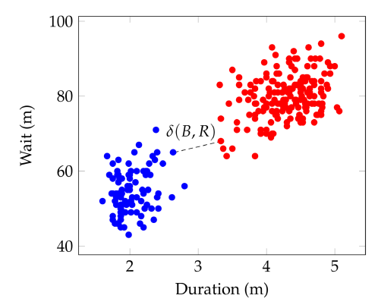

DSC40A says
Let’s model this as an optimization problem
  first develop a way to measure / quantify the “goodness” of different grouping
  then compute the best grouping with highest goodness score
A grouping candidate:
  assign each point to be either blue or red
Quality (goodness):
  min separation distance $δ(B, R)$
    smallest distance between a red or blue point
Goal:
  given points $X=\left\{x_{1},…, x_{n}\right\}$
  return the assignment of $X=B∪R$ with largest separation distance $δ(B, R)$

Slide 17
Are we done?
But… how do we really solve this optimization problem?
What is an algorithm to achieve this?
  The algorithm needs to be correct
If we develop a correct algorithm, is this algorithm good?
  How do we know? (aka: how to analyze our algorithm?)
How do we design better algorithms?

Slide 18
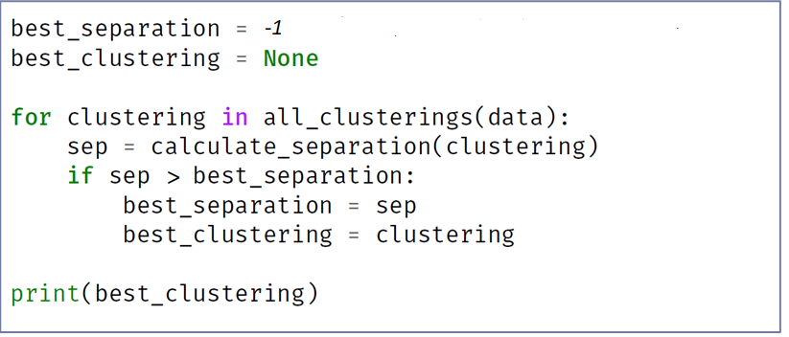
A first algorithm for clustering
Intuition: to compute min-separation grouping
  try all possible assignment of all input data points
  compute separation distance for each assignment (grouping)
  return the one with largest separation distance (the best)

Slide 19
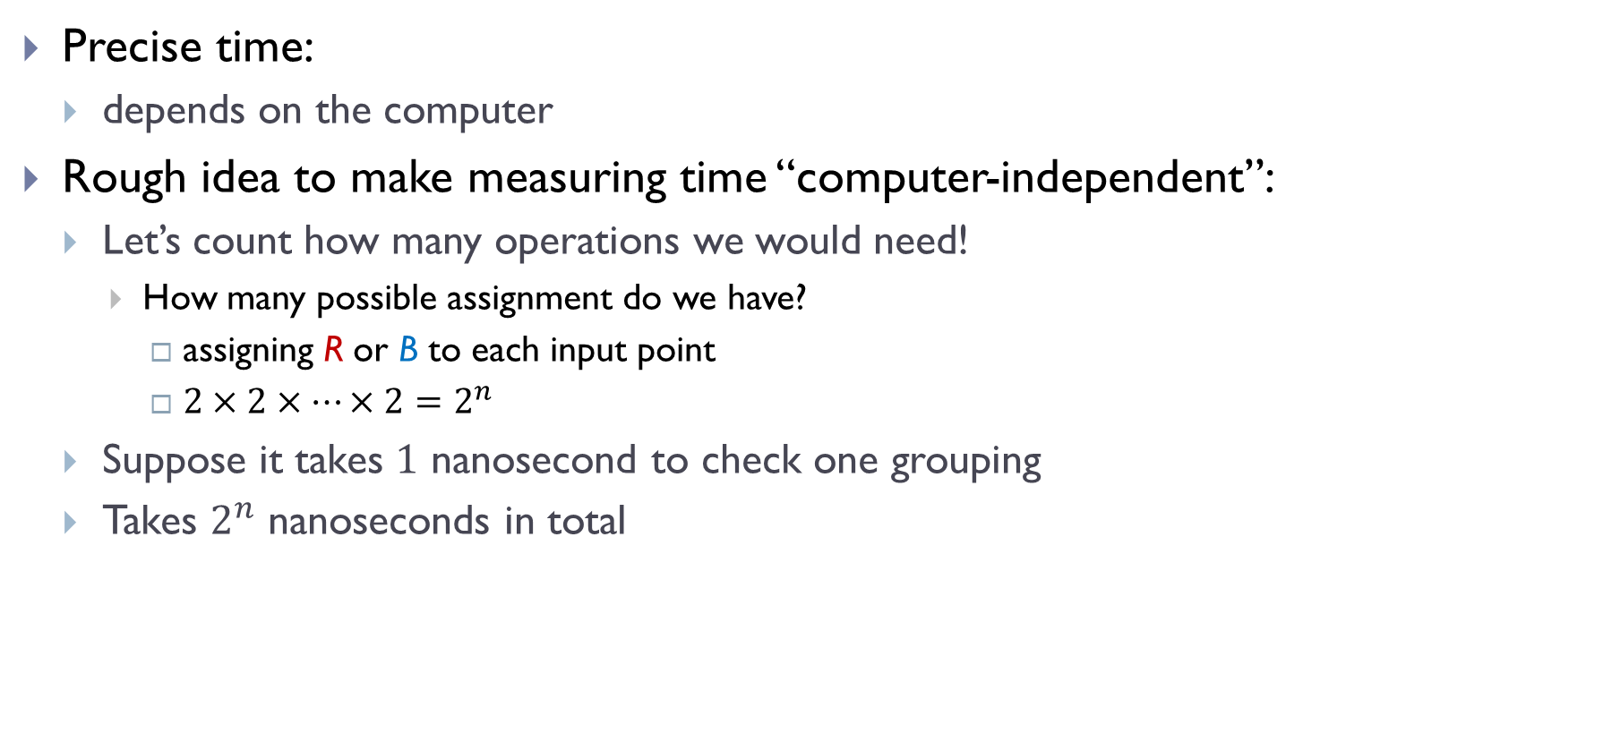
Running time?
Precise time:
  depends on the computer
Rough idea to make measuring time “computer-independent”:
  Let’s count how many operations we would need!
    How many possible assignment do we have?
      assigning R or B to each input point
      $2×2×⋯×2=2^{n}$
  Suppose it takes $1$ nanosecond to check one grouping
  Takes $2^{n}$ nanoseconds in total

Slide 20
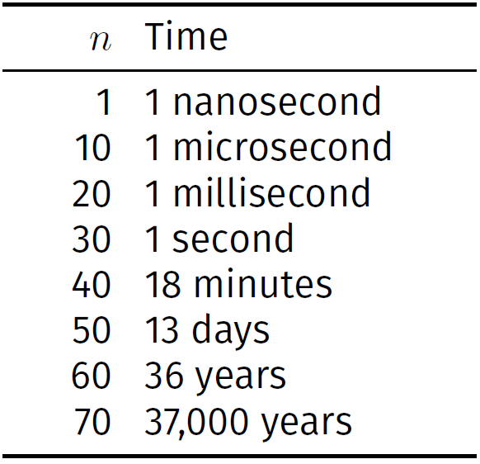
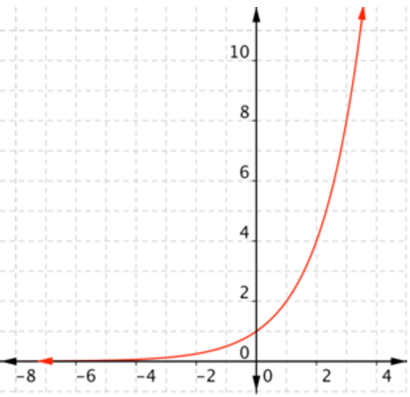
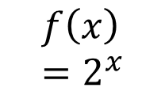
Time needed
Clearly not efficient. Can we do better? How to design better algorithms?
$$f\left(x\right)=2^{x}$$

Slide 21
This course: DSC40B
DSC40A how to model / formulate a problem to tackle an input task
DSC40B: how we then solve it efficiently using computers!
Focus on “algorithms”
  What is an algorithm?
    step by step strategy to solve problems
    in general, should terminate and return correct answer for any input instance (this may hold only in probability)
Notes:
After DSC40A of how to model problems

Slide 22
This course: DSC40B
Often, obvious algorithms might not be “efficient”
  Doesn’t mean that the problem at hand is hard!
Various issues involved in designing good algorithms
  What do we mean by “good”?
    algorithm analysis, asymptotic language used to measure performance
  How to design good algorithms
    data structures, algorithm paradigms
  Fundamental problems
    graph traversal, shortest path etc.
Notes:
After DSC40A of how to model problems

Slide 23
How to measure efficiency?
Time complexity

Slide 24
Efficiency
An algorithm takes an input and performs a task (which could produce an output)
Efficiency matters!
  Running time?
  How much memory it needs?
  An algorithm is only useful when it is efficient enough
How do we measure time efficiency?
Note: running time
  Depends on computing environments
  depends on size of input
  depends on specific input too
Notes:
Just having a correct algorithm is not enough
We will focus on running time in the remainder of this course. Space efficiency will also matter, in fact, in many setting, you may also want to look at communication cost, although often running time is more prominent and serves as a bigger bottleneck. The principles often apply to other costs / efficiency measurements.

Slide 25
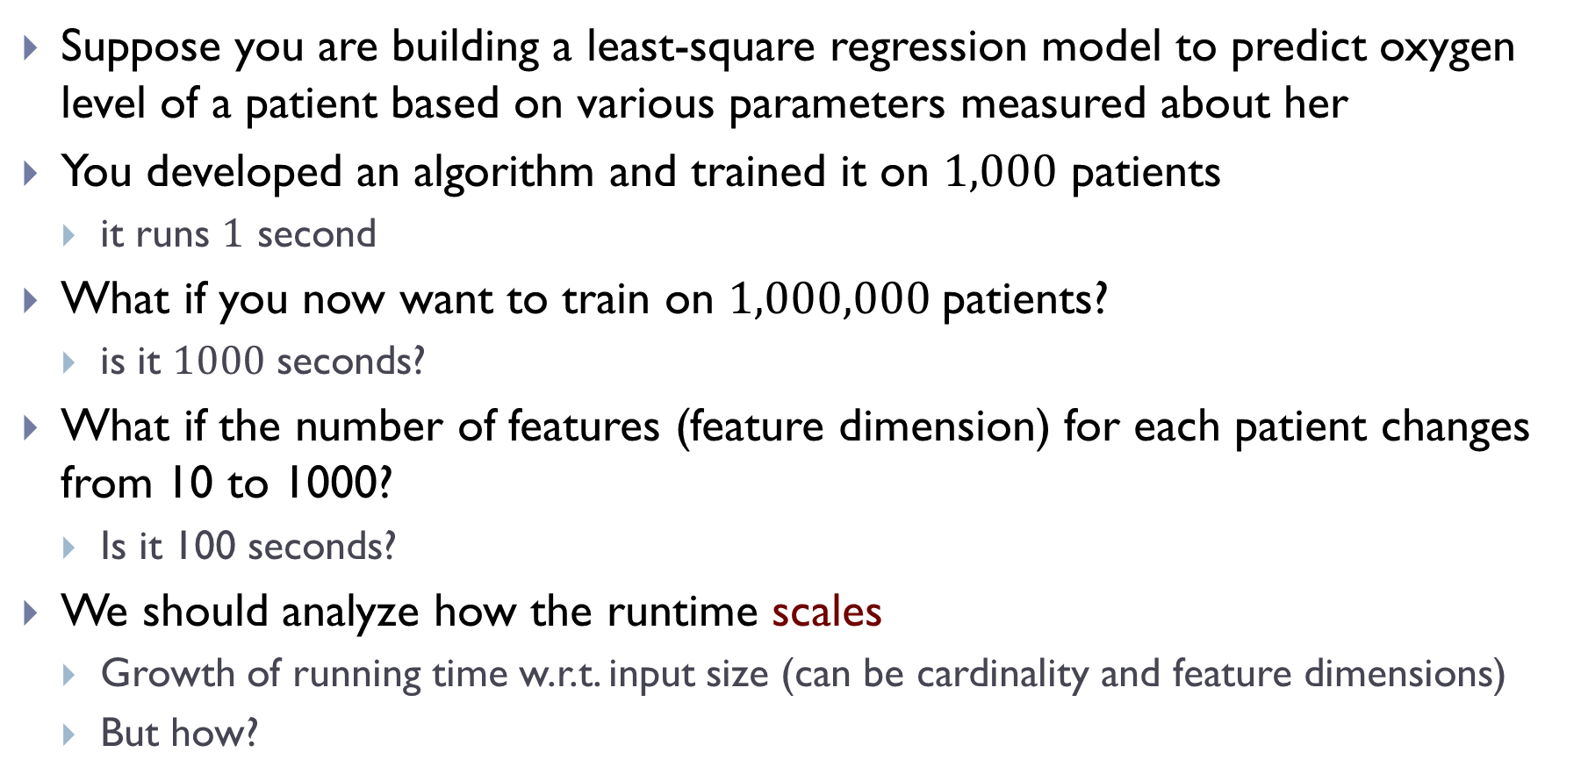
Scenario
Suppose you are building a least-square regression model to predict oxygen level of a patient based on various parameters measured about her
You developed an algorithm and trained it on $1,000$ patients
  it runs $1$ second
What if you now want to train on $1,000,000$patients?
  is it $1000$ seconds?
What if the number of features (feature dimension) for each patient changes from 10 to 1000?
  Is it 100 seconds?
We should analyze how the runtime scales
  Growth of running time w.r.t. input size (can be cardinality and feature dimensions)
  But how?

Slide 26
We will answer the question of “time complexity” in coming lectures
Today:
  Some simple examples to provide intuition

Slide 27
Approach #1: just time it!
How about we time it
  e.g, using Jupyter tools: time and timeit
Disadvantages:
  depending on the machine
  to get the growth, need to perform multiple runs and plot the time to obtain the pattern
    one timing doesn’t tell how the algorithm scales
  even then, the time may depend on specific input
    input of the same size could incur different running time

Slide 28
Approach 2: Time complexity analysis
Count intuitively just operations
  eliminate the precise running time of a specific computer
Determine it by analyzing the code without running it
Obtain a function (a formula) on how the ``count” changes with input size (i.e, growth w.r.t input size)
  instead of timing or plotting to find how time scales

Slide 29

An example
Consider the following code
  input is an array $A$ of numbers
def Func(A):
total = 0
n = len(A)
for i in range(n):
total += A[i]
return total / n

Slide 30
An example
Consider the following code
  input is an array $A$ of numbers
def Mean(A):
total = 0
n = len(A)
for i in range(n):
total += A[i]
return total / n

Slide 31
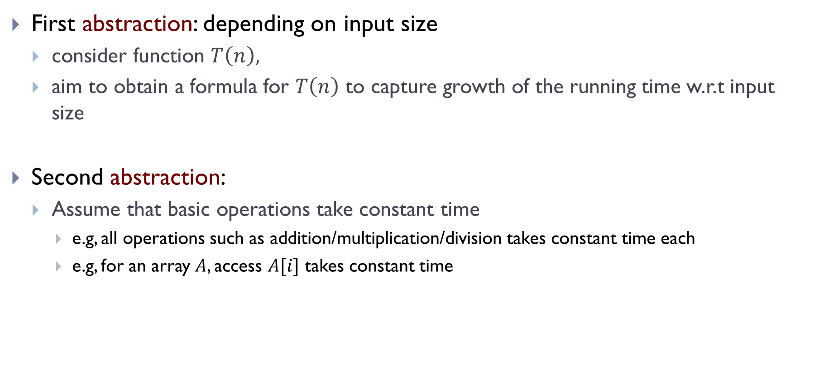
Time complexity
First abstraction: depending on input size
  consider function $T\left(n\right),$
  aim to obtain a formula for $T\left(n\right)$ to capture growth of the running time w.r.t input size
Second abstraction:
  Assume that basic operations take constant time
    e.g, all operations such as addition/multiplication/division takes constant time each
    e.g, for an array $A$, access $A[i]$ takes constant time

Slide 32

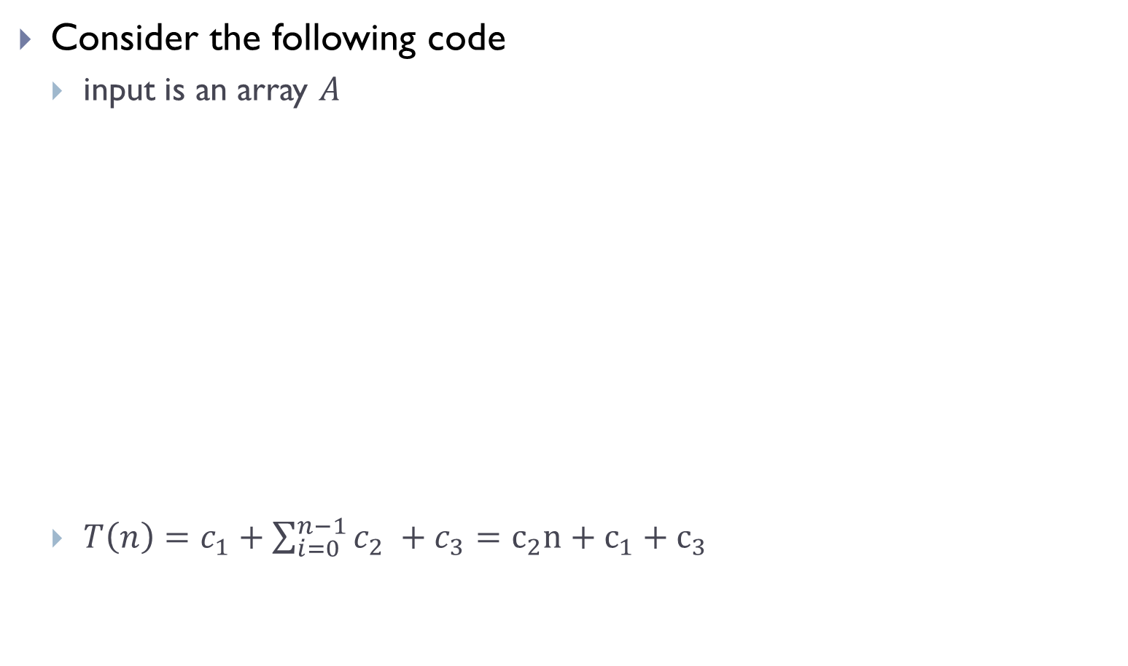


Back to our example
Consider the following code
  input is an array $A$
  $T\left(n\right)=c_{1}+\sum_{i=0}^{n−1}{c_{2} }+c_{3}=c_{2}n+c_{1}+c_{3}$
def Func(A):
total = 0
n = len(A)
for i in range(n):
total += A[i]
return total / n
$$c_{1}$$
$$c_{2}$$
$$c_{3}$$

Slide 33
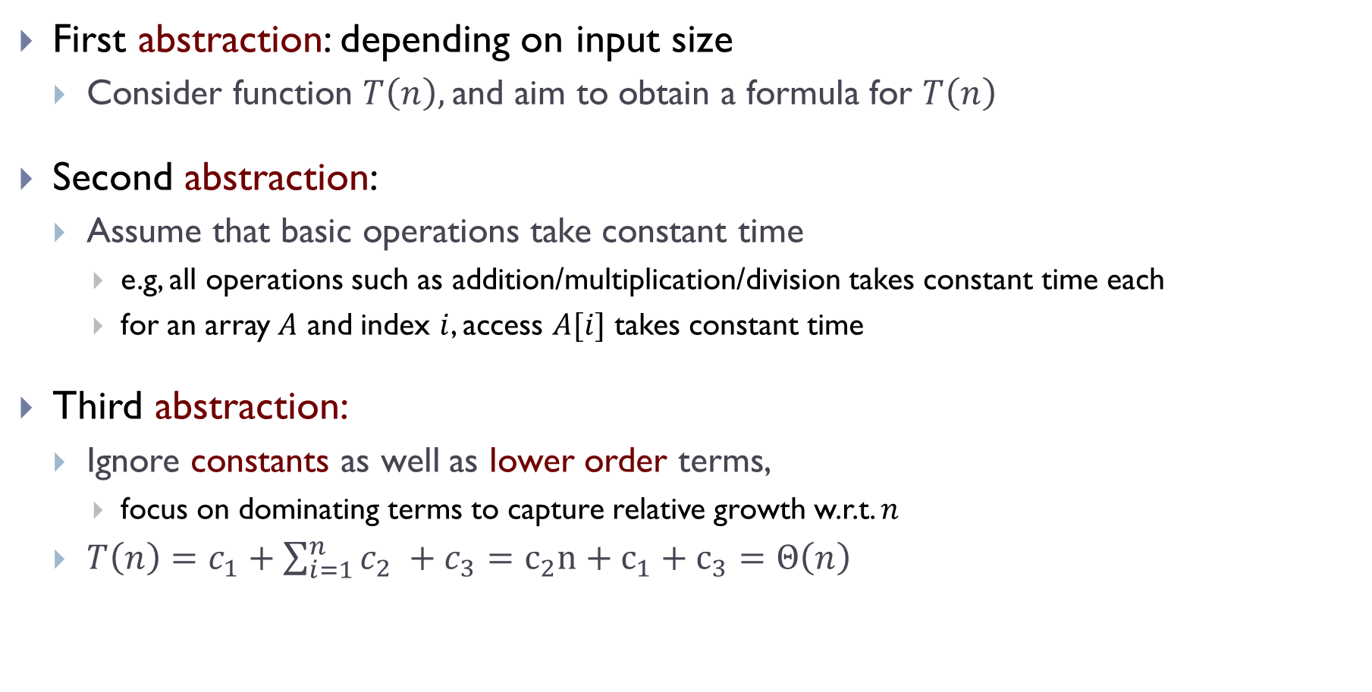
Time complexity
First abstraction: depending on input size
  Consider function $T\left(n\right),$and aim to obtain a formula for $T\left(n\right)$
Second abstraction:
  Assume that basic operations take constant time
    e.g, all operations such as addition/multiplication/division takes constant time each
    for an array $A$ and index $i$, access $A[i]$ takes constant time
Third abstraction:
  Ignore constants as well as lower order terms,
    focus on dominating terms to capture relative growth w.r.t. $n$
  $T\left(n\right)=c_{1}+\sum_{i=1}^{n}{c_{2} }+c_{3}=c_{2}n+c_{1}+c_{3}=Θ\left(n\right)$
Notes:
Intuitively, whether it is 2n or 3n, it grows in the same scale.
Mention the lower order terms means that T(n) = n + \sqrt{n} = \Theta(n)

Slide 34
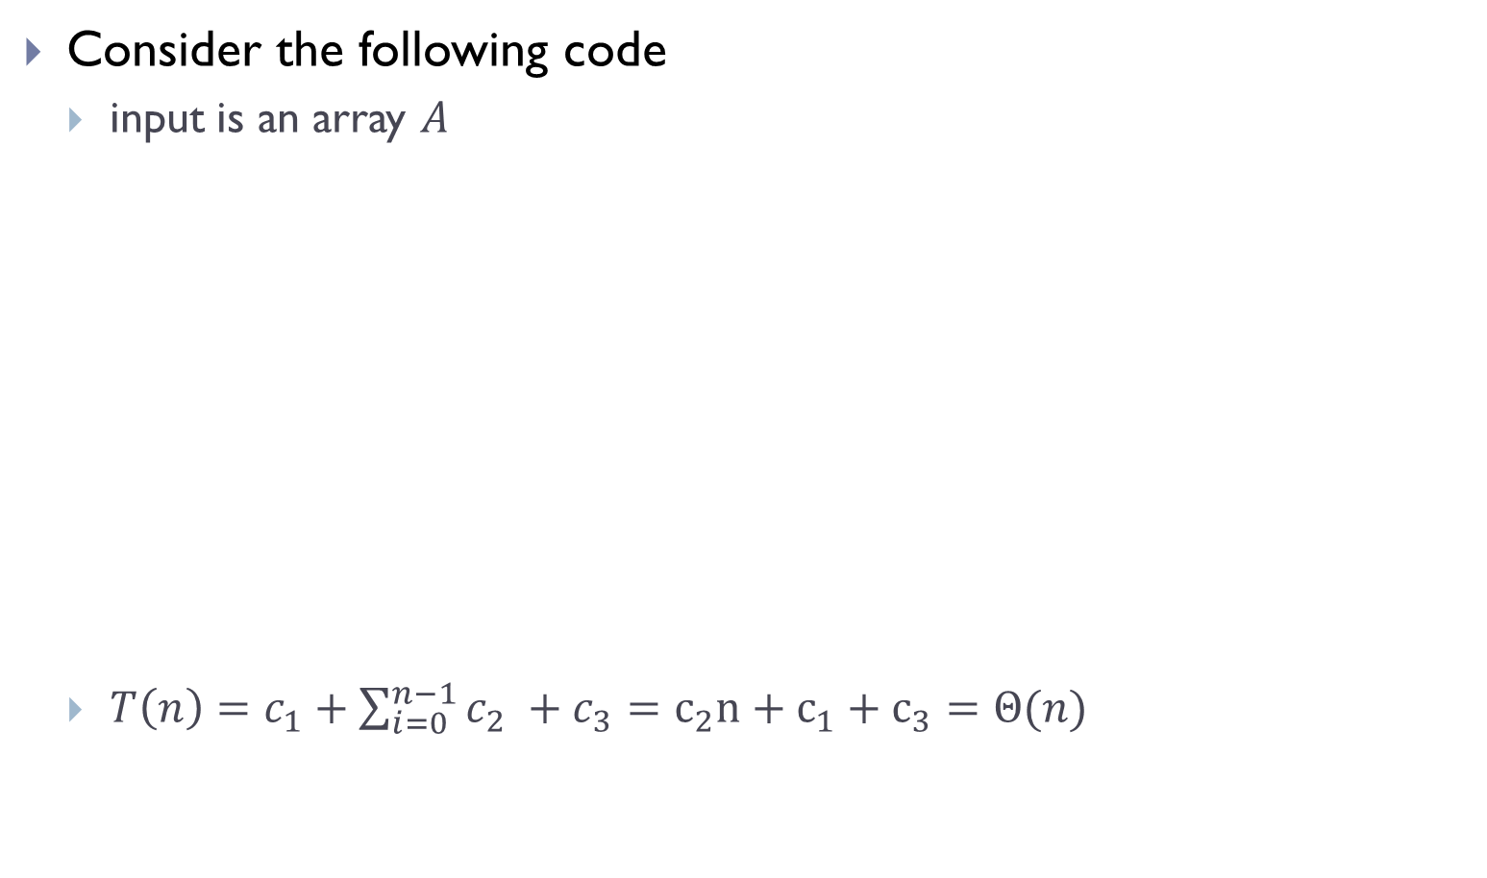

Putting everything together
Consider the following code
  input is an array $A$
  $T\left(n\right)=c_{1}+\sum_{i=0}^{n−1}{c_{2} }+c_{3}=c_{2}n+c_{1}+c_{3}=Θ(n)$
def mean(A):
total = 0
n = len(A)
for i in range(n):
total += A[i]
return total / n
$$c_{1}$$
Algorithm mean($A$) has time complexity $T\left(n\right)=Θ\left(n\right)$
$$c_{2}$$
$$c_{3}$$

Slide 35
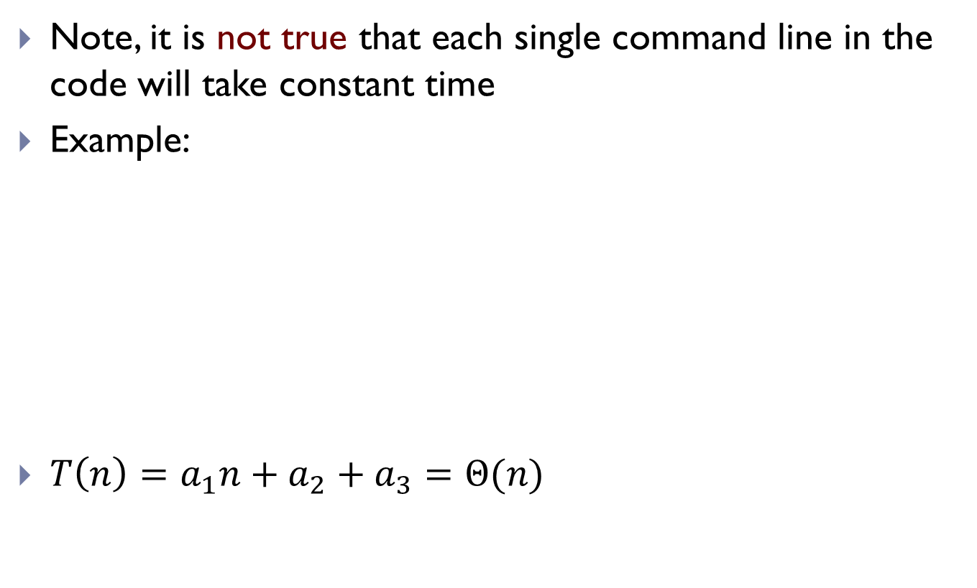
Caution
Note, it is not true that each single command line in the code will take constant time
Example:
$T\left(n\right)=a_{1}n+a_{2}+a_{3}=Θ(n)$
def mean_2(A):
total = sum(A)
n = len(A)
return total / n

Slide 36
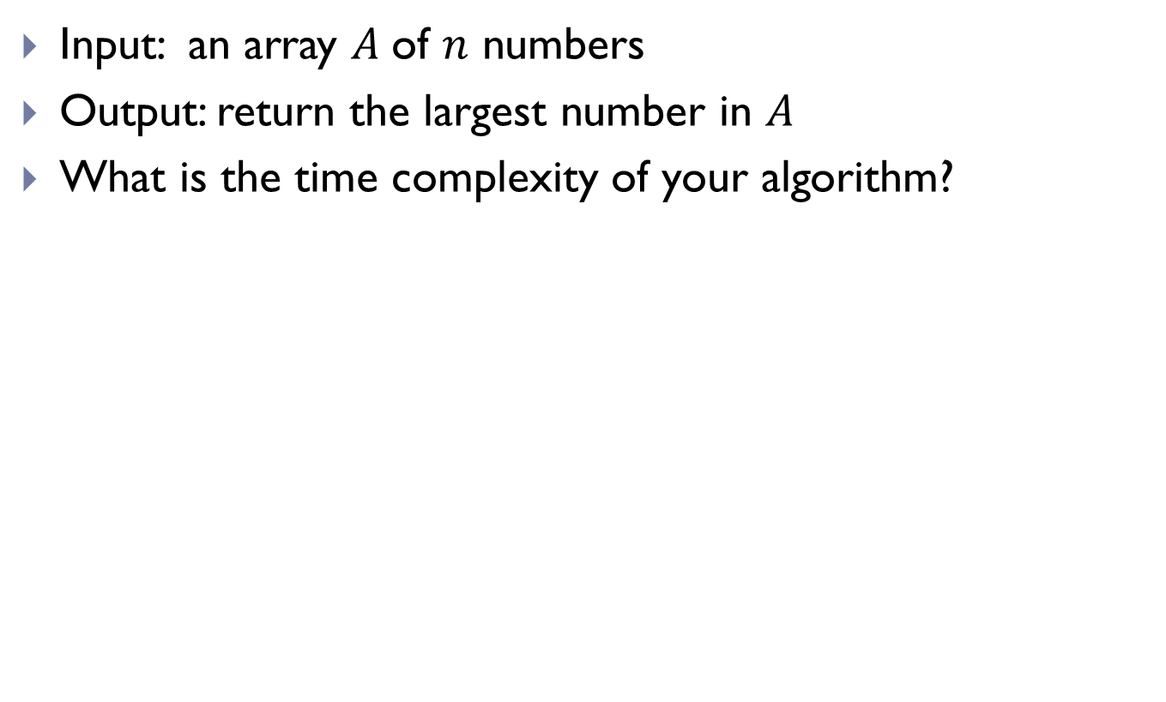
A simple exercise
Input: an array $A$of $n$ numbers
Output: return the largest number in $A$
What is the time complexity of your algorithm?
def maximum(A):
current_max = -float('inf')
for x in A:
if x > current_max:
current_max = x
return current_max

Slide 37
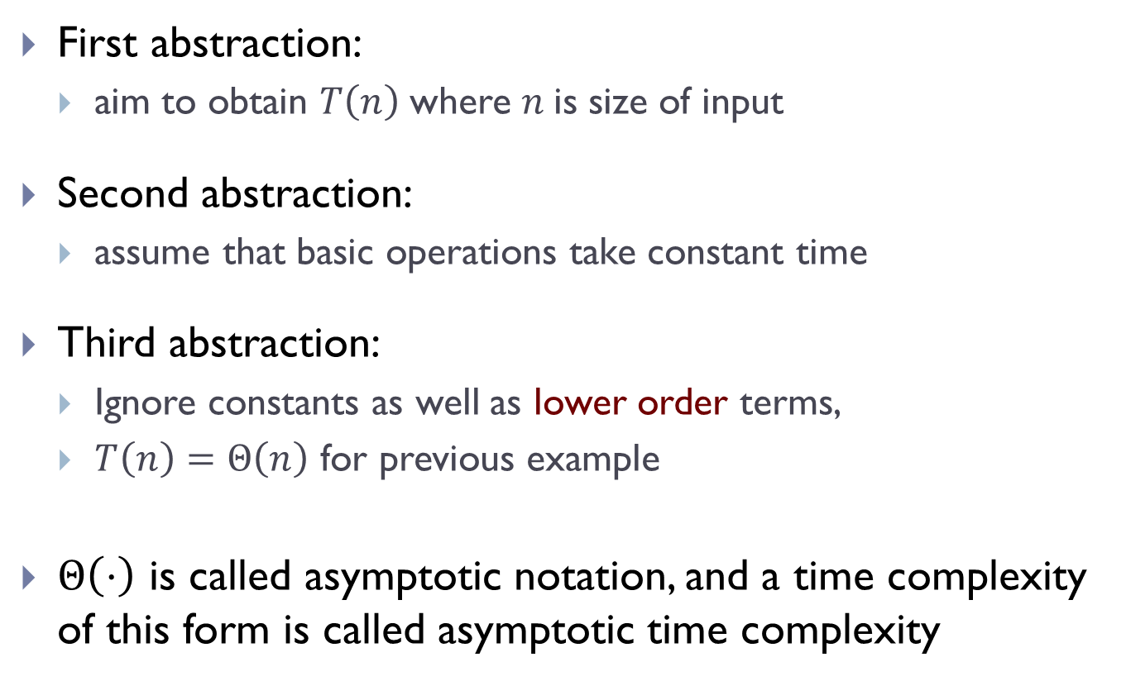
Time complexity
First abstraction:
  aim to obtain $T\left(n\right)$where $n$is size of input
Second abstraction:
  assume that basic operations take constant time
Third abstraction:
  Ignore constants as well as lower order terms,
  $T\left(n\right)=Θ\left(n\right)$ for previous example
$Θ\left(⋅\right)$ is called asymptotic notation, and a time complexity of this form is called asymptotic time complexity
Next time
We will learn what exactly are asymptotic time complexity and go through more examples
Notes:
Intuitively, whether it is 2n or 3n, it grows in the same scale.
Mention the lower order terms means that T(n) = n + \sqrt{n} = \Theta(n)

Slide 38
FIN

