Slide 1
DSC40B:
Theoretical Foundations of Data Science II
Lecture 2: Nested loops and asymptotic time complexity
Instructor: Yusu Wang

Slide 2

Today’s Agenda
Warm up: analyzing nested loops
What is $Θ$ notation ?

Slide 3
More examples: Nest loops

Slide 4
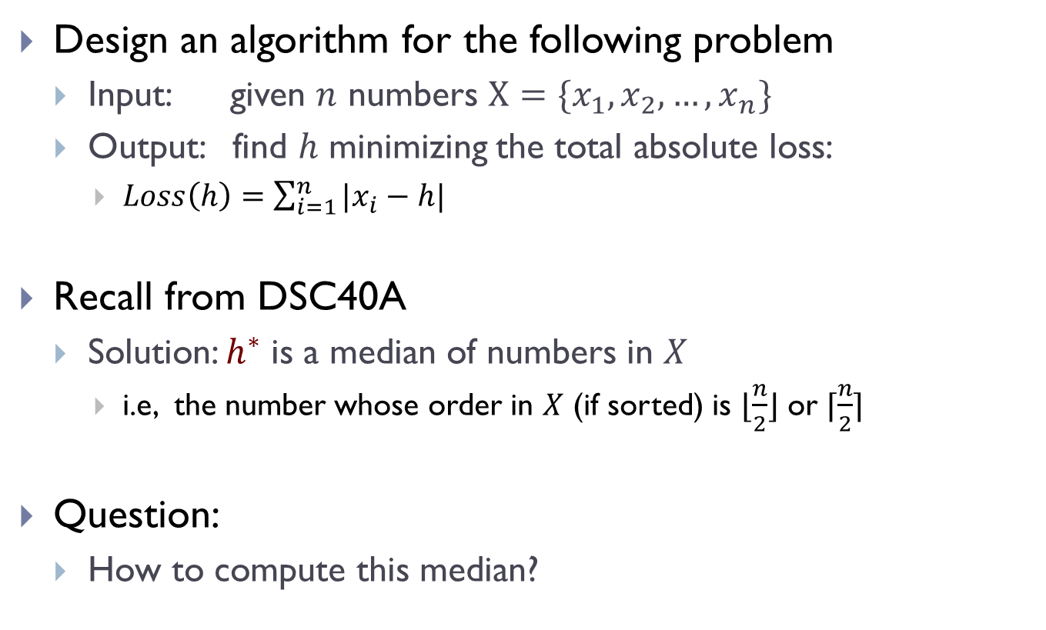
The median problem
Design an algorithm for the following problem
  Input: given $n$ numbers $X=\{x_{1},x_{2},…, x_{n}\}$
  Output: find $h$ minimizing the total absolute loss:
    $Loss\left(h\right)=\sum_{i=1}^{n}{|x_{i}−h|}$
Recall from DSC40A
  Solution: $h^{∗}$ is a median of numbers in $X$
    i.e, the number whose order in $X$ (if sorted) is $⌊\frac{n}{2}⌋$ or $⌈\frac{n}{2}⌉$
Question:
  How to compute this median?

Slide 5
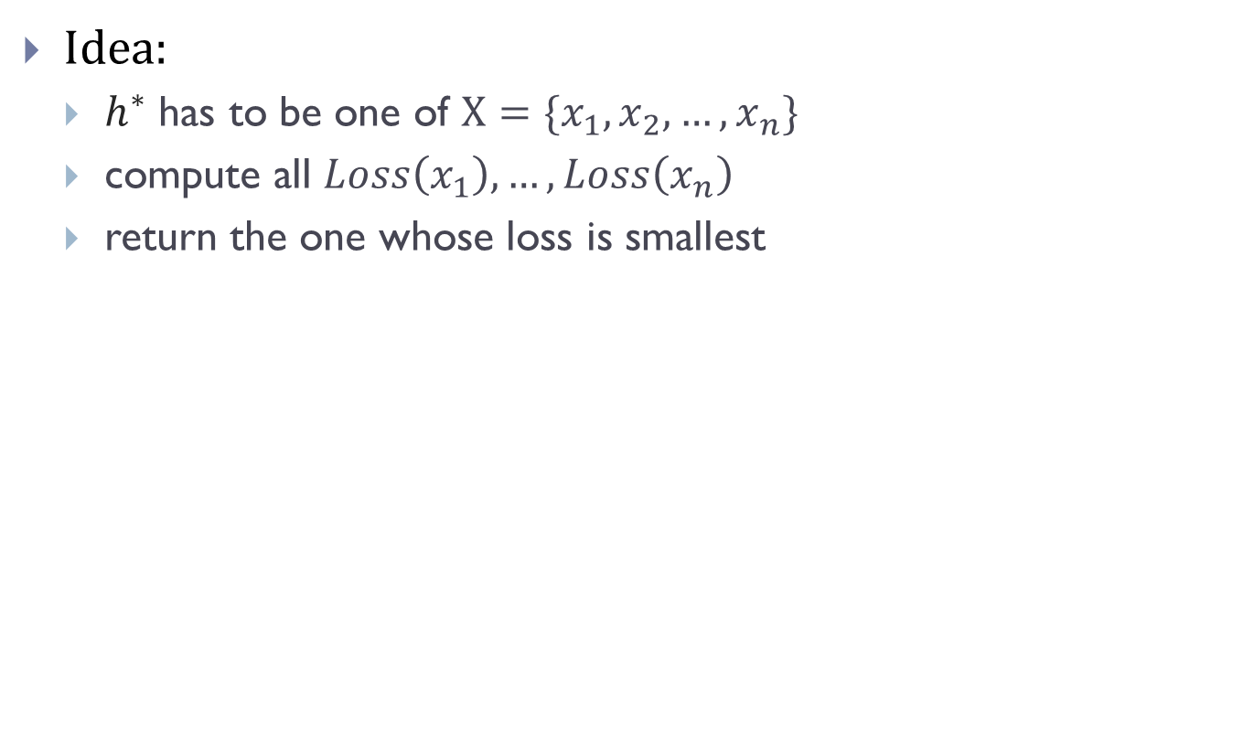
One algorithm
Idea:
  $h^{∗}$ has to be one of $X=\{x_{1},x_{2},…, x_{n}\}$
  compute all $Loss\left(x_{1}\right), …, Loss\left(x_{n}\right)$
  return the one whose loss is smallest
Notes:
There are many ways to compute this. We will see other solutions later.

Slide 6
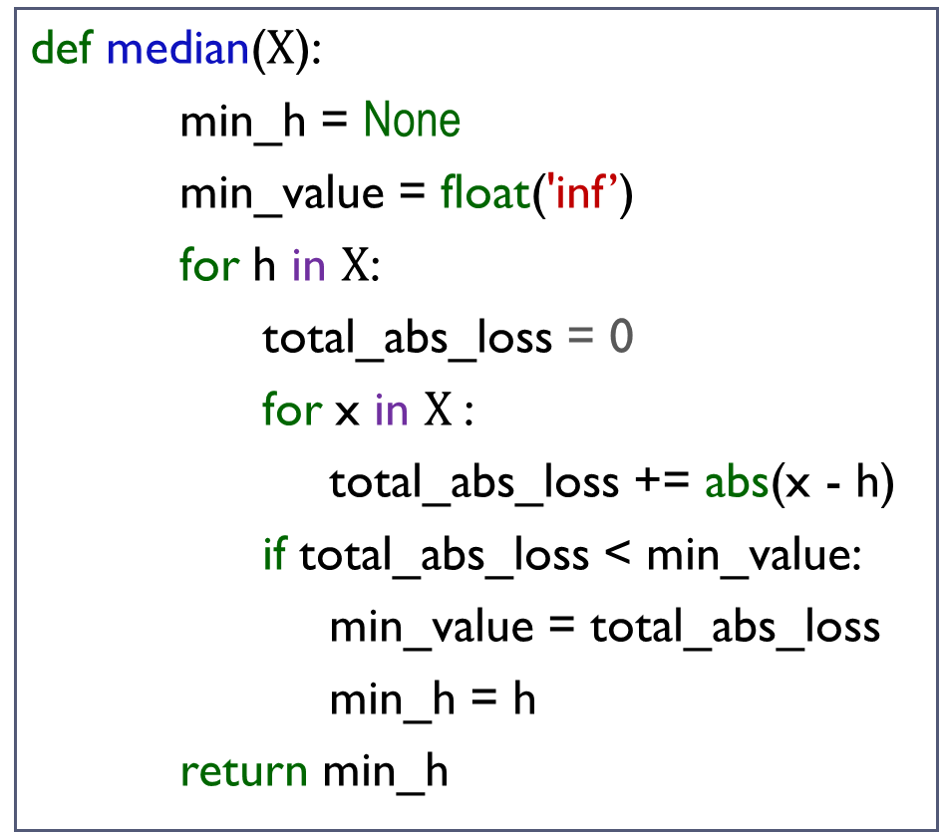
One algorithm
def median($X$):
min_h = None
min_value = float('inf’)
for h in $X$:
total_abs_loss = 0
for x in $X$:
total_abs_loss += abs(x - h)
if total_abs_loss < min_value:
min_value = total_abs_loss
min_h = h
return min_h
Inner-for loop:
Outer-for loop:
Total:

Slide 7
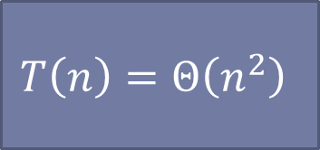
One algorithm
def median($X$):
min_h = None
min_value = float('inf’)
for h in $X$:
total_abs_loss = 0
for x in $X$:
total_abs_loss += abs(x - h)
if total_abs_loss < min_value:
min_value = total_abs_loss
min_h = h
return min_h
$$T\left(n\right)=Θ\left(n^{2}\right)$$
We will see how to do better later in class.

Slide 8
More abstract form
def foo_0(n):
for x in range(n):
for y in range(n):
print(x + y)

Slide 9

More abstract form
def foo_0(n):
for x in range(n):
for y in range(n):
print(x + y)
Inner-most line will be called $n^{2}$ times.
Thus the time complexity is
$$T_{0}\left(n\right)=n^{2}$$

Slide 10

Caution!
Not all nested loop takes $Θ\left(n^{2}\right)$ time
def foo_1(n):
for x in range(n):
for y in range(n, n+10):
print(x + y)

Slide 11

Caution!
Not all nested loop takes $Θ\left(n^{2}\right)$ time
def foo_1(n):
for x in range(n):
for y in range(n, n+10):
print(x + y)
$$T_{1}\left(n\right)=Θ\left(n\right)$$

Slide 12
Caution!
Not all nested loop takes $Θ\left(n^{2}\right)$ time
def foo_1(n):
for x in range(n):
for y in range(n, n+10):
print(x + y)
$$T_{1}\left(n\right)=Θ\left(n\right)$$
def foo_2(n):
for x in range(n):
for y in range(n, 2n-10):
print(x + y)

Slide 13

Caution!
Not all nested loop takes $Θ\left(n^{2}\right)$ time
def foo_1(n):
for x in range(n):
for y in range(n, n+10):
print(x + y)
$$T_{1}\left(n\right)=Θ\left(n\right)$$
def foo_2(n):
for x in range(n):
for y in range(n, 2n-10):
print(x + y)
$$T_{2}\left(n\right)=Θ\left(n^{2}\right)$$

Slide 14
Caution!
Not all nested loop takes $Θ\left(n^{2}\right)$ time
def foo_1(n):
for x in range(n):
for y in range(n, n+10):
print(x + y)
$$T_{1}\left(n\right)=Θ\left(n\right)$$
def foo_2(n):
for x in range(n):
for y in range(n, 2n-10):
print(x + y)
$$T_{2}\left(n\right)=Θ\left(n^{2}\right)$$
def foo_3(n):
for x in range(3*n**3 + 5*n**2 - 100):
for y in range(n**5, n**6):
print(x + y)

Slide 15

Caution!
Not all nested loop takes $Θ\left(n^{2}\right)$ time
def foo_1(n):
for x in range(n):
for y in range(n, n+10):
print(x + y)
$$T_{1}\left(n\right)=Θ\left(n\right)$$
def foo_2(n):
for x in range(n):
for y in range(n, 2n-10):
print(x + y)
$$T_{2}\left(n\right)=Θ\left(n^{2}\right)$$
def foo_3(n):
for x in range(3*n**3 + 5*n**2 - 100):
for y in range(n**5, n**6):
print(x + y)
$$T_{2}\left(n\right)=Θ\left(n^{9}\right)$$

Slide 16

A second example
Alex is given $n$ sticks. He needs to design an algorithm to compute the tallest pole he can make by stacking two sticks

Slide 17
A second example
Alex is given $n$ sticks. He needs to design an algorithm to compute the tallest pole he can make by stacking two sticks
def tallest_pole(heights):
1. max_height = -float (‘inf’)
2. n = len(heights)
3. for i in range(n):
4. for j in range(i+1, n):
5. h = heights[i] + heights[j]
6. if h > max_height
7. max_height = h
8. return max_height

Slide 18

A second example
Alex is given $n$ sticks. He needs to design an algorithm to compute the tallest pole he can make by stacking two sticks
How many times does line $5−7$ (inner body) run?
def tallest_pole(heights):
1. max_height = -float (‘inf’)
2. n = len(heights)
3. for i in range(n):
4. for j in range(i+1, n):
5. h = heights[i] + heights[j]
6. if h > max_height
7. max_height = h
8. return max_height

Slide 19
A second example
Alex is given $n$ sticks. He needs to design an algorithm to compute the tallest pole he can make by stacking two sticks
How many times does line $5−7$ (inner body) run?
def tallest_pole(heights):
1. max_height = -float (‘inf’)
2. n = len(heights)
3. for i in range(n):
4. for j in range(i+1, n):
5. h = heights[i] + heights[j]
6. if h > max_height
7. max_height = h
8. return max_height
On outer iter.#1, inner body runs ____ times
On outer iter.#2, inner body runs ____ times
On outer iter.#3, inner body runs ____ times
On outer iter.#n, inner body runs ____ times

Slide 20
A second example
Alex is given $n$ sticks. He needs to design an algorithm to compute the tallest pole he can make by stacking two sticks
How many times does line $5−7$ (inner body) run?
def tallest_pole(heights):
1. max_height = -float (‘inf’)
2. n = len(heights)
3. for i in range(n):
4. for j in range(i+1, n):
5. h = heights[i] + heights[j]
6. if h > max_height
7. max_height = h
8. return max_height
On outer iter.#1, inner body runs ____ times
On outer iter.#2, inner body runs ____ times
On outer iter.#3, inner body runs ____ times
On outer iter.#n, inner body runs ____ times

Slide 21

A second example
Alex is given $n$ sticks. He needs to design an algorithm to compute the tallest pole he can make by stacking two sticks
How many times does line $5−7$ (inner body) run?
def tallest_pole(heights):
1. max_height = -float (‘inf’)
2. n = len(heights)
3. for i in range(n):
4. for j in range(i+1, n):
5. h = heights[i] + heights[j]
6. if h > max_height
7. max_height = h
8. return max_height
On outer iter.#1, inner body runs ____ times
On outer iter.#2, inner body runs ____ times
On outer iter.#3, inner body runs ____ times
On outer iter.#n, inner body runs ____ times
For the k-th iteration of outer loop, the inner loop takes $c(n−k)$ time.

Slide 22

A second example
Alex is given $n$ sticks. He needs to design an algorithm to compute the tallest pole he can make by stacking two sticks
How many times does line $5−7$ (inner body) run?
def tallest_pole(heights):
1. max_height = -float (‘inf’)
2. n = len(heights)
3. for i in range(n):
4. for j in range(i+1, n):
5. h = heights[i] + heights[j]
6. if h > max_height
7. max_height = h
8. return max_height
On outer iter.#1, inner body runs ____ times
On outer iter.#2, inner body runs ____ times
On outer iter.#3, inner body runs ____ times
On outer iter.#n, inner body runs ____ times
For the k-th iteration of outer loop, the inner loop takes $c(n−k)$ time.

Slide 23
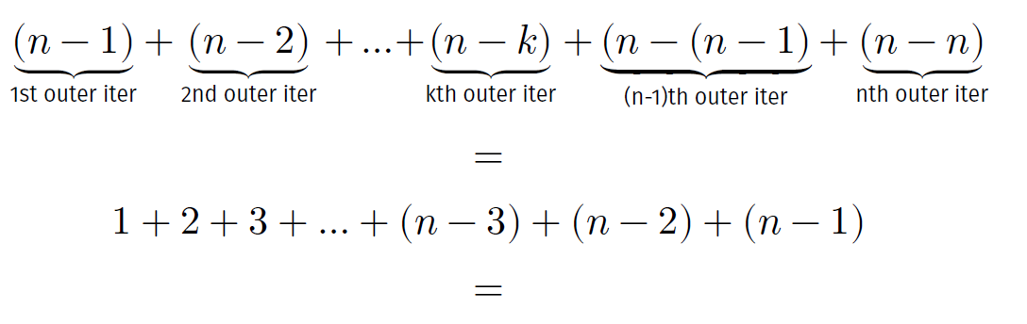
Tallest_pole, cont.
Total times line 5-7 (inner body) is executed:
Notes:
Arithmetic sum
We could have also analyzed this in another way –

Slide 24
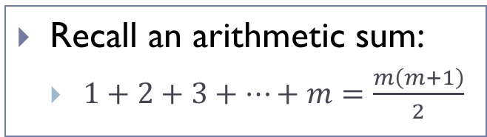
Tallest_pole, cont.
Total times line 5-7 (inner body) is executed:
Recall an arithmetic sum:
  $1+2+3+…+m=\frac{m\left(m+1\right)}{2}$
Notes:
Arithmetic sum
We could have also analyzed this in another way –

Slide 25

Tallest_pole, cont.
Total times line 5-7 (inner body) is executed:
Algorithm tallest_pole has $T\left(n\right)=Θ\left(n^{2}\right)$
Recall an arithmetic sum:
  $1+2+3+…+m=\frac{m\left(m+1\right)}{2}$
Notes:
Arithmetic sum
We could have also analyzed this in another way –

Slide 26

Tallest_pole, cont.
Total times line 5-7 (inner body) is executed:
Algorithm tallest_pole has $T\left(n\right)=Θ\left(n^{2}\right)$
Another way to see the time complexity:
  Number of pairs of n objects is $\left({n \atop 2}\right)=\frac{n\left(n−1\right)}{2}=Θ(n^{2})$
Recall an arithmetic sum:
  $1+2+3+…+m=\frac{m\left(m+1\right)}{2}$
Notes:
Arithmetic sum
We could have also analyzed this in another way –

Slide 27
Tallest_pole, cont.
Total times line 5-7 (inner body) is executed:
Algorithm tallest_pole has $T\left(n\right)=Θ\left(n^{2}\right)$
Another way to see the time complexity:
  Number of pairs of n objects is $\left({n \atop 2}\right)=\frac{n\left(n−1\right)}{2}=Θ(n^{2})$
Recall an arithmetic sum:
  $1+2+3+…+m=\frac{m\left(m+1\right)}{2}$
Exercise: Find a linear-time algorithm for this problem.
Notes:
Arithmetic sum
We could have also analyzed this in another way –

Slide 28

Note
Alex is given $n$ sticks. He needs to design an algorithm to compute the tallest pole he can make by stacking two sticks
def tallest_pole(heights):
1. max_height = -float (‘inf’)
2. n = len(heights)
3. for i in range(n):
4. for j in range(i+1, n):
5. h = heights[i] + heights[j]
6. if h > max_height
7. max_height = h
8. return max_height
Essentially the same as the following

Slide 29
Note
Alex is given $n$ sticks. He needs to design an algorithm to compute the tallest pole he can make by stacking two sticks
def tallest_pole(heights):
1. max_height = -float (‘inf’)
2. n = len(heights)
3. for i in range(n):
4. for j in range(i+1, n):
5. h = heights[i] + heights[j]
6. if h > max_height
7. max_height = h
8. return max_height
Essentially the same as the following
def foo_3(n):
for x in range(n):
for y in range(i+1, n):
do sth. in constant time

Slide 30
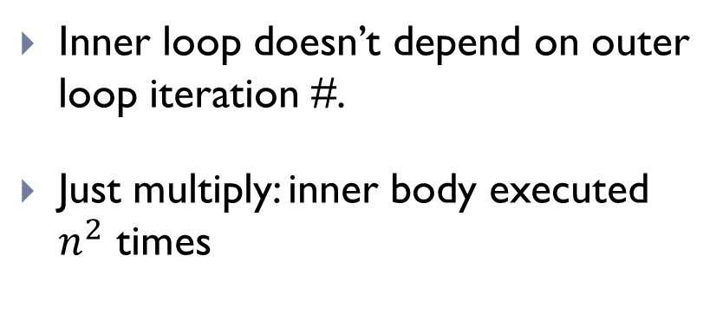
What’s the difference?
The number of iterations of the inner loop depends on the outer loop
def foo_0(n):
for x in range(n):
for y in range(n):
print(x + y)
def foo_3(n):
for x in range(n):
for y in range(i+1, n):
print(x + y)
Inner loop doesn’t depend on outer loop iteration #.
Just multiply: inner body executed $n^{2}$ times
Inner loop depends on outer loop iteration #.
Cannot just multiply: need to figure out for each outer loop iteration #, how many times inner loop will run.

Slide 31
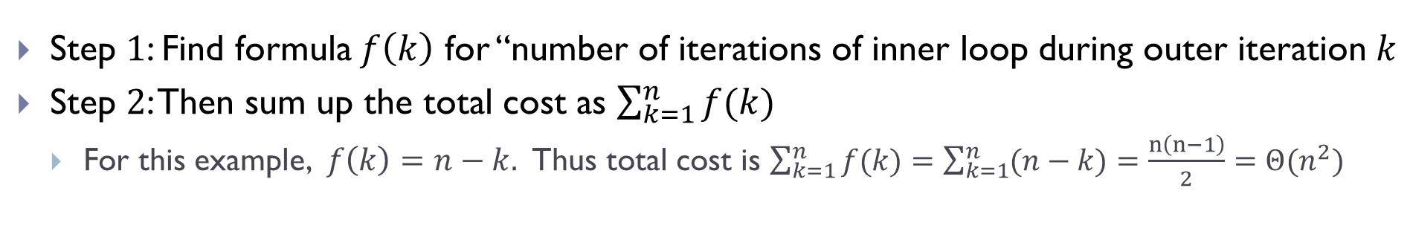
Depended Nested Loop
def foo_3(n):
for x in range(n):
for y in range(i+1, n):
print(x + y)
Step $1$: Find formula $f\left(k\right)$ for “number of iterations of inner loop during outer iteration $k$
Step $2$: Then sum up the total cost as $\sum_{k=1}^{n}{f(k)}$
  For this example, $f\left(k\right)=n−k.$ Thus total cost is $\sum_{k=1}^{n}{f(k)}=\sum_{k=1}^{n}{(n−k)}=\frac{n\left(n−1\right)}{2}=Θ(n^{2})$

Slide 32
Depended Nested Loop
def foo_3(n):
for x in range(n):
for y in range(i+1, n):
print(x + y)
Step $1$: Find formula $f\left(k\right)$ for “number of iterations of inner loop during outer iteration $k$
Step $2$: Then sum up the total cost as $\sum_{k=1}^{n}{f(k)}$
  For this example, $f\left(k\right)=n−k.$ Thus total cost is $\sum_{k=1}^{n}{f(k)}=\sum_{k=1}^{n}{(n−k)}=\frac{n\left(n−1\right)}{2}=Θ(n^{2})$
What if there are more two layers of nested loops?
  Always calculate the cost inside-out ! First figure out the cost of inner-most loop
What if the loops are not just for–loops?
  We will see examples of while loops soon

Slide 33
Linear vs quadratic growth

Slide 34
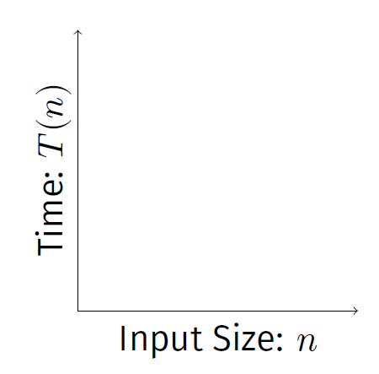
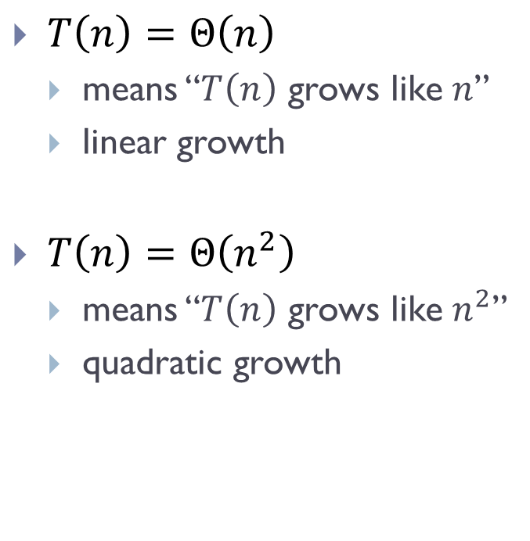
Scaling
$T\left(n\right)=Θ\left(n\right)$
  means “$T\left(n\right)$ grows like $n$”
  linear growth
$T\left(n\right)=Θ\left(n^{2}\right)$
  means “$T\left(n\right)$ grows like $n^{2}$”
  quadratic growth

Slide 35
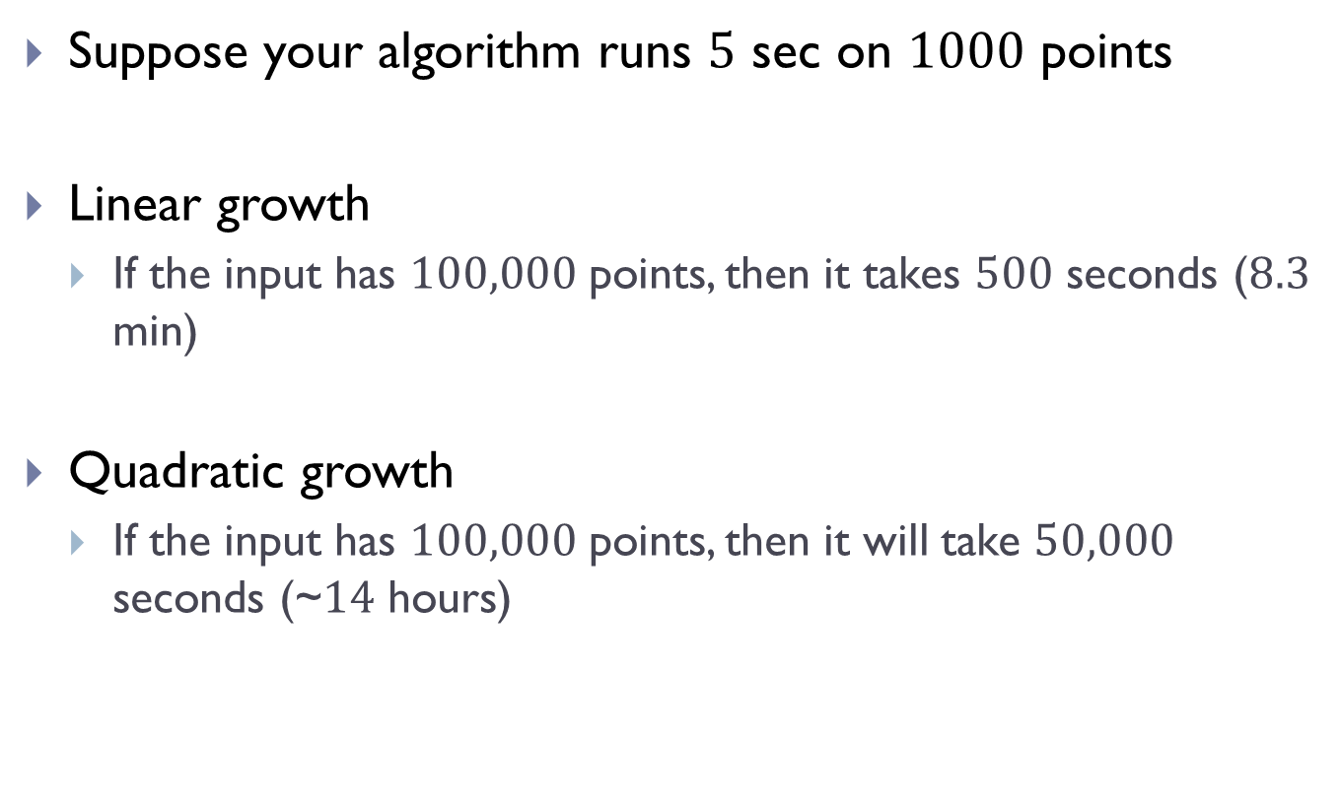
Suppose your algorithm runs $5$ sec on $1000$ points
Linear growth
  If the input has $100,000$ points, then it takes $500$ seconds ($8.3$ min)
Quadratic growth
  If the input has $100,000$ points, then it will take $50,000$ seconds (~$14$ hours)

Slide 36
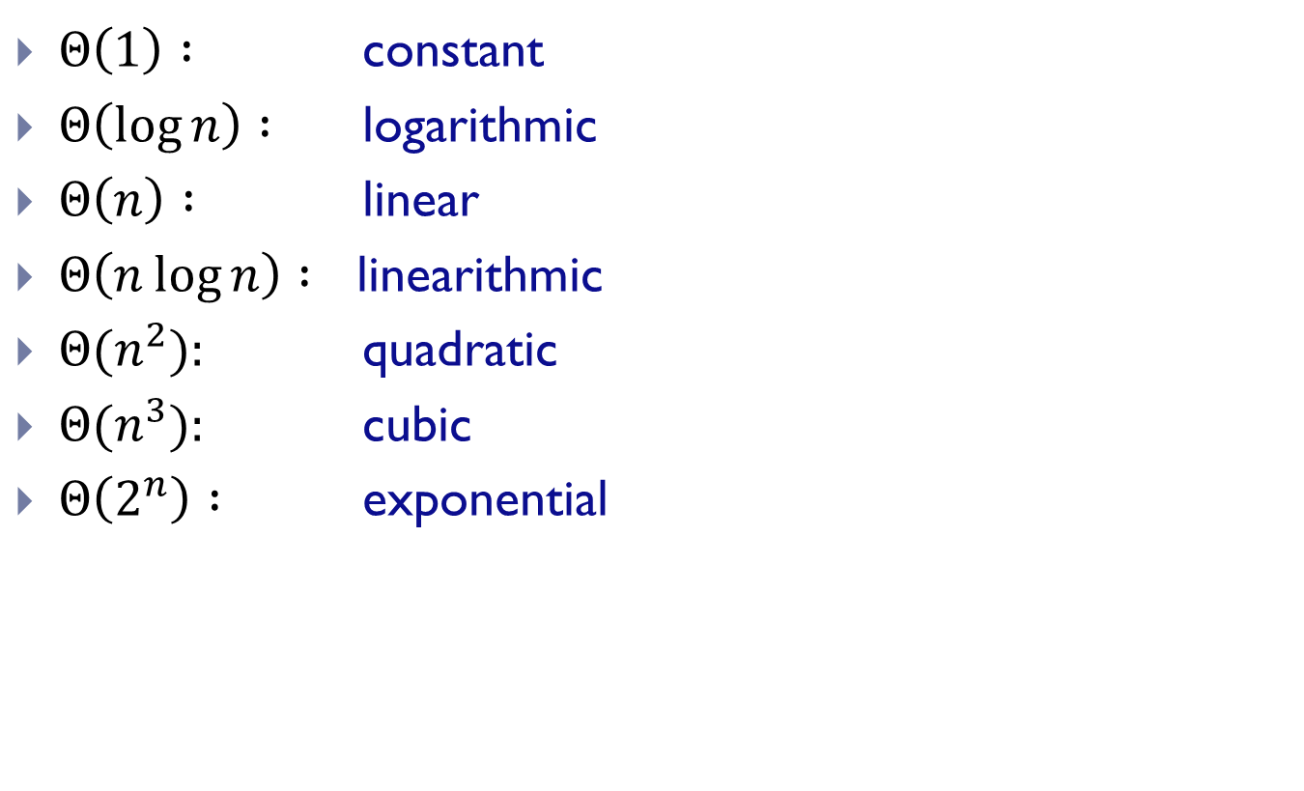
Some common growth rates
$Θ\left(1\right) :$ constant
$Θ\left(\log{n}\right) :$ logarithmic
$Θ\left(n\right) :$ linear
$Θ\left(n\log{n}\right) :$ linearithmic
$Θ(n^{2}):$ quadratic
$Θ(n^{3}):$ cubic
$Θ\left(2^{n}\right) :$ exponential

Slide 37
More on nested loops analysis

Slide 38
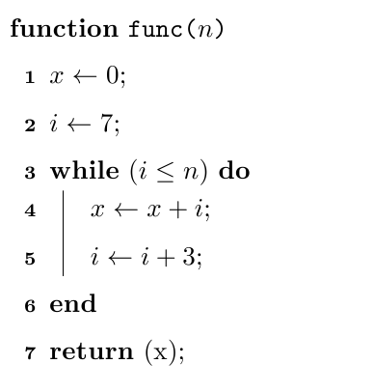

A first example
Cost of this iteration
#iteration
value of i
$$0;$$

Slide 39
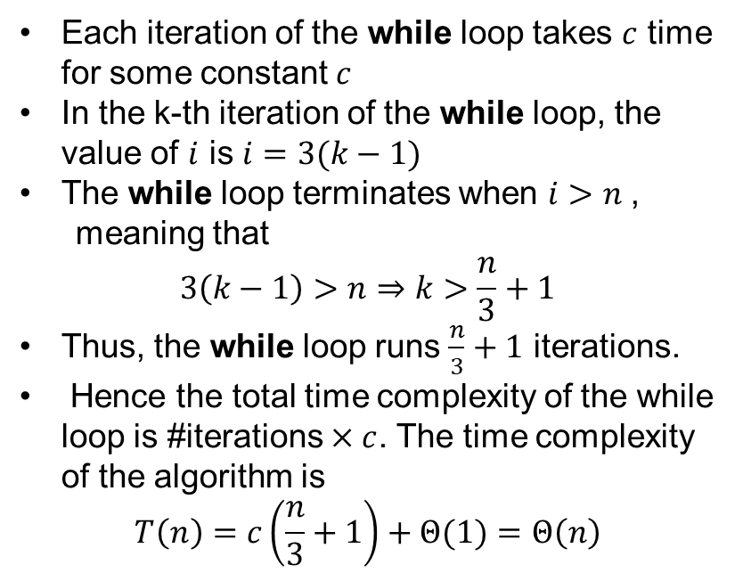

A pseudo-code example
Each iteration of the while loop takes $c$ time for some constant $c$
In the k-th iteration of the while loop, the value of $i$ is $i=3(k−1)$
The while loop terminates when $i>n$,
meaning that
$$3\left(k−1\right)>n⇒k>\frac{n}{3}+1$$
Thus, the while loop runs $\frac{n}{3}+1$ iterations.
Hence the total time complexity of the while loop is #iterations $×c$. The time complexity of the algorithm is
$$T\left(n\right)=c\left(\frac{n}{3}+1\right)+Θ(1)=Θ\left(n\right)$$
$$0;$$

Slide 40


A second example
Cost of this iteration
#iteration
value of i
$$1;$$
$$∗$$

Slide 41
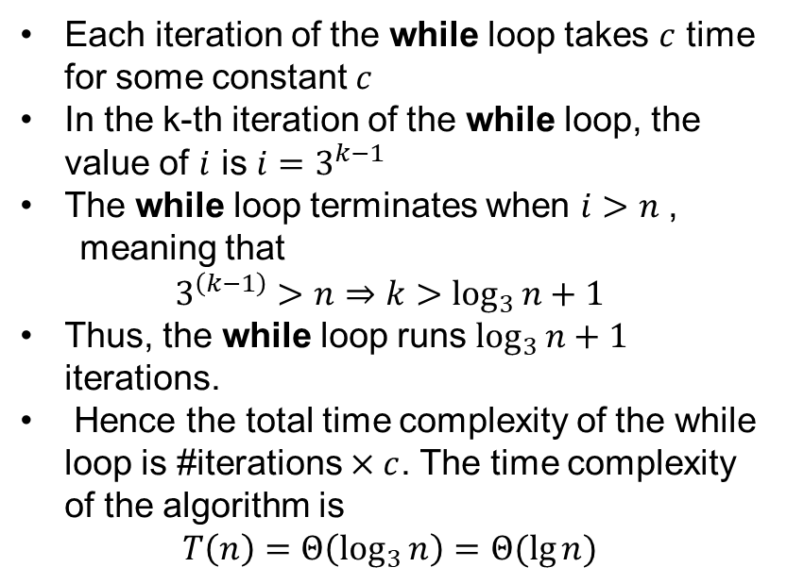
A second example
Each iteration of the while loop takes $c$ time for some constant $c$
In the k-th iteration of the while loop, the value of $i$ is $i=3^{k−1}$
The while loop terminates when $i>n$,
meaning that
$$3^{\left(k−1\right)}>n⇒k>\log_{3}{n}+1$$
Thus, the while loop runs $\log_{3}{n}+1$ iterations.
Hence the total time complexity of the while loop is #iterations $×c$. The time complexity of the algorithm is
$$T\left(n\right)=Θ\left(\log_{3}{n}\right)=Θ(\lg{n})$$
$$1;$$
$$∗$$

Slide 42
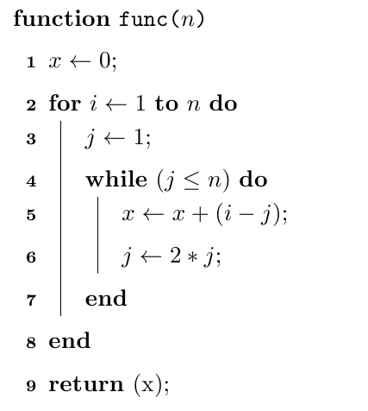
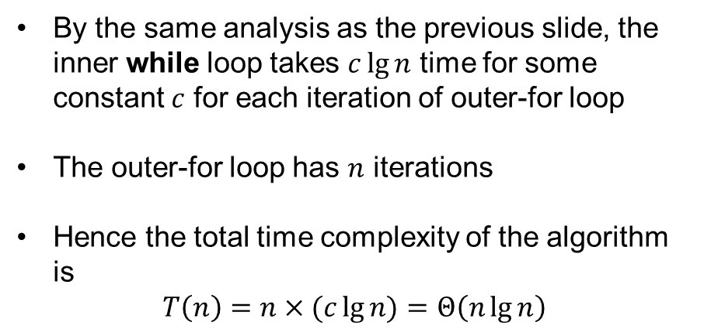
A third example
By the same analysis as the previous slide, the inner while loop takes $c\lg{n}$ time for some constant $c$ for each iteration of outer-for loop
The outer-for loop has $n$ iterations
Hence the total time complexity of the algorithm is
$$T\left(n\right)=n×(c\lg{n)}=Θ\left(n\lg{n}\right)$$

Slide 43

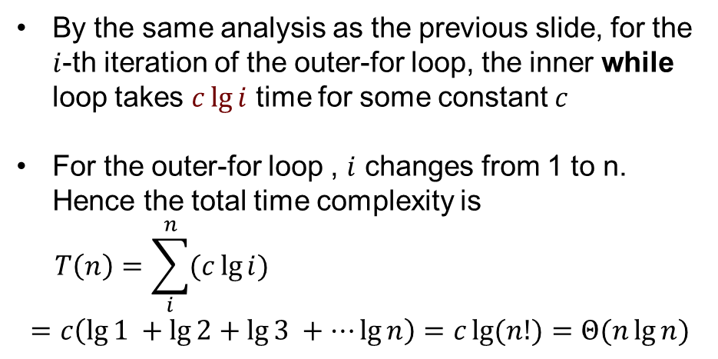
A fourth example
By the same analysis as the previous slide, for the $i$-th iteration of the outer-for loop, the inner while loop takes $c\lg{i}$ time for some constant $c$
For the outer-for loop , $i$ changes from 1 to n. Hence the total time complexity is
$$T\left(n\right)=\sum_{i}^{n}{(c\lg{i})}$$
$$=c\left(\lg{1 }+\lg{2}+\lg{3 }+⋯\lg{n}\right)=c\lg{(n!)}=Θ(n\lg{n})$$
$$i$$

Slide 44
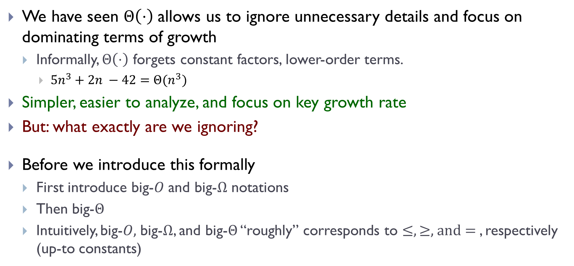
We have seen $Θ\left(⋅\right)$allows us to ignore unnecessary details and focus on dominating terms of growth
  Informally, $Θ\left(⋅\right)$ forgets constant factors, lower-order terms.
    $5n^{3}+2n −42=Θ(n^{3})$
Simpler, easier to analyze, and focus on key growth rate
But: what exactly are we ignoring?
Before we introduce this formally
  First introduce big-$O$ and big-$Ω$ notations
  Then big-$Θ$
  Intuitively, big-$O,$ big-$Ω$, and big-$Θ$ “roughly” corresponds to $≤, ≥,$and $=$, respectively (up-to constants)

Slide 45
Asymptotic notations

Slide 46
Big-O notation

Slide 47
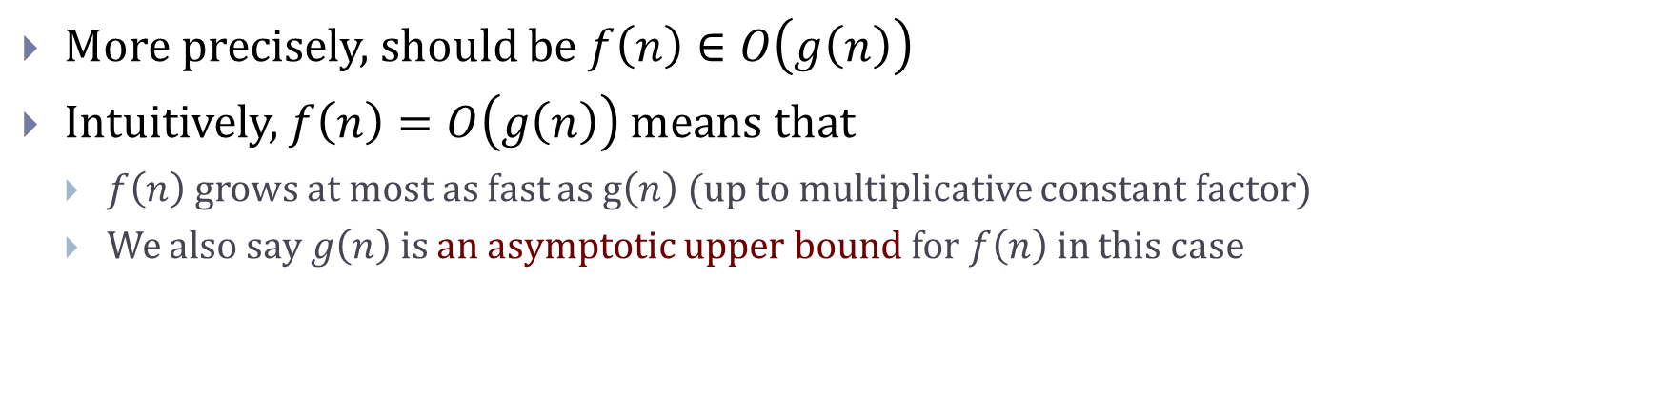
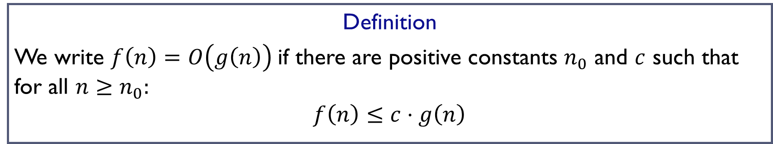
Big-O notation
Definition
We write $f\left(n\right)=O\left(g\left(n\right)\right)$if there are positive constants $n_{0}$ and $c$ such that for all $n≥n_{0}:$
$$f\left(n\right)≤c⋅g\left(n\right)$$
More precisely, should be $f\left(n\right)∈O\left(g\left(n\right)\right)$
Intuitively, $f\left(n\right)=O\left(g\left(n\right)\right)$ means that
  $f\left(n\right)$ grows at most as fast as g$\left(n\right)$ (up to multiplicative constant factor)
  We also say $g\left(n\right)$ is an asymptotic upper bound for $f\left(n\right)$ in this case

Slide 48
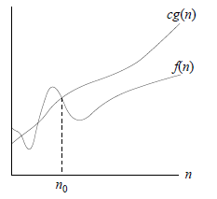
Big-O notation
Definition
We write $f\left(n\right)=O\left(g\left(n\right)\right)$if there are positive constants $n_{0}$ and $c$ such that for all $n≥n_{0}:$
$$f\left(n\right)≤c⋅g\left(n\right)$$

Slide 49
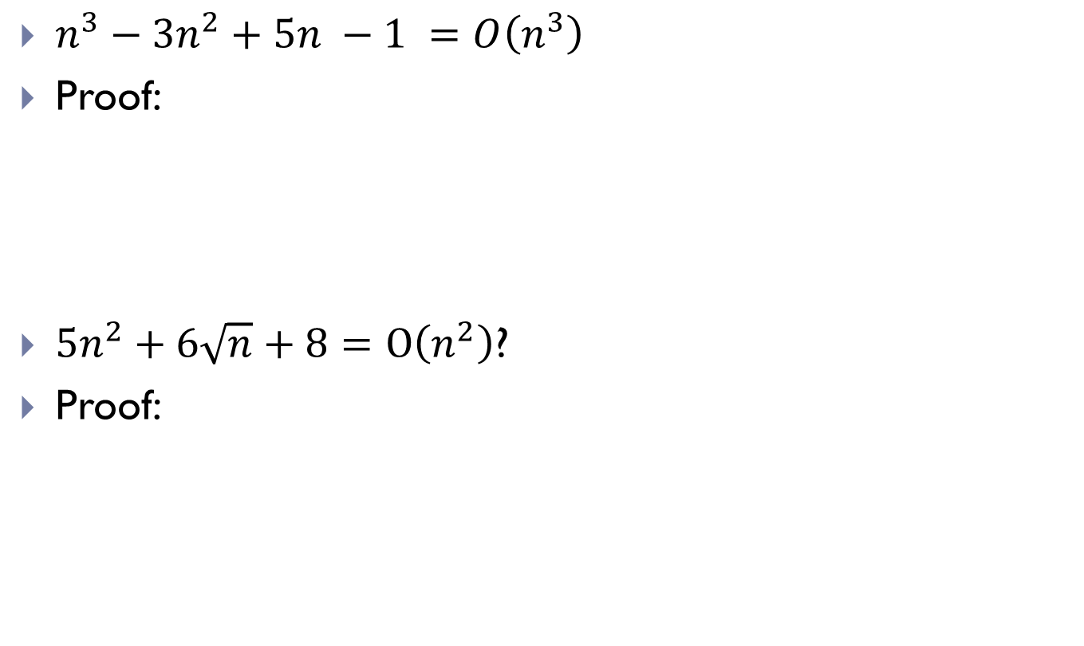
Examples
$n^{3}−3n^{2}+5n −1 =O\left(n^{3}\right)$
Proof:
$5n^{2}+6\sqrt{n}+8=O\left(n^{2}\right)$?
Proof:

Slide 50
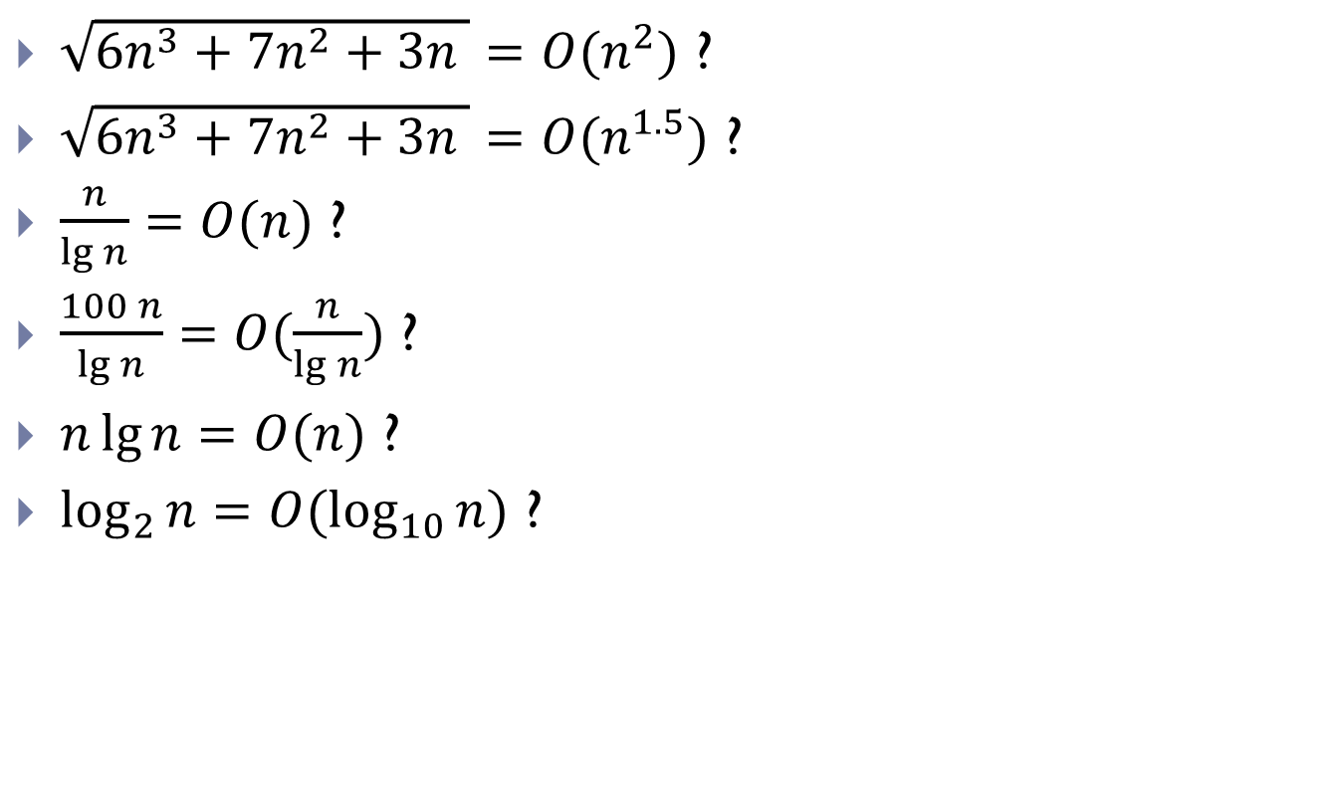
More examples
$\sqrt{6n^{3}+7n^{2}+3n }=O(n^{2})$ ?
$\sqrt{6n^{3}+7n^{2}+3n }=O(n^{1.5})$ ?
$\frac{n}{\lg{n}}=O(n)$ ?
$\frac{100 n}{\lg{n}}=O(\frac{n}{\lg{n}})$ ?
$n\lg{n}=O(n)$ ?
$\log_{2}{n}=O(\log_{10}{n})$ ?

Slide 51
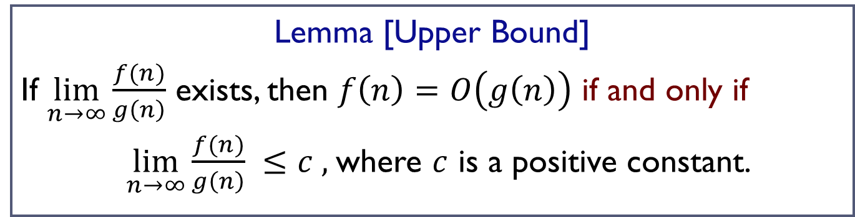
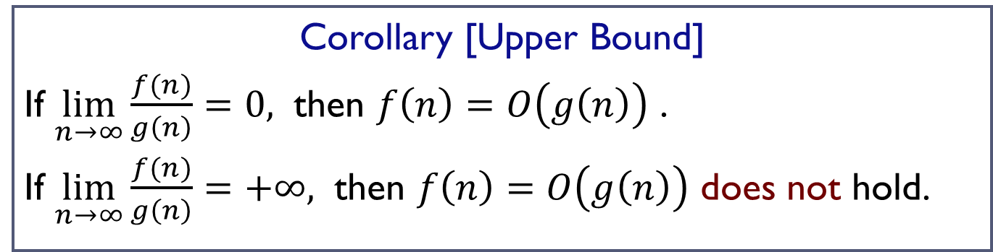
A useful result
Lemma [Upper Bound]
If $\lim_{n→∞}{\frac{f(n)}{g\left(n\right)}}$ exists, then $f\left(n\right)=O\left(g\left(n\right)\right)$ if and only if
$\lim_{n→∞}{\frac{f(n)}{g\left(n\right)}} ≤c ,$where $c$ is a positive constant.
Corollary [Upper Bound]
If $\lim_{n→∞}{\frac{f(n)}{g\left(n\right)}=0, }$ then $f\left(n\right)=O\left(g\left(n\right)\right)$ .
If $\lim_{n→∞}{\frac{f(n)}{g\left(n\right)}=+∞, }$ then $f\left(n\right)=O\left(g\left(n\right)\right)$ does not hold.

Slide 52
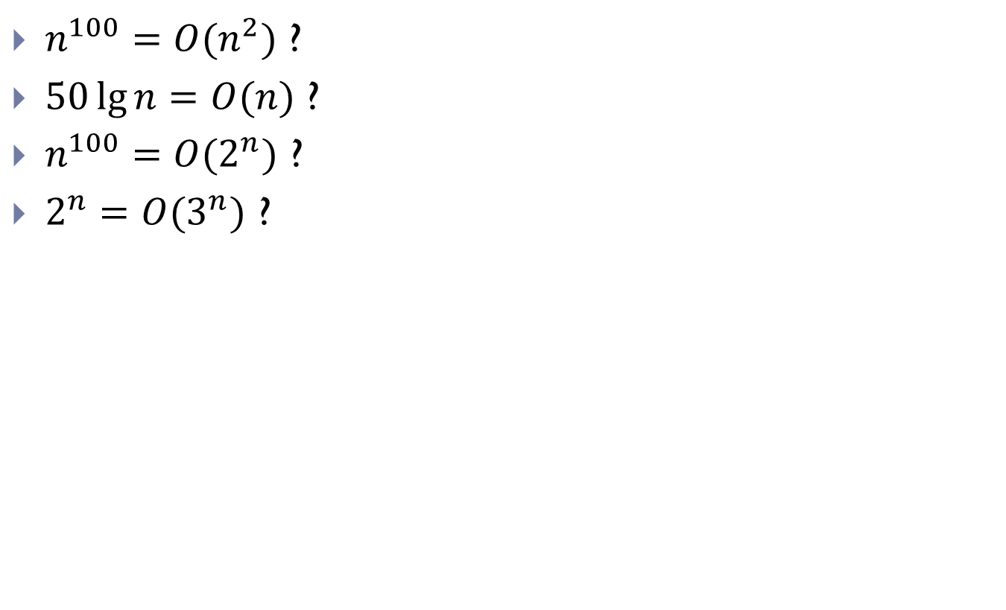
More examples
$n^{100}=O(n^{2})$ ?
$50\lg{n}=O(n)$ ?
$n^{100}=O(2^{n})$ ?
$2^{n}=O(3^{n})$ ?

Slide 53

Big-$Ω$ notation

Slide 54
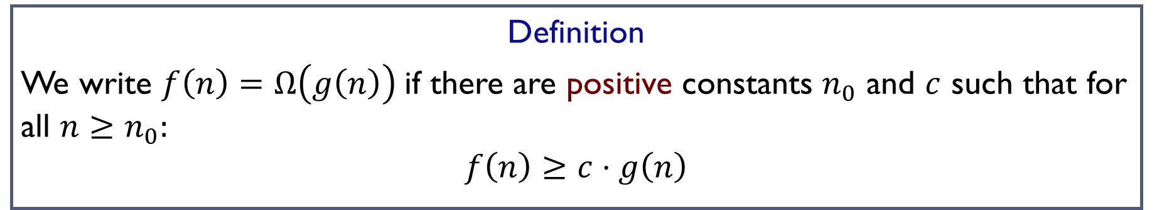
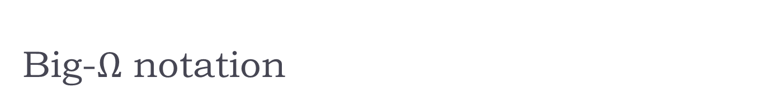
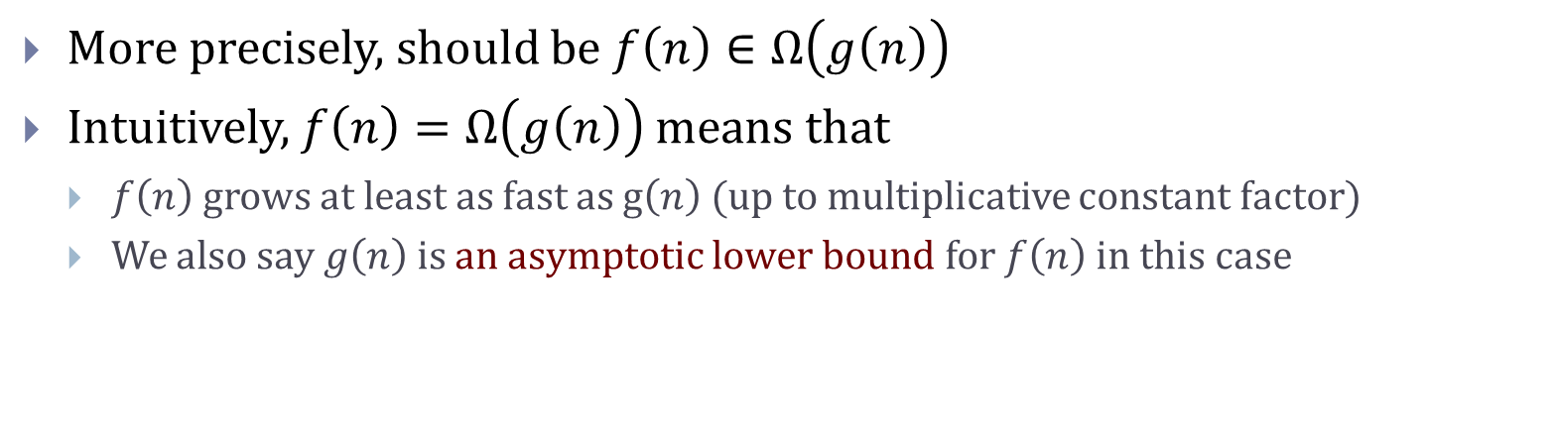
Big-$Ω$ notation
Definition
We write $f\left(n\right)=Ω\left(g\left(n\right)\right)$if there are positive constants $n_{0}$ and $c$ such that for all $n≥n_{0}:$
$$f\left(n\right)≥c⋅g\left(n\right)$$
More precisely, should be $f\left(n\right)∈Ω\left(g\left(n\right)\right)$
Intuitively, $f\left(n\right)=Ω\left(g\left(n\right)\right)$ means that
  $f\left(n\right)$ grows at least as fast as g$\left(n\right)$ (up to multiplicative constant factor)
  We also say $g\left(n\right)$ is an asymptotic lower bound for $f\left(n\right)$ in this case

Slide 55
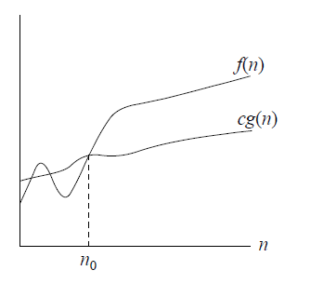
Big-$Ω$ notation
Definition
We write $f\left(n\right)=Ω\left(g\left(n\right)\right)$if there are positive constants $n_{0}$ and $c$ such that for all $n≥n_{0}:$
$$f\left(n\right)≥c⋅g\left(n\right)$$

Slide 56

Examples
$n^{3}−3n^{2}+5n =Ω\left(n^{3}\right)$ ?
Proof:

Slide 57
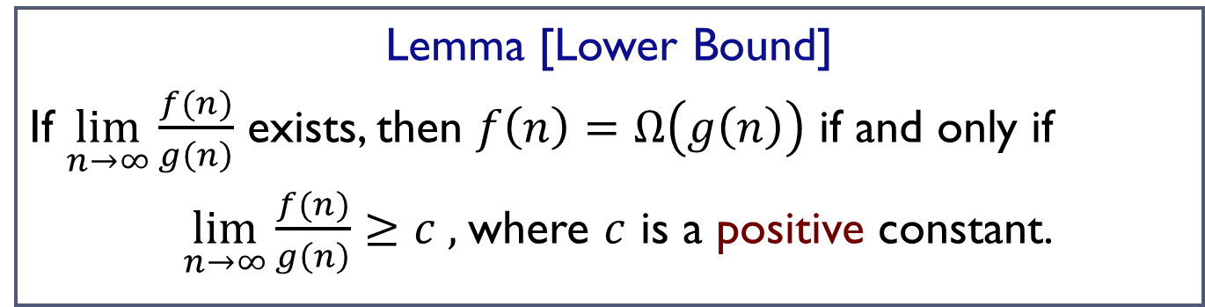
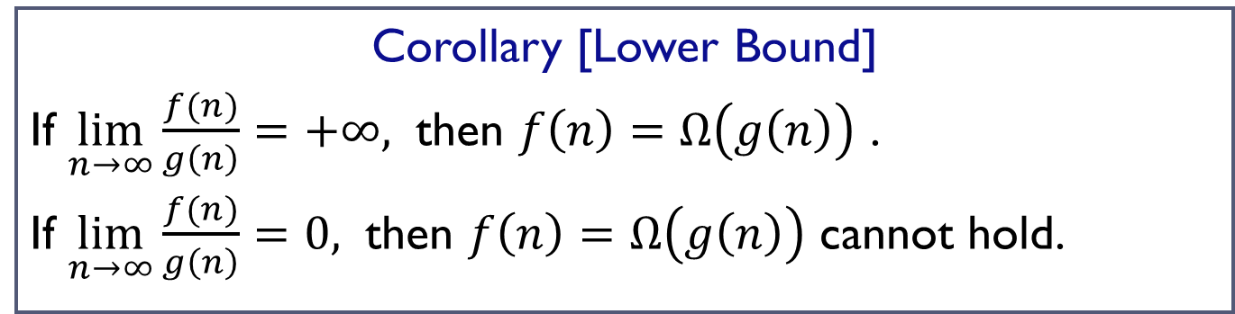
A useful result
Lemma [Lower Bound]
If $\lim_{n→∞}{\frac{f(n)}{g\left(n\right)}}$ exists, then $f\left(n\right)=Ω\left(g\left(n\right)\right)$ if and only if
$\lim_{n→∞}{\frac{f(n)}{g\left(n\right)}}≥c ,$where $c$ is a positive constant.
Corollary [Lower Bound]
If $\lim_{n→∞}{\frac{f(n)}{g\left(n\right)}=+∞, }$ then $f\left(n\right)=Ω\left(g\left(n\right)\right)$ .
If $\lim_{n→∞}{\frac{f(n)}{g\left(n\right)}=0, }$ then $f\left(n\right)=Ω\left(g\left(n\right)\right)$ cannot hold.

Slide 58
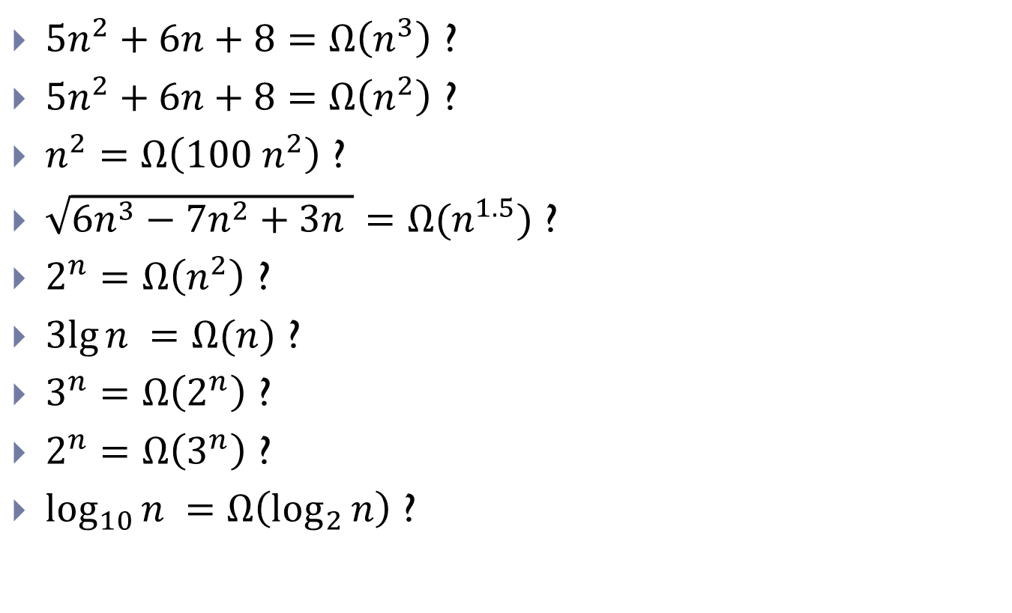
More Examples
$5n^{2}+6n+8=Ω\left(n^{3}\right)$ ?
$5n^{2}+6n+8=Ω\left(n^{2}\right)$ ?
$n^{2}=Ω\left({100 n}^{2}\right)$ ?
$\sqrt{6n^{3}−7n^{2}+3n }=Ω(n^{1.5})$ ?
$2^{n}=Ω\left(n^{2}\right)$ ?
$3lg{n }=Ω(n)$ ?
$3^{n}=Ω\left(2^{n}\right)$ ?
$2^{n}=Ω\left(3^{n}\right)$ ?
$\log_{10}{n }=Ω\left(\log_{2}{n}\right)$ ?

Slide 59

Big-$Θ$ notation

Slide 60
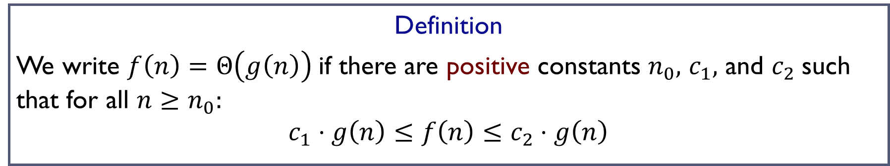

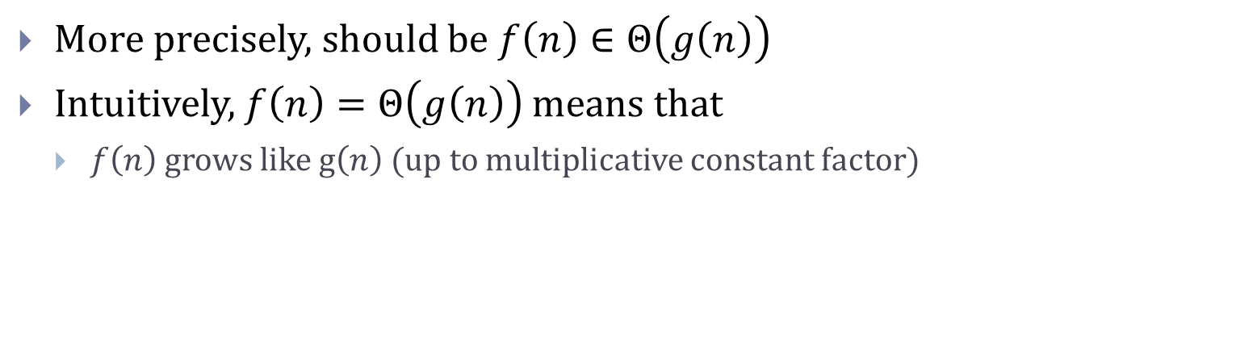
Big-$Θ$ notation
Definition
We write $f\left(n\right)=Θ\left(g\left(n\right)\right)$if there are positive constants $n_{0},$ $c_{1},$ and $c_{2}$such that for all $n≥n_{0}:$
$$c_{1}⋅g\left(n\right)≤f\left(n\right)≤c_{2}⋅g\left(n\right)$$
More precisely, should be $f\left(n\right)∈Θ\left(g\left(n\right)\right)$
Intuitively, $f\left(n\right)=Θ\left(g\left(n\right)\right)$ means that
  $f\left(n\right)$ grows like g$\left(n\right)$ (up to multiplicative constant factor)

Slide 61
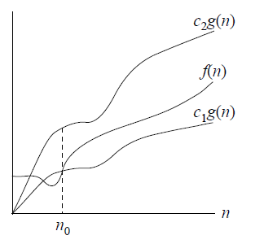
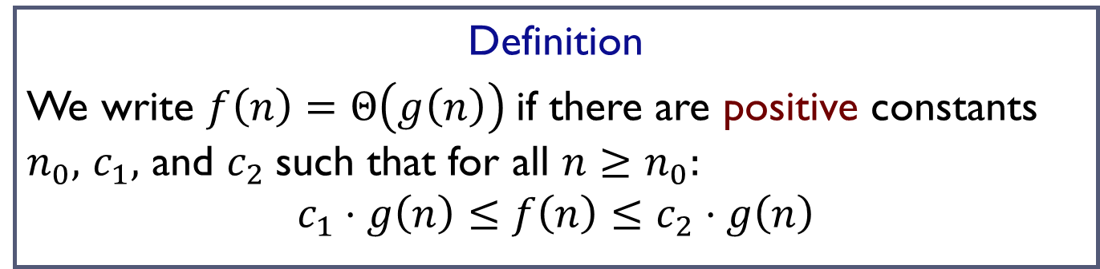
Big-$Θ$ notation
Definition
We write $f\left(n\right)=Θ\left(g\left(n\right)\right)$if there are positive constants $n_{0},$ $c_{1},$ and $c_{2}$such that for all $n≥n_{0}:$
$$c_{1}⋅g\left(n\right)≤f\left(n\right)≤c_{2}⋅g\left(n\right)$$

Slide 62
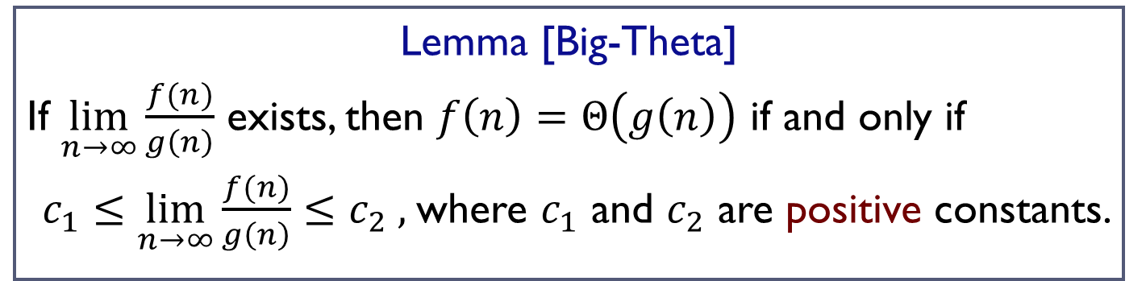
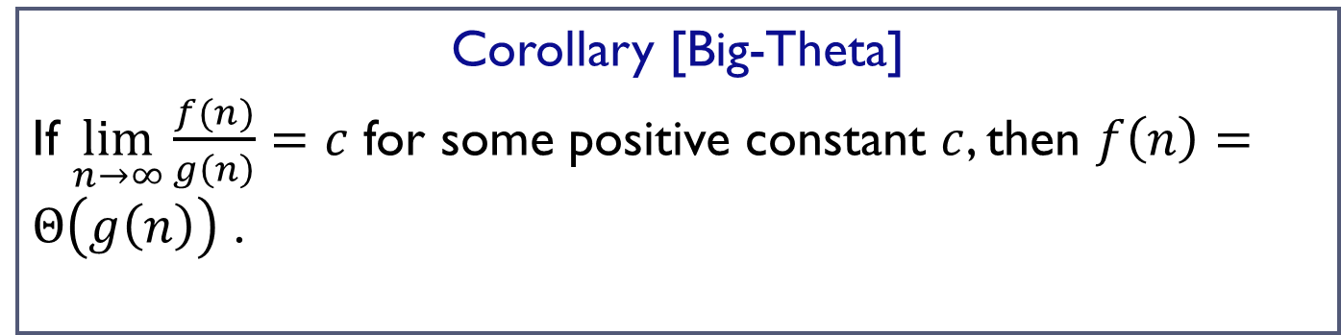
A useful result
Lemma [Big-Theta]
If $\lim_{n→∞}{\frac{f(n)}{g\left(n\right)}}$ exists, then $f\left(n\right)=Θ\left(g\left(n\right)\right)$ if and only if
$c_{1}≤\lim_{n→∞}{\frac{f(n)}{g\left(n\right)}}≤c_{2} ,$where $c_{1}$ and $c_{2}$ are positive constants.
Corollary [Big-Theta]
If $\lim_{n→∞}{\frac{f(n)}{g\left(n\right)}=c}$ for some positive constant $c$, then $f\left(n\right)=Θ\left(g\left(n\right)\right)$ .

Slide 63

Examples
$2n^{3}−3n^{2}=Θ\left(n^{3}\right)$
Proof:

Slide 64
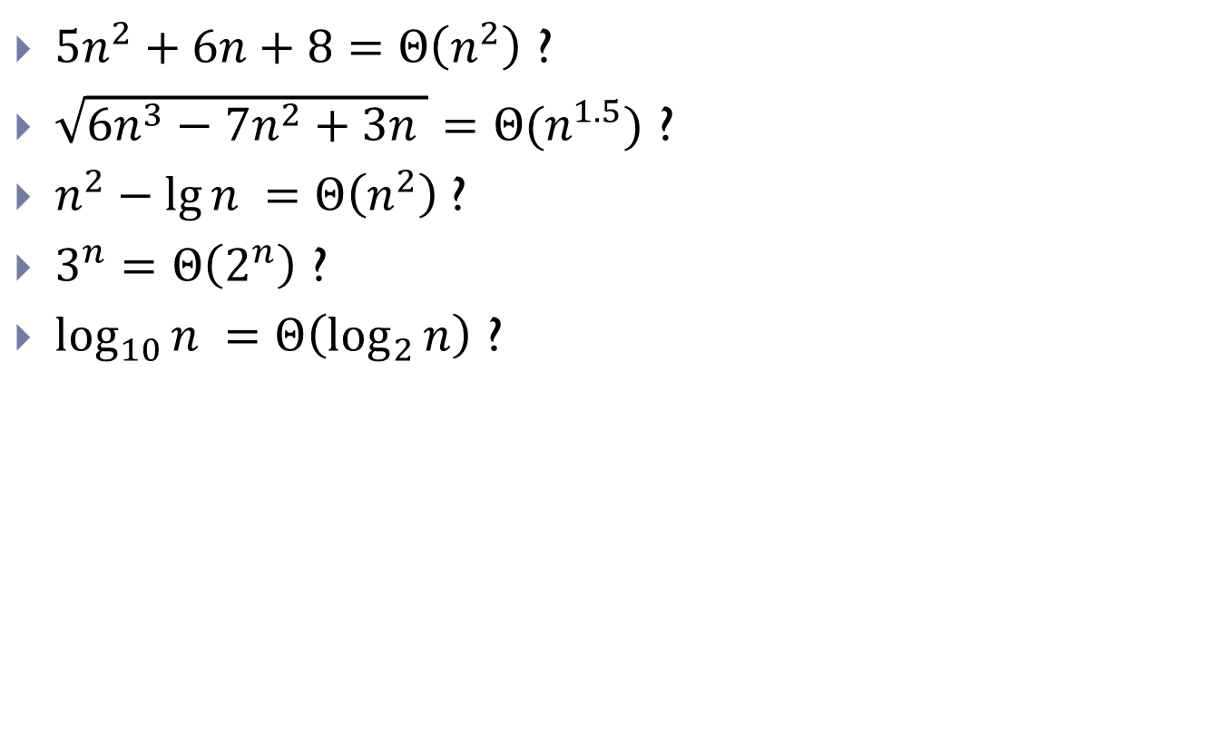
More Examples
$5n^{2}+6n+8=Θ\left(n^{2}\right)$ ?
$\sqrt{6n^{3}−7n^{2}+3n }=Θ(n^{1.5})$ ?
$n^{2}−\lg{n }=Θ\left(n^{2}\right)$?
$3^{n}=Θ\left(2^{n}\right)$ ?
$\log_{10}{n }=Θ\left(\log_{2}{n}\right)$ ?

Slide 65
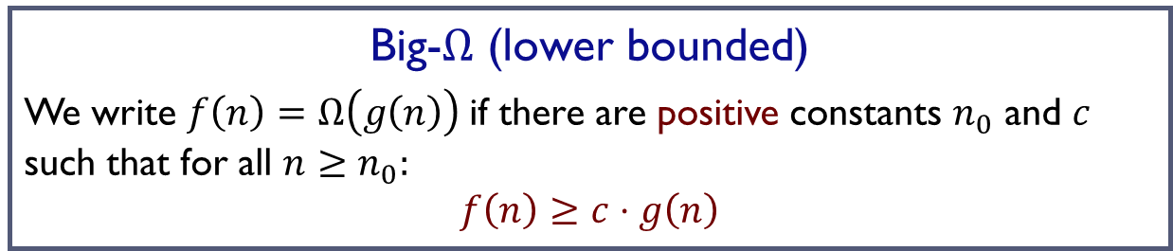
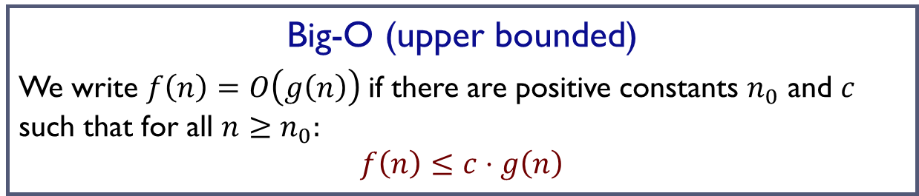

In summary
Big-O (upper bounded)
We write $f\left(n\right)=O\left(g\left(n\right)\right)$if there are positive constants $n_{0}$ and $c$ such that for all $n≥n_{0}:$
$$f\left(n\right)≤c⋅g\left(n\right)$$
Big-$Ω$ (lower bounded)
We write $f\left(n\right)=Ω\left(g\left(n\right)\right)$if there are positive constants $n_{0}$ and $c$ such that for all $n≥n_{0}:$
$$f\left(n\right)≥c⋅g\left(n\right)$$
Big-$Θ$ (asymptoticly the same)
We write $f\left(n\right)=Θ\left(g\left(n\right)\right)$if there are positive constants $n_{0},$ $c_{1},$ and $c_{2}$such that for all $n≥n_{0}:$
$$c_{1}⋅g\left(n\right)≤f\left(n\right)≤c_{2}⋅g\left(n\right)$$

Slide 66
FIN

