Slide 1
DSC40B:
Theoretical Foundations of Data Science II
Lecture 6: Sorting, and more on recurrences
Instructor: Yusu Wang

Slide 2
Previously
Binary search operation in an array
  Require that the array is already sorted!
Today: the sorting problem
  Input: given an arbitrary array of numbers
  Output: convert them into an array where all elements are either in non-decreasing or non-increasing order.
    from now on, unless otherwise specified, in this class, we will assume a sorted array is in non-decreasing order.

Slide 3
Motivation
There are many reasons why we want to solve the sorting problem
  Given a list of tasks with different priority values, the CPU may want to process them in decreasing order of priority
  Sorting can also make other problems easy
    E.g, the search problem discussed last lecture,
    or more generally, range search in multidimensional databases etc.
But we will just focus on the simplest version
  where the input is just a list of real numbers stored in an array.

Slide 4
Part A:
(1) A simple sorting algorithm: Selection sort
(2) Correctness of algorithm via loop invariants

Slide 5
A simple idea
Start with input array:
  At each iteration, identify the smallest number in the remainder unsorted portion of the array
  Put it at the end of the already-sorted portion
  Iterate till the end
Example:
  Input array A = [12, 4, -1, 9, 10 ]

Slide 6
How to implement this idea using an algorithm
How to prove the correctness of the algorithm
Time complexity

Slide 7
How to implement this idea using an algorithm
  in-place selection sort
    meaning that it will only operate on the same array
  separate “good” / “bad” part of the array by a barrier-id
How to prove the correctness of the algorithm
Time complexity

Slide 8
Algorithm selection_sort
def selection_sort(A):
n = len(A)
if n <= 1:
return
for barrier_id in range(n-1):
# find index of min in A[start:]
min_id = find_minimum(A, start=barrier_id)
#swap
A[barrier_id], A[min_id] = (
A[min_id], A[barrier_id]
)

Slide 9
Subroutine find_minimum
def find_minimum(A, start):
”””Finds index of minimum from [start, len(A)). Assumes non-empty.”””
n = len(A)
min_value = A[start]
min_id = start
for i in range(start + 1, n):
if A[i] < min_value:
min_value = A[i]
min_id = i
return min_id
Note that instead of using this sub-routine, selection_sort can be written by using a nested loop.

Slide 10
Correctness
How to convince us that this algorithm is correct?
  Using loop invariants
    Similar to the inductive idea mentioned earlier

Slide 11
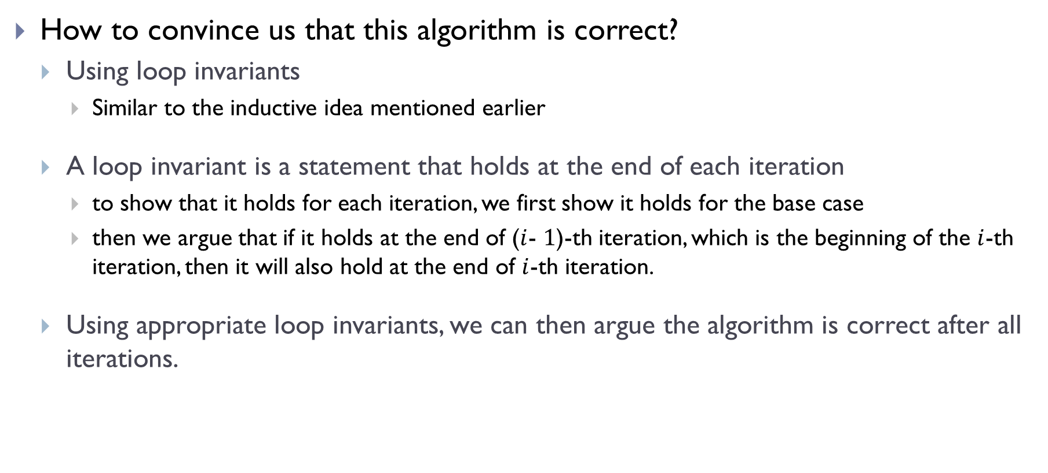
Correctness
How to convince us that this algorithm is correct?
  Using loop invariants
    Similar to the inductive idea mentioned earlier
  A loop invariant is a statement that holds at the end of each iteration
    to show that it holds for each iteration, we first show it holds for the base case
    then we argue that if it holds at the end of ($i$- $1$)-th iteration, which is the beginning of the $i$-th iteration, then it will also hold at the end of $i$-th iteration.
  Using appropriate loop invariants, we can then argue the algorithm is correct after all iterations.

Slide 12
Algorithm selection_sort
def selection_sort(A):
n = len(A)
if n <= 1:
return
for barrier_id in range(n-1):
# find index of min in A[start:]
min_id = find_minimum(A, start=barrier_id)
#swap
A[barrier_id], A[min_id] = (
A[min_id], A[barrier_id]
)

Slide 13
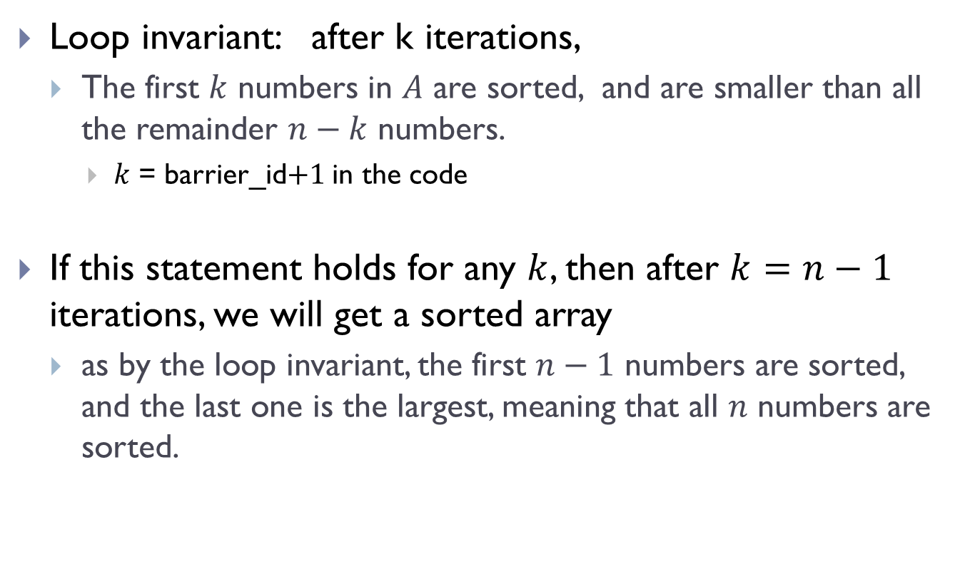
Loop invariants for selection_sort
Loop invariant: after k iterations,
  The first $k$ numbers in $A$ are sorted, and are smaller than all the remainder $n−k$ numbers.
    $k$ = barrier_id$+1$ in the code
If this statement holds for any $k$, then after $k=n−1$ iterations, we will get a sorted array
  as by the loop invariant, the first $n−1$ numbers are sorted, and the last one is the largest, meaning that all $n$ numbers are sorted.

Slide 14

Base case:
  $k = 0$: loop invariant holds trivially

Slide 15
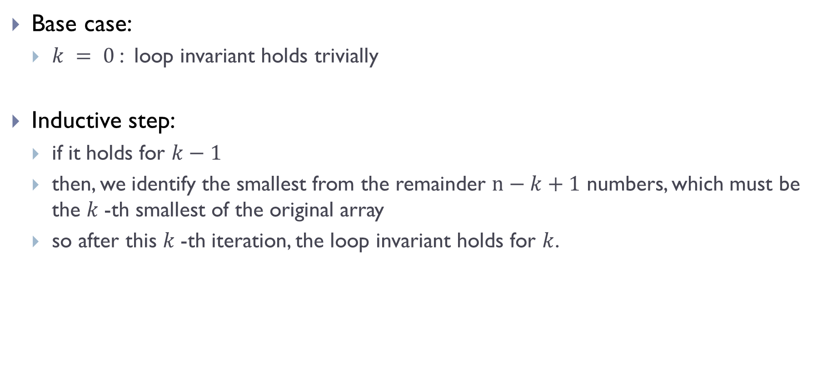
Base case:
  $k = 0$: loop invariant holds trivially
Inductive step:
  if it holds for $k−1$
  then, we identify the smallest from the remainder $n−k+1$ numbers, which must be the $k$-th smallest of the original array
  so after this $k$-th iteration, the loop invariant holds for $k$.

Slide 16
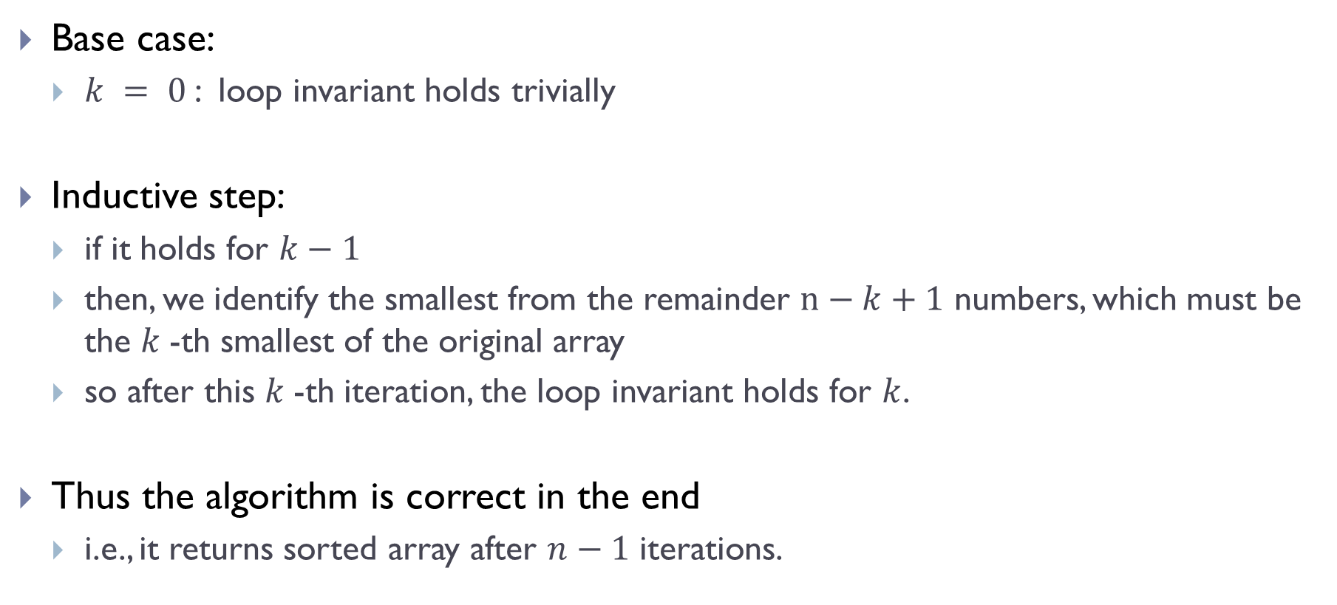
Base case:
  $k = 0$: loop invariant holds trivially
Inductive step:
  if it holds for $k−1$
  then, we identify the smallest from the remainder $n−k+1$ numbers, which must be the $k$-th smallest of the original array
  so after this $k$-th iteration, the loop invariant holds for $k$.
Thus the algorithm is correct in the end
  i.e., it returns sorted array after $n−1$ iterations.

Slide 17
Time complexity
The algorithm is essentially nested for-loops

Slide 18

Time complexity
The algorithm is essentially nested for-loops
  $T\left(n\right)=cn+c\left(n−1\right)+c\left(n−2\right)+ …c⋅1$
  $=Θ(n^{2})$

Slide 19
Part B: A more efficient sorting algorithm:
Merge sort

Slide 20
MergeSort
A faster sorting algorithm
  has the optimal worst-case time complexity under the so-called comparison model.
Use an idea called
  divide-and-conquer to solve problems, which naturally leads to recursive algorithms.

Slide 21
Merge sort
Use divide-and-conquer paradigm

Slide 22
Merge sort
Use divide-and-conquer paradigm
Divide

Slide 23
Merge sort
Use divide-and-conquer paradigm
Divide

Slide 24
Merge sort
Use divide-and-conquer paradigm
Divide

Slide 25
Merge sort
Use divide-and-conquer paradigm
Divide
Conquer

Slide 26
Merge sort
Use divide-and-conquer paradigm
Divide
?
?
Conquer

Slide 27
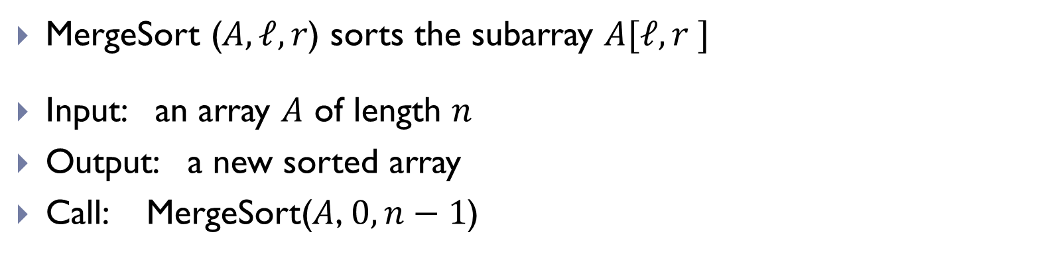
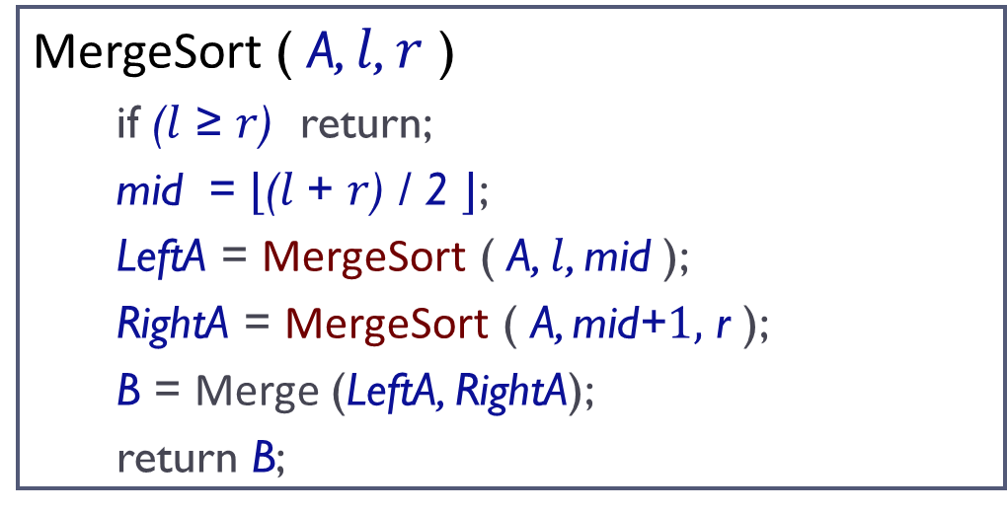
Pseudo-code
MergeSort ( A, $l$, $r$ )
  if ($l$ ≥ $r$) return;
  mid = $⌊$($l$+ $r$) / 2 $⌋$;
  LeftA = MergeSort ( A, $l$, mid );
  RightA = MergeSort ( A, mid+$1,$ r );
  B = Merge (LeftA, RightA);
  return B;
MergeSort ($A, ℓ, r$) sorts the subarray $A[ℓ, r ]$
Input: an array $A$ of length $n$
Output: a new sorted array
Call: MergeSort($A$, $0,n−1$)

Slide 28
Pseudo-code
MergeSort ( A, $l$, $r$ )
  if ($l$ ≥ $r$) return;
  mid = $⌊$($l$+ $r$) / 2 $⌋$;
  LeftA = MergeSort ( A, $l$, mid );
  RightA = MergeSort ( A, mid+$1,$ r );
  B = Merge (LeftA, RightA);
  return B;
Use recursive calls!
This is NOT in-place sorting!
MergeSort ($A, ℓ, r$) sorts the subarray $A[ℓ, r ]$
Input: an array $A$ of length $n$
Output: a new sorted array
Call: MergeSort($A$, $0,n−1$)

Slide 29
Conquer: Merge(B, C)
Input: Given two sorted arrays B and C
Output: Merge into a single sorted array
16
10
8
3
7
5
4
2

Slide 30
Conquer: Merge(B, C)
Input: Given two sorted arrays B and C
Output: Merge into a single sorted array
16
10
8
3
7
5
4
2
2

Slide 31
Conquer: Merge(B, C)
Input: Given two sorted arrays B and C
Output: Merge into a single sorted array
16
10
8
3
7
5
4
2
2 3

Slide 32
Conquer: Merge(B, C)
Input: Given two sorted arrays B and C
Output: Merge into a single sorted array
16
10
8
3
7
5
4
2
2 3 4

Slide 33
Conquer: Merge(B, C)
Input: Given two sorted arrays B and C
Output: Merge into a single sorted array
16
10
8
3
7
5
4
2
2 3 4 5

Slide 34
Conquer: Merge(B, C)
Input: Given two sorted arrays B and C
Output: Merge into a single sorted array
16
10
8
3
7
5
4
2
2 3 4 5 7

Slide 35
Conquer: Merge(B, C)
Input: Given two sorted arrays B and C
Output: Merge into a single sorted array
16
10
8
3
7
5
4
2
2 3 4 5 7 8 10 16

Slide 36
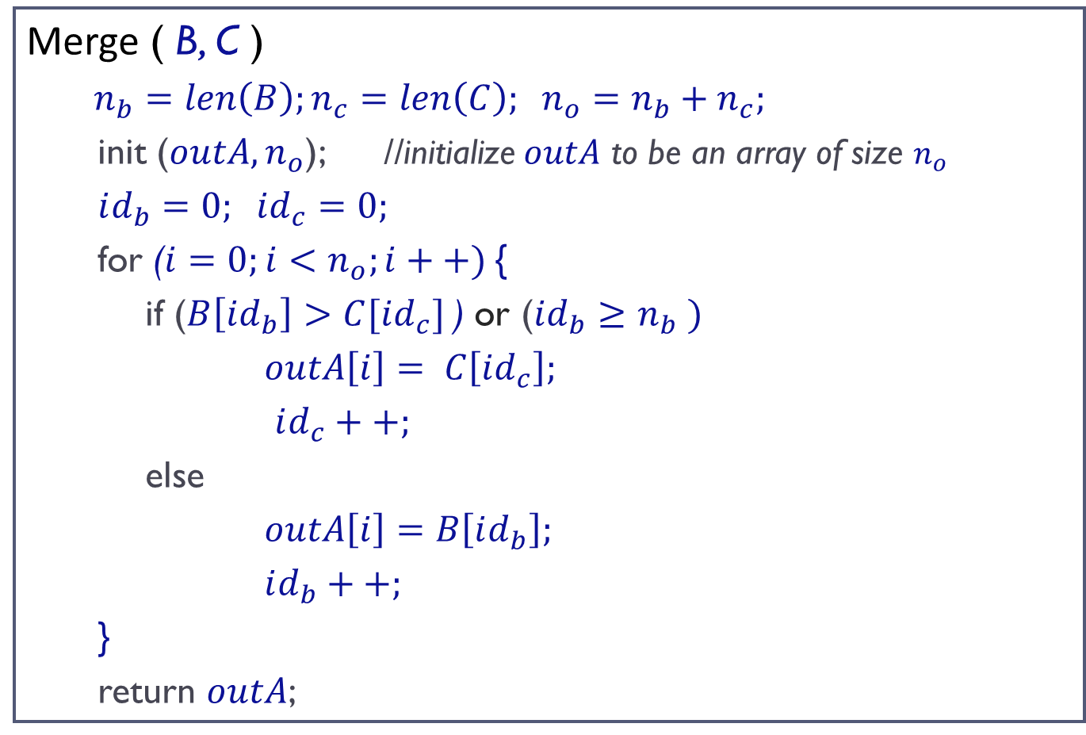
Pseudo-code
Merge ( B, C )
  $n_{b}=len\left(B\right);n_{c}=len\left(C\right); n_{o}=n_{b}+n_{c};$
  init ($outA,n_{o}$); //initialize $outA$ to be an array of size $n_{o}$
  $id_{b}=0; id_{c}=0;$
  for ($i=0;i<n_{o};i++)${
  if ($B\left[id_{b}\right]>C[id_{c}]$) or ($id_{b}$ $≥n_{b} )$
  $outA\left[i\right]= C\left[id_{c}\right];$
  $id_{c}++;$
  else
  $outA\left[i\right]=B\left[id_{b}\right];$
  $id_{b}++;$
  }
  return $outA$;

Slide 37

Time complexity analysis
First: worst case time complexity for Merge(B, C)
  Let $n_{b}=len\left(B\right);n_{c}=len\left(C\right)$

Slide 38

Time complexity analysis
First: worst case time complexity for Merge(B, C)
  Let $n_{b}=len\left(B\right);n_{c}=len\left(C\right)$
  Then the time $T_{merge(B, C)}=Θ(n_{b}+n_{c})$

Slide 39
Pseudo-code
MergeSort ( A, $l$, $r$ )
  if ($l$ ≥ $r$) return;
  mid = $⌊$($l$+ $r$) / 2 $⌋$;
  LeftA = MergeSort ( A, $l$, mid );
  RightA = MergeSort ( A, mid+$1,$ r );
  B = Merge (LeftA, RightA);
  return B;
MergeSort ($A, ℓ, r$) sorts the subarray $A[ℓ, r ]$
Input: an array $A$ of length $n$
Output: a new sorted array
Call: MergeSort($A$, $0,n−1$)

Slide 40
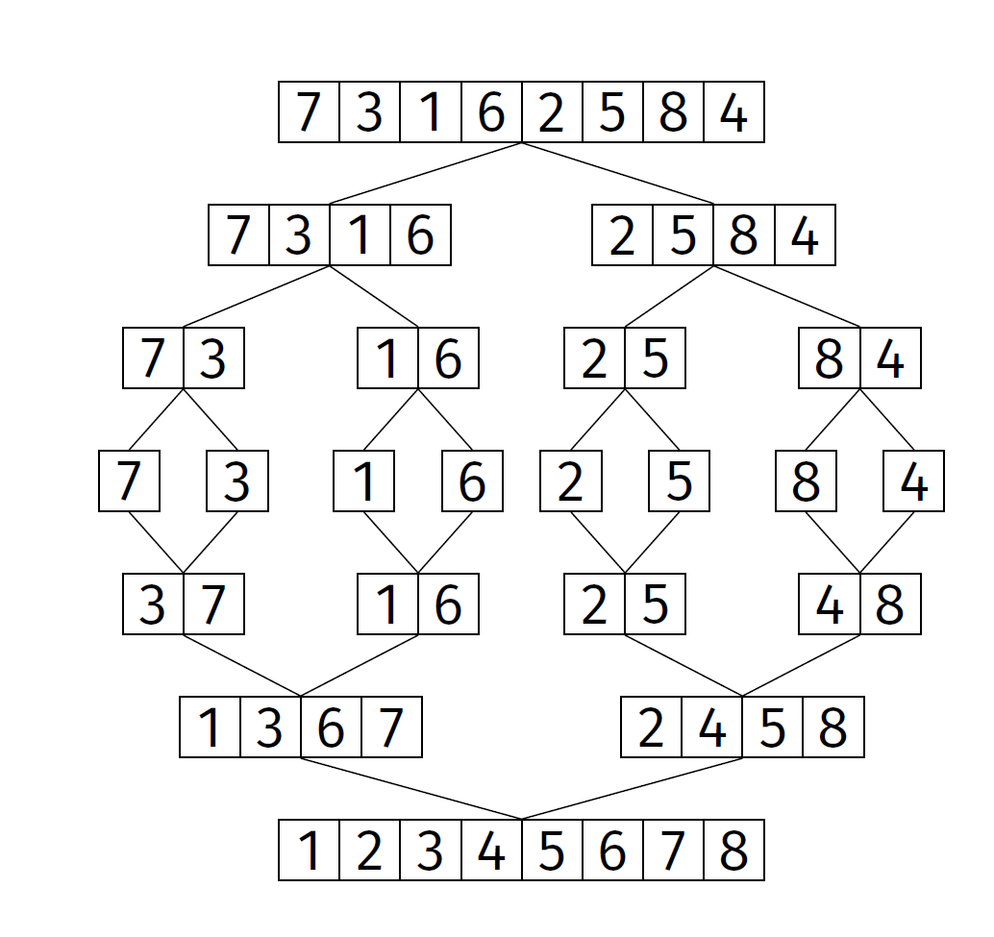
Example

Slide 41
Correctness
Recall for a recursive algorithm:
  (1) Make sure algorithm works in the base case.
  (2) Check that all recursive calls are on smaller problems, and that it terminates
  (3) Assuming that the recursive calls work, does the whole algorithm work?

Slide 42
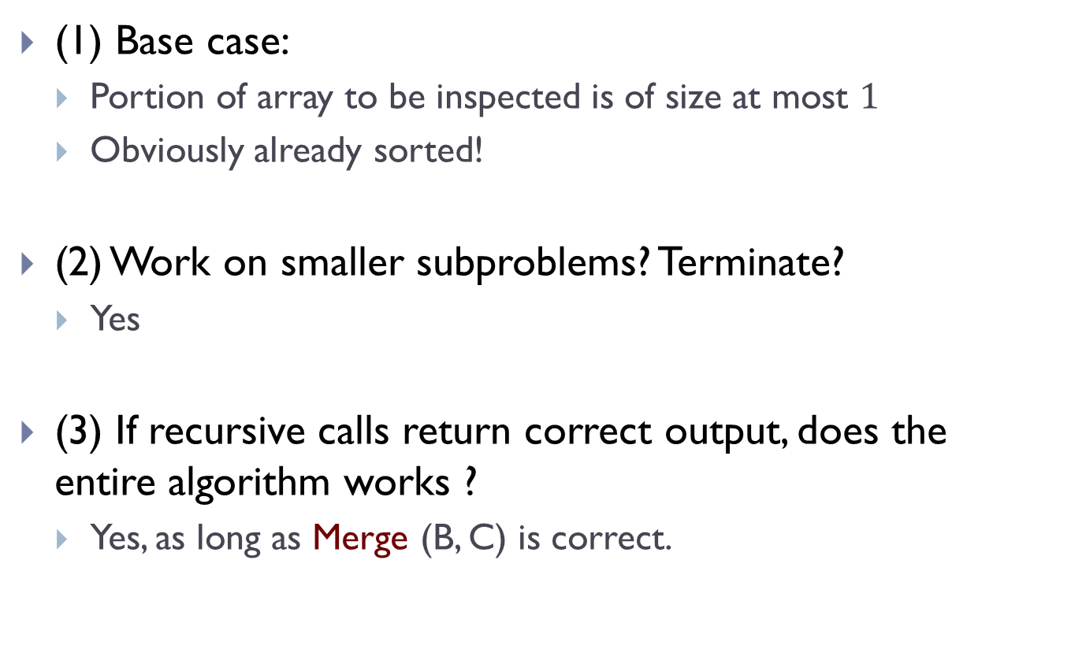
(1) Base case:
  Portion of array to be inspected is of size at most $1$
  Obviously already sorted!
(2) Work on smaller subproblems? Terminate?
  Yes
(3) If recursive calls return correct output, does the entire algorithm works ?
  Yes, as long as Merge (B, C) is correct.

Slide 43
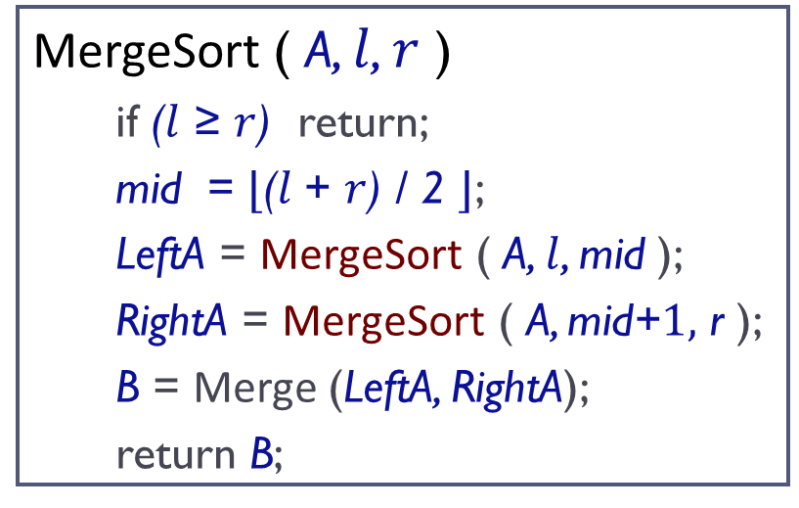
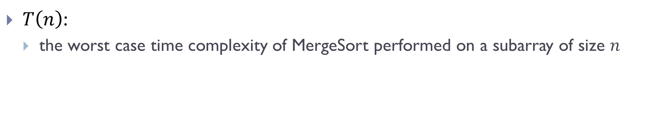
Pseudo-code
MergeSort ( A, $l$, $r$ )
  if ($l$ ≥ $r$) return;
  mid = $⌊$($l$+ $r$) / 2 $⌋$;
  LeftA = MergeSort ( A, $l$, mid );
  RightA = MergeSort ( A, mid+$1,$ r );
  B = Merge (LeftA, RightA);
  return B;
$T\left(n\right)$:
  the worst case time complexity of MergeSort performed on a subarray of size $n$

Slide 44
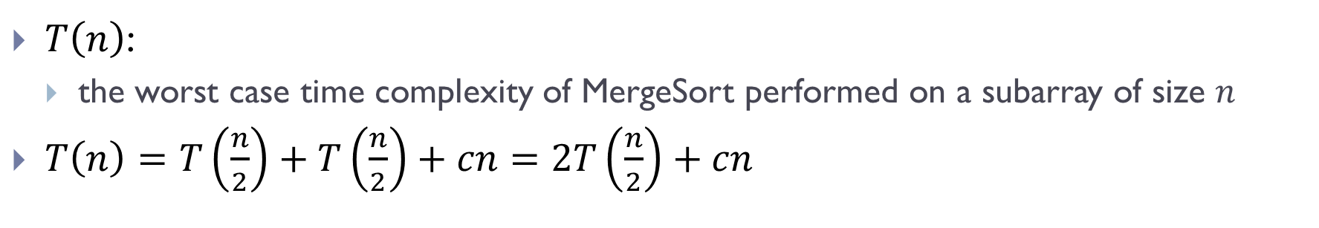
Pseudo-code
MergeSort ( A, $l$, $r$ )
  if ($l$ ≥ $r$) return;
  mid = $⌊$($l$+ $r$) / 2 $⌋$;
  LeftA = MergeSort ( A, $l$, mid );
  RightA = MergeSort ( A, mid+$1,$ r );
  B = Merge (LeftA, RightA);
  return B;
$T\left(n\right)$:
  the worst case time complexity of MergeSort performed on a subarray of size $n$
$T\left(n\right)=T\left(\frac{n}{2}\right)+T\left(\frac{n}{2}\right)+cn=2T\left(\frac{n}{2}\right)+cn$

Slide 45
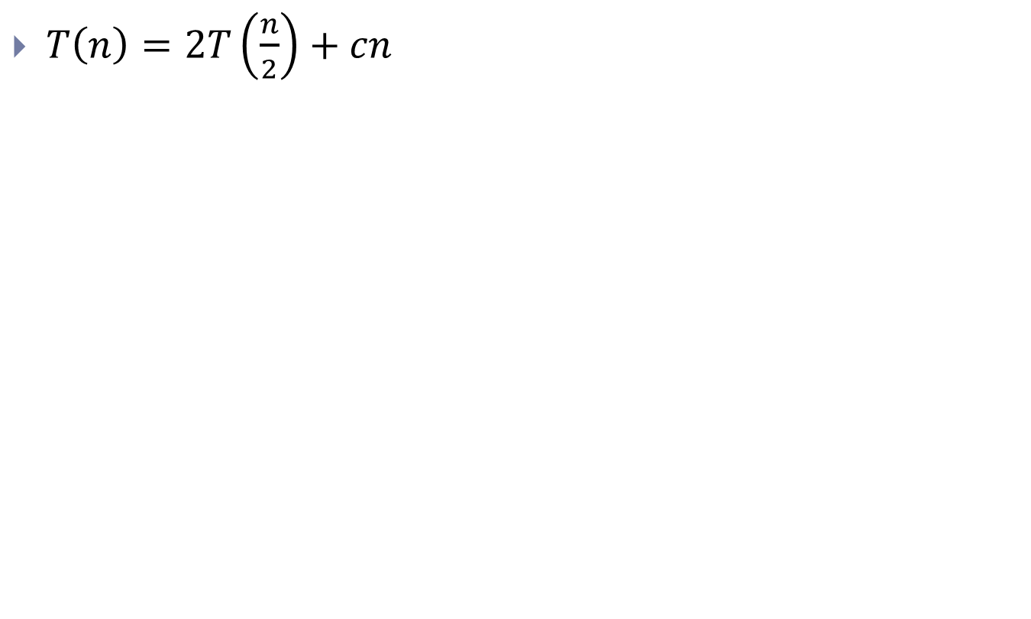
Solving Recurrence relations
$T\left(n\right)=2T\left(\frac{n}{2}\right)+cn$

Slide 46
Solving Recurrence
One way is via the following strategy:
  1. “Unroll” several times to find a pattern.
  2. Write general formula for 𝑘th unroll.
  3. Solve for # of unrolls needed to reach base case.
  4. Plug this number into general formula.

Slide 47
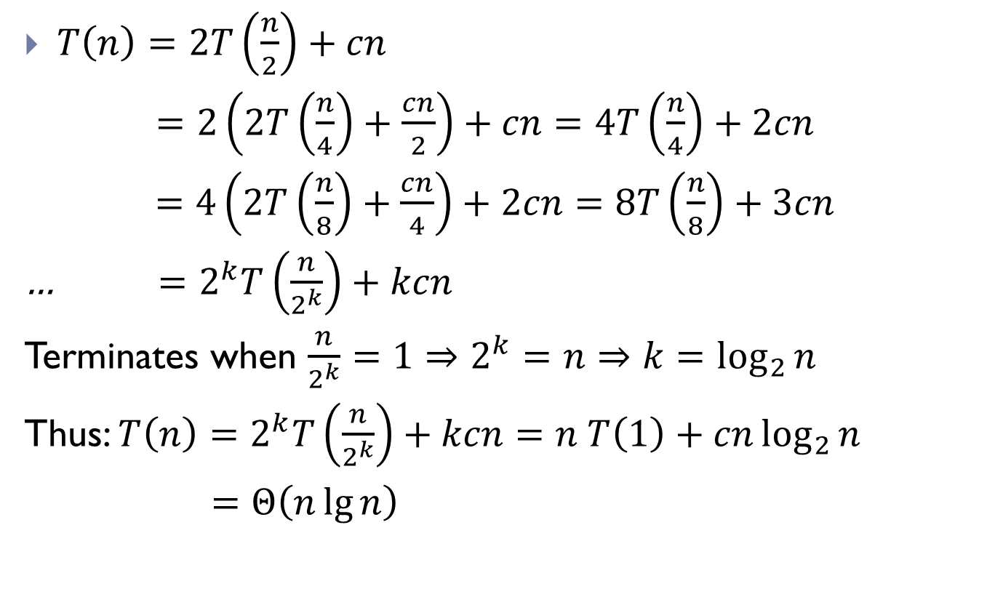
Solving Recurrence relations
$T\left(n\right)=2T\left(\frac{n}{2}\right)+cn$
$=2\left(2T\left(\frac{n}{4}\right)+\frac{cn}{2}\right)+cn=4T\left(\frac{n}{4}\right)+2cn$
$=4\left(2T\left(\frac{n}{8}\right)+\frac{cn}{4}\right)+2cn=8T\left(\frac{n}{8}\right)+3cn$
… $=2^{k}T\left(\frac{n}{2^{k}}\right)+kcn$
Terminates when $\frac{n}{2^{k}}=1⇒2^{k}=n⇒k=\log_{2}{n}$
Thus: $T\left(n\right)=2^{k}T\left(\frac{n}{2^{k}}\right)+kcn=n T\left(1\right)+cn\log_{2}{n}$
$=Θ\left(n\lg{n}\right)$

Slide 48
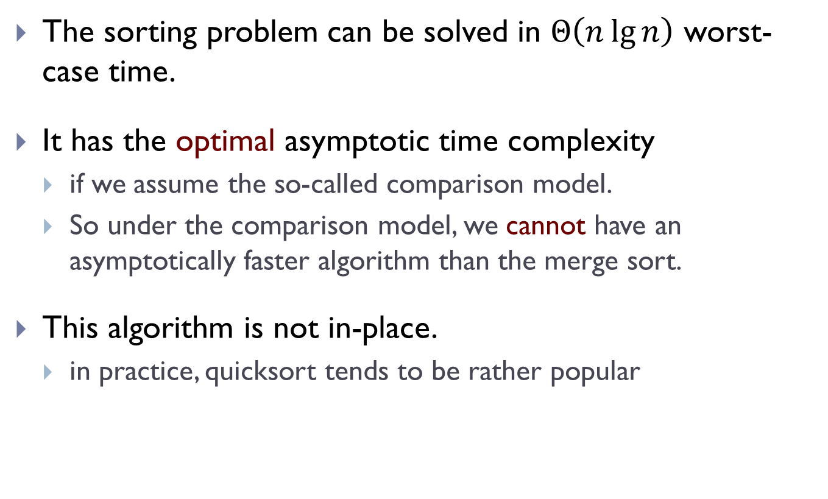
Sorting problem
The sorting problem can be solved in $Θ\left(n\lg{n}\right)$ worst-case time.
It has the optimal asymptotic time complexity
  if we assume the so-called comparison model.
  So under the comparison model, we cannot have an asymptotically faster algorithm than the merge sort.
This algorithm is not in-place.
  in practice, quicksort tends to be rather popular

Slide 49
Part C:
Three-way MergeSort, and more on solving recurrences

Slide 50
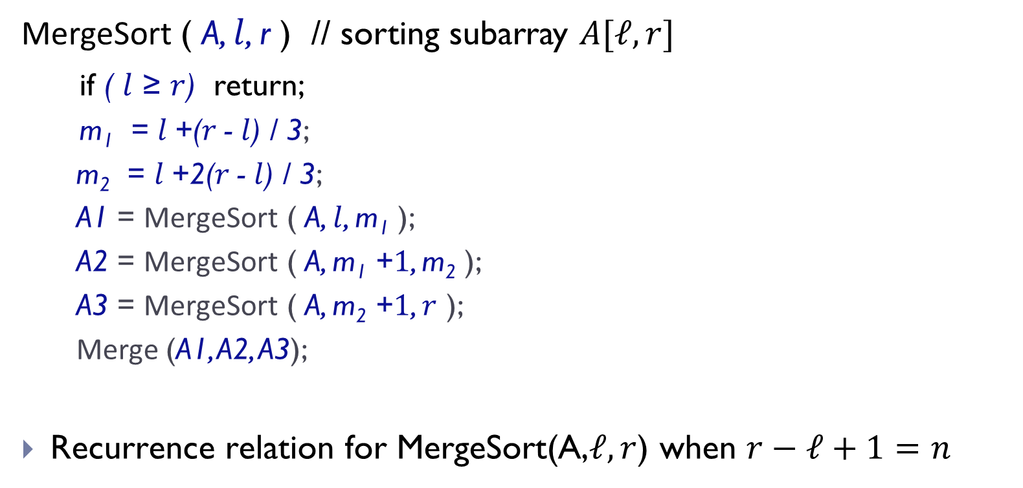
Another MergeSort
MergeSort ( A, $l$, r ) // sorting subarray $A[ℓ, r]$
if ( $l$ ≥ $r$) return;
  m₁ = $l$+($r$- $l$) / 3;
  m₂ = $l$+2($r$- $l$) / 3;
  A1 = MergeSort ( A, $l$, m₁ );
  A2 = MergeSort ( A, m₁ +$1$, m₂ );
  A3 = MergeSort ( A, m₂ +$1$, $r$ );
  Merge (A1, A2, A3);
Recurrence relation for MergeSort(A,$ℓ, r$) when $r−ℓ+1=n$

Slide 51
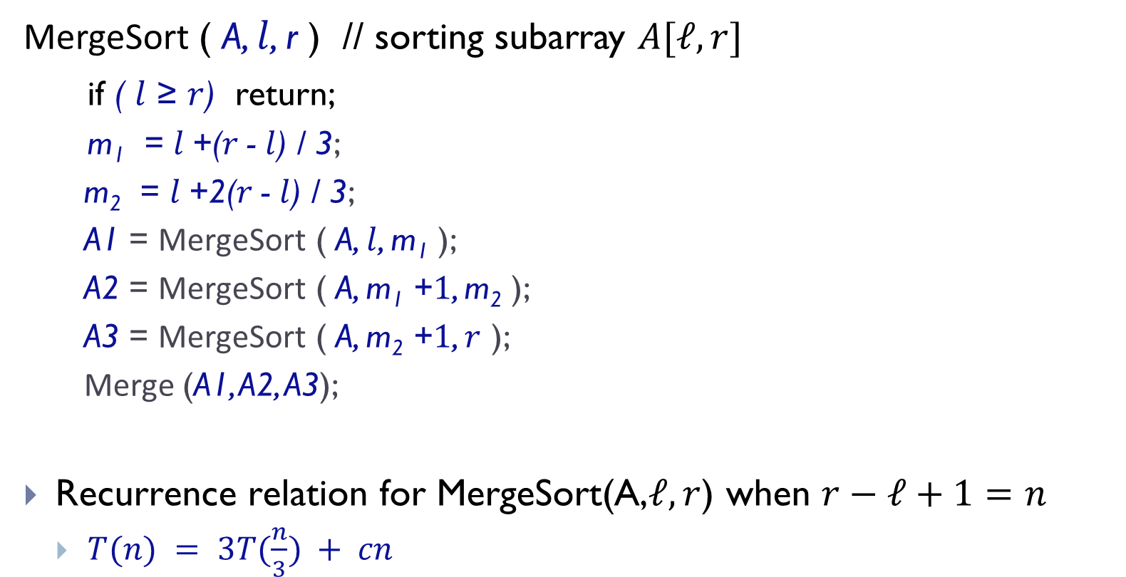
Another MergeSort
MergeSort ( A, $l$, r ) // sorting subarray $A[ℓ, r]$
if ( $l$ ≥ $r$) return;
  m₁ = $l$+($r$- $l$) / 3;
  m₂ = $l$+2($r$- $l$) / 3;
  A1 = MergeSort ( A, $l$, m₁ );
  A2 = MergeSort ( A, m₁ +$1$, m₂ );
  A3 = MergeSort ( A, m₂ +$1$, $r$ );
  Merge (A1, A2, A3);
Recurrence relation for MergeSort(A,$ℓ, r$) when $r−ℓ+1=n$
  $T(n) = 3T(\frac{n}{3}) + cn$

Slide 52
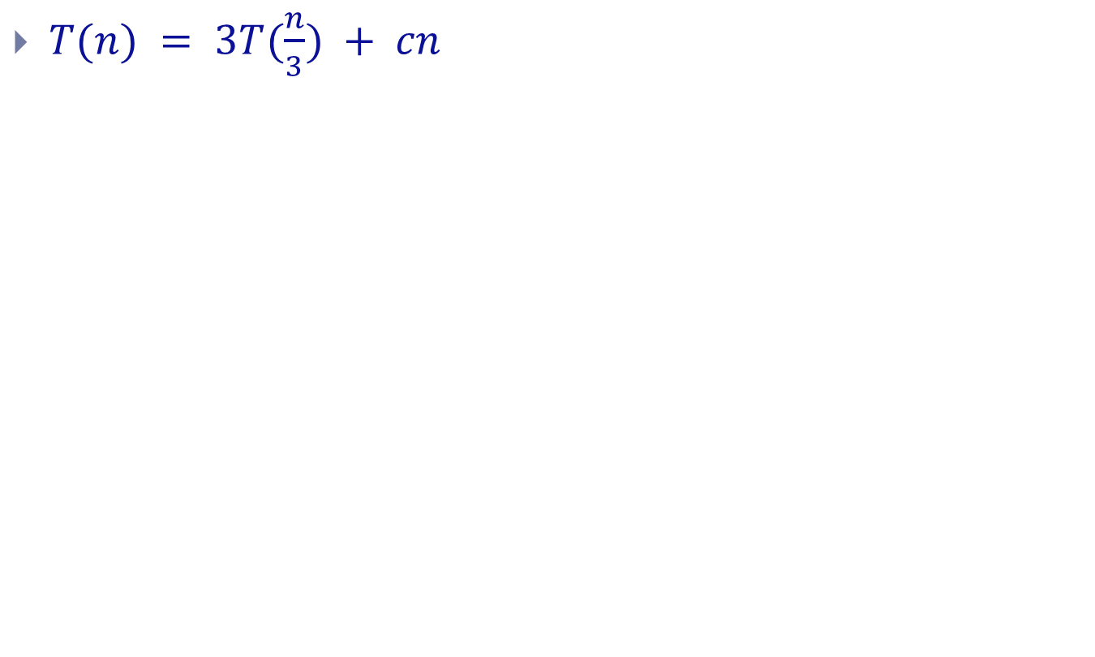
Solving recurrence
$T(n) = 3T(\frac{n}{3}) + cn$

Slide 53

Another example
$T(n) = T(\frac{n}{3}) + cn$

Slide 54
Part D:
The Movie problem revisited

Slide 55
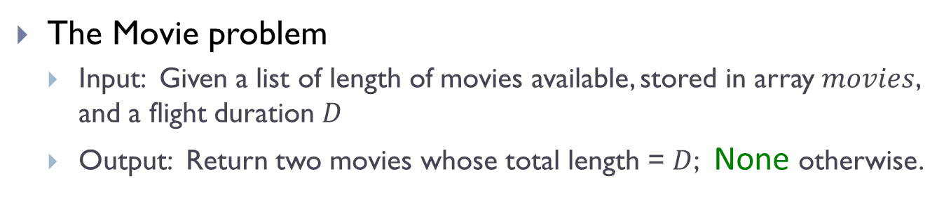
Recall
The Movie problem
  Input: Given a list of length of movies available, stored in array $movies$, and a flight duration $D$
  Output: Return two movies whose total length = $D$; None otherwise.

Slide 56
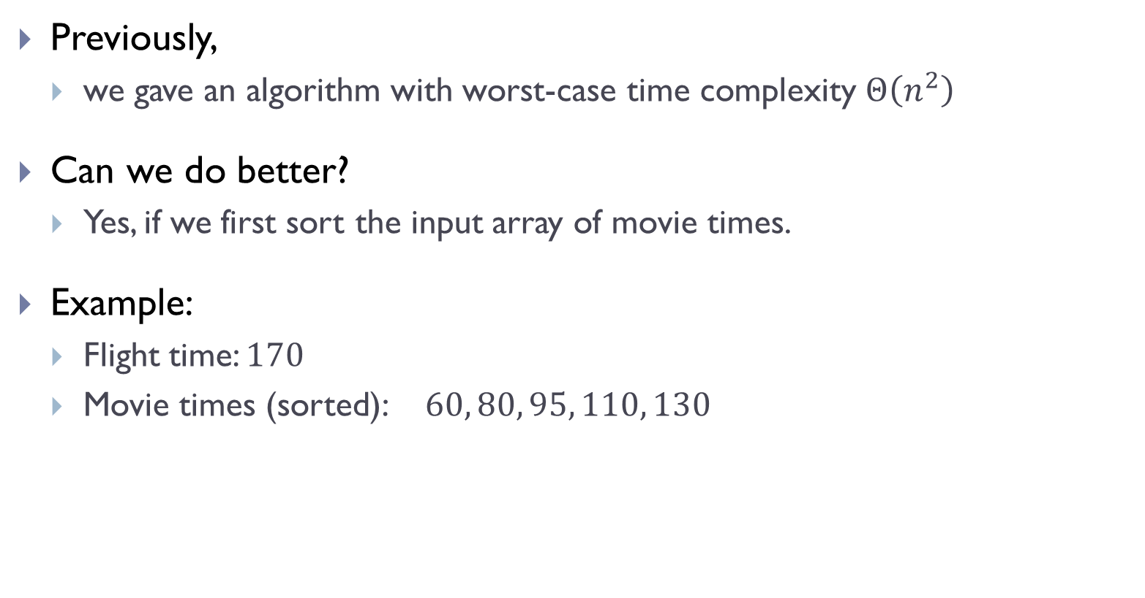
Previously,
  we gave an algorithm with worst-case time complexity $Θ\left(n^{2}\right)$
Can we do better?
  Yes, if we first sort the input array of movie times.
Example:
  Flight time: $170$
  Movie times (sorted): $60, 80, 95, 110, 130$

Slide 57
Code
def optimize_entertainment(times, target):
n = len(times)
MergeSort(times, 0, n-1)
shortest = 0
longest = n - 1
for i in range(n - 1):
total_time = times[shortest] + times[longest]
if total_time == target:
return (shortest, longest)
elif total_time < target:
shortest += 1
else: # total_time > target
longest -= 1
return None

Slide 58
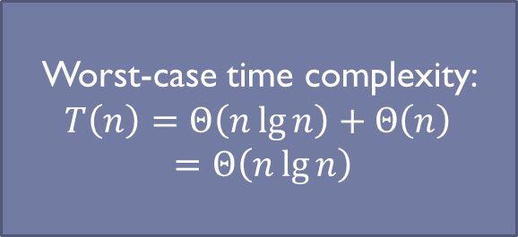
Code
def optimize_entertainment(times, target):
n = len(times)
MergeSort(times, 0, n-1)
shortest = 0
longest = n - 1
for i in range(n - 1):
total_time = times[shortest] + times[longest]
if total_time == target:
return (shortest, longest)
elif total_time < target:
shortest += 1
else: # total_time > target
longest -= 1
return None
Worst-case time complexity:
$$T\left(n\right)=Θ\left(n\lg{n}\right)+Θ\left(n\right)$$
$=Θ\left(n\lg{n}\right)$

Slide 59
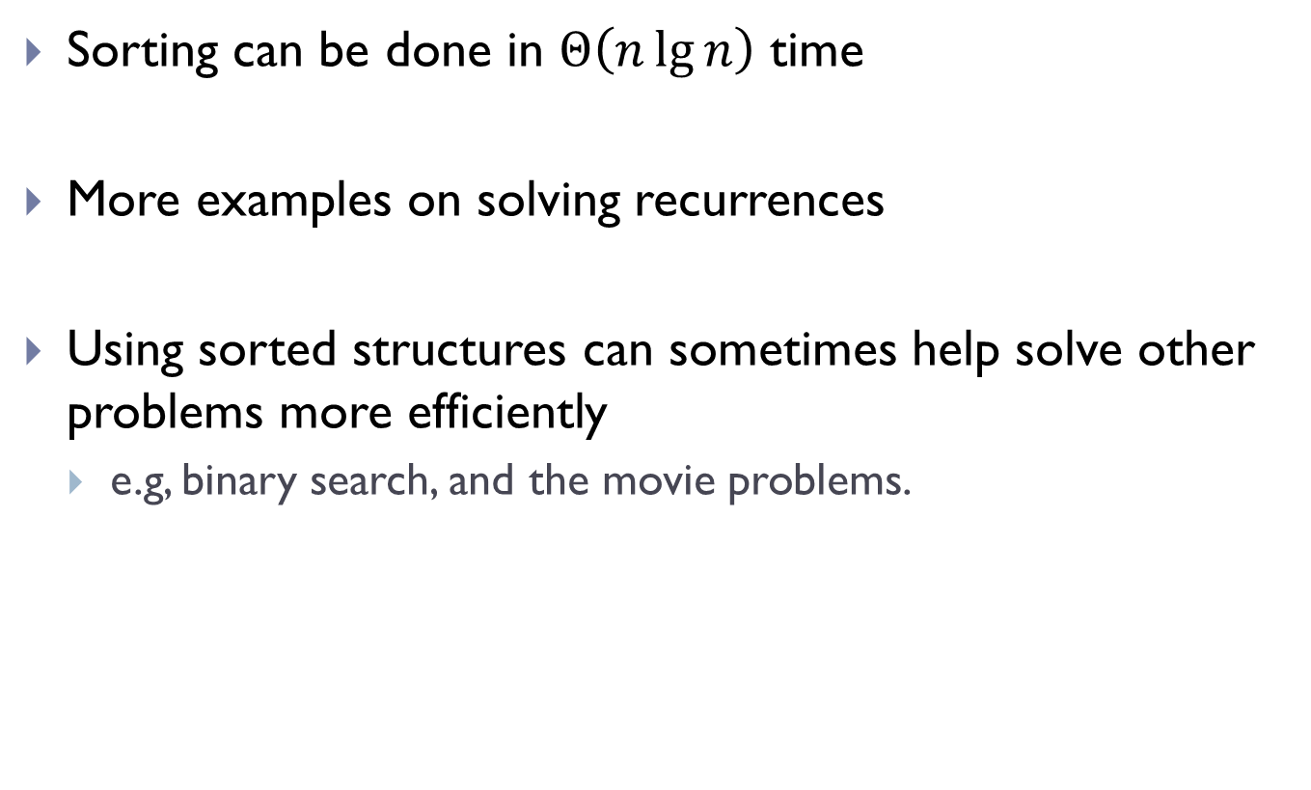
Take-home messages
Sorting can be done in $Θ\left(n\lg{n}\right)$ time
More examples on solving recurrences
Using sorted structures can sometimes help solve other problems more efficiently
  e.g, binary search, and the movie problems.

Slide 60
FIN

