Slide 1
DSC40B:
Theoretical Foundations of Data Science II
Lecture 10: Graphs: basics and representations
Instructor: Yusu Wang

Slide 2
Graphs: directed and undirected

Slide 3
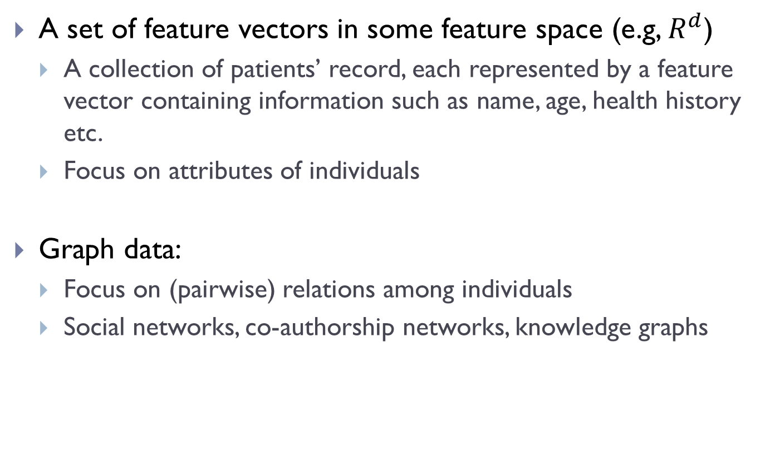
Common data types
A set of feature vectors in some feature space (e.g, $R^{d}$)
  A collection of patients’ record, each represented by a feature vector containing information such as name, age, health history etc.
  Focus on attributes of individuals
Graph data:
  Focus on (pairwise) relations among individuals
  Social networks, co-authorship networks, knowledge graphs

Slide 4
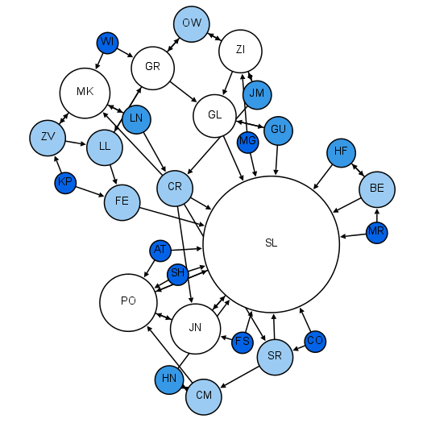
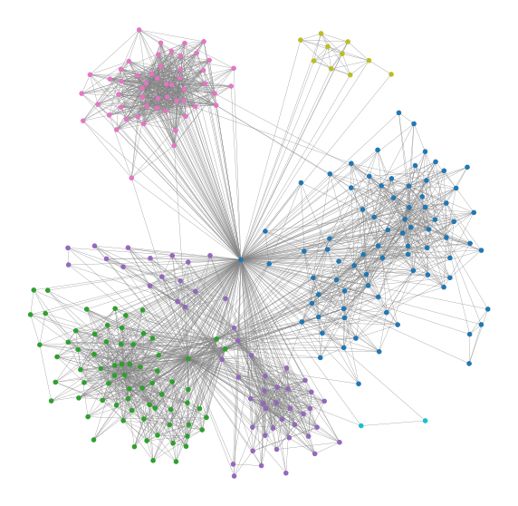
Examples
Social networks
Moreno's sociogram of a 2nd grade class
Facebook friendship social graph

Slide 5
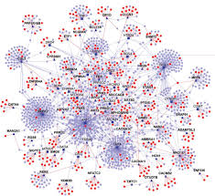
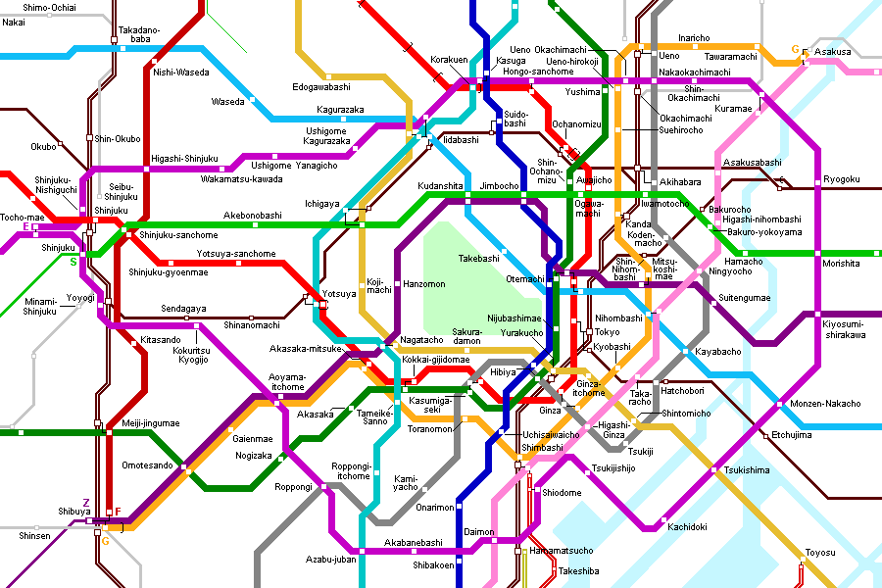
Examples
Biological networks
Road networks
Protein-protein interaction networks
Tokyo subway map

Slide 6
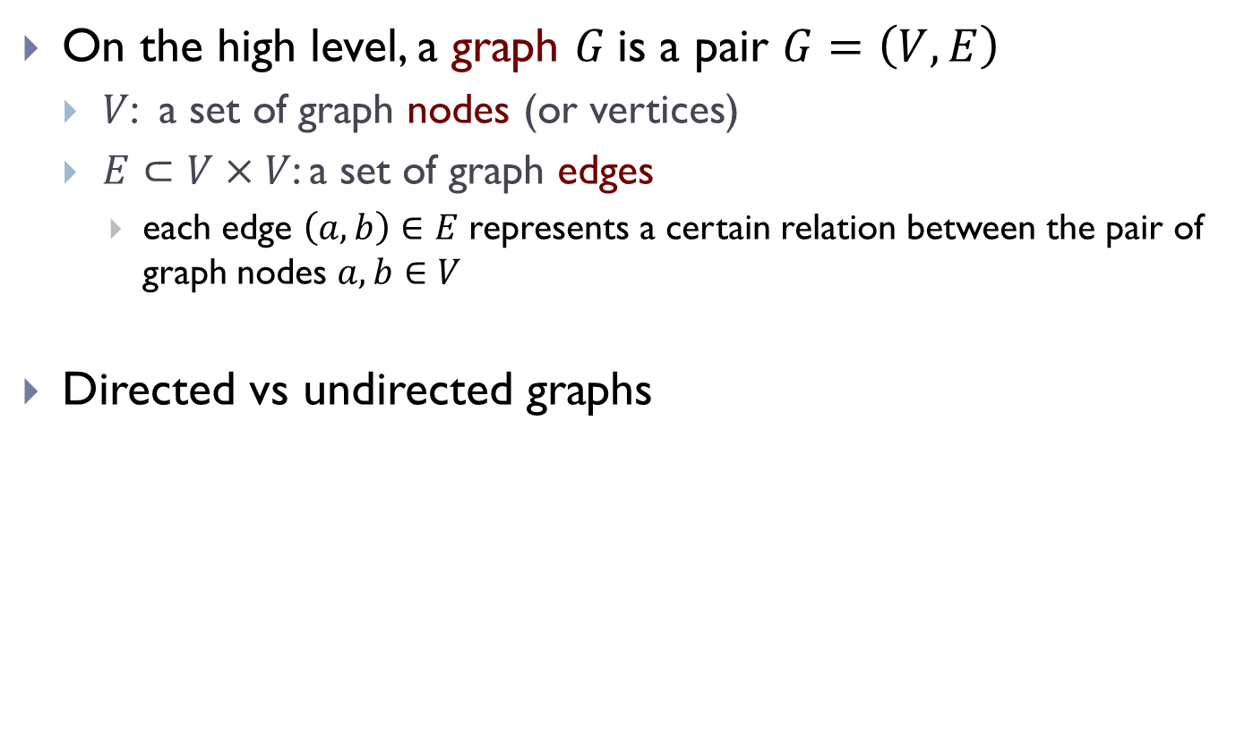
What is a graph?
On the high level, a graph $G$is a pair $G=\left(V, E\right)$
  $V$: a set of graph nodes (or vertices)
  $E⊂V×V$: a set of graph edges
    each edge $\left(a, b\right)∈E$ represents a certain relation between the pair of graph nodes $a, b∈V$
Directed vs undirected graphs

Slide 7
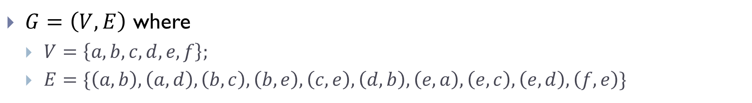
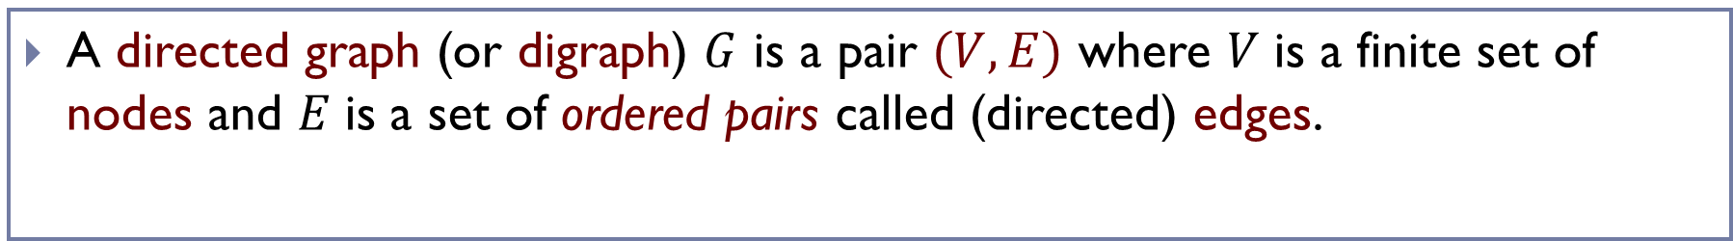
Directed graphs
A directed graph (or digraph) $G$ is a pair $(V, E)$ where 𝑉 is a finite set of nodes and 𝐸 is a set of ordered pairs called (directed) edges.
a
b
c
d
e
f
$G=\left(V, E\right)$ where
  $V=\left\{a, b, c, d, e, f\right\};$
  $E=\{\left(a,b\right), \left(a,d\right), \left(b, c\right),\left(b, e\right), \left(c,e\right),\left(d, b\right), \left(e,a\right), \left(e, c\right), \left(e, d\right), \left(f, e\right)\}$

Slide 8
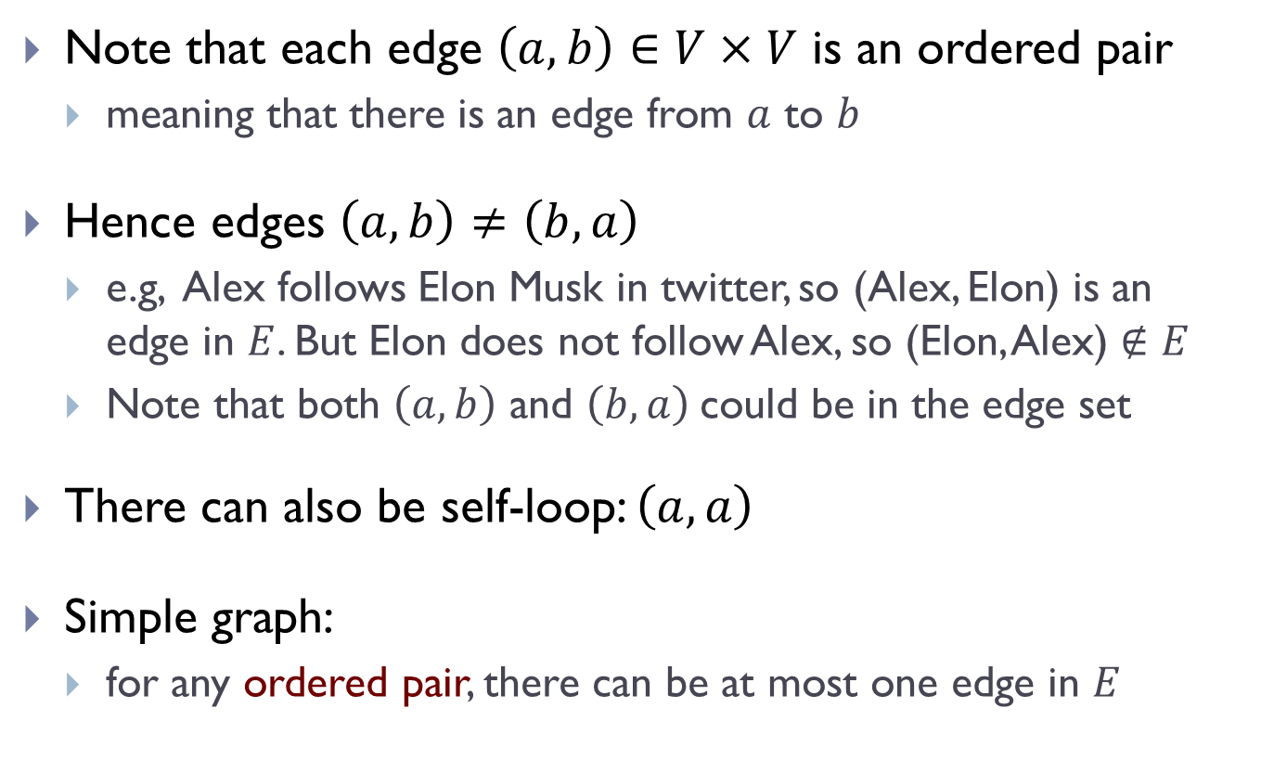
Remarks
Note that each edge $\left(a, b\right)∈V×V$ is an ordered pair
  meaning that there is an edge from $a$ to $b$
Hence edges $\left(a, b\right)≠\left(b, a\right)$
  e.g, Alex follows Elon Musk in twitter, so (Alex, Elon) is an edge in $E$. But Elon does not follow Alex, so (Elon, Alex) $∉E$
  Note that both $\left(a, b\right)$ and $\left(b, a\right)$could be in the edge set
There can also be self-loop: $\left(a, a\right)$
Simple graph:
  for any ordered pair, there can be at most one edge in $E$

Slide 9
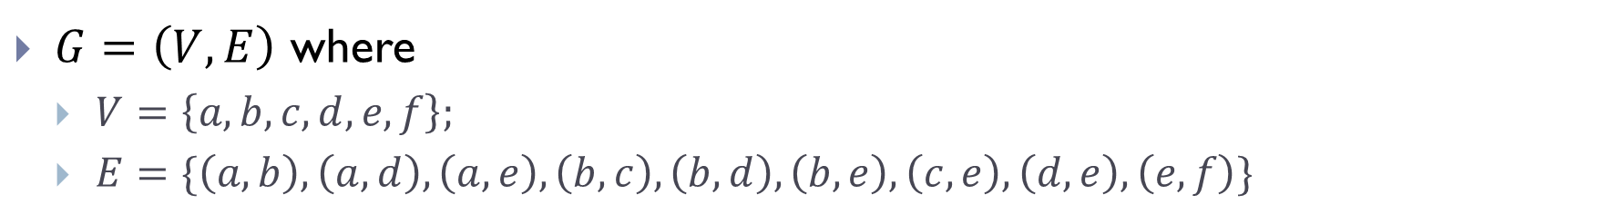
Directed graphs
A undirected graph $G$ is a pair $(V, E)$ where 𝑉 is a finite set of nodes and 𝐸 is a set of unordered pairs called edges.
a
b
c
d
e
f
$G=\left(V, E\right)$ where
  $V=\left\{a, b, c, d, e, f\right\};$
  $E=\{\left(a,b\right), \left(a,d\right), \left(a,e\right), \left(b, c\right), \left(b,d\right), \left(b, e\right),\left(c, e\right),\left(d, e\right), \left(e, f\right)\}$

Slide 10
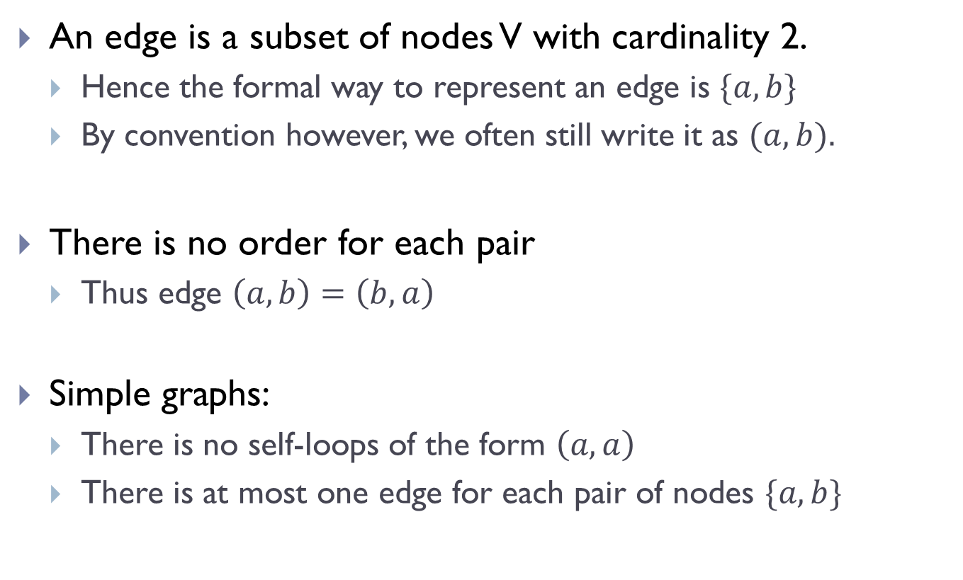
Remarks
An edge is a subset of nodes V with cardinality 2.
  Hence the formal way to represent an edge is $\{a, b\}$
  By convention however, we often still write it as $(a, b).$
There is no order for each pair
  Thus edge $\left(a, b\right)=\left(b, a\right)$
Simple graphs:
  There is no self-loops of the form $\left(a, a\right)$
  There is at most one edge for each pair of nodes $\{a, b\}$

Slide 11
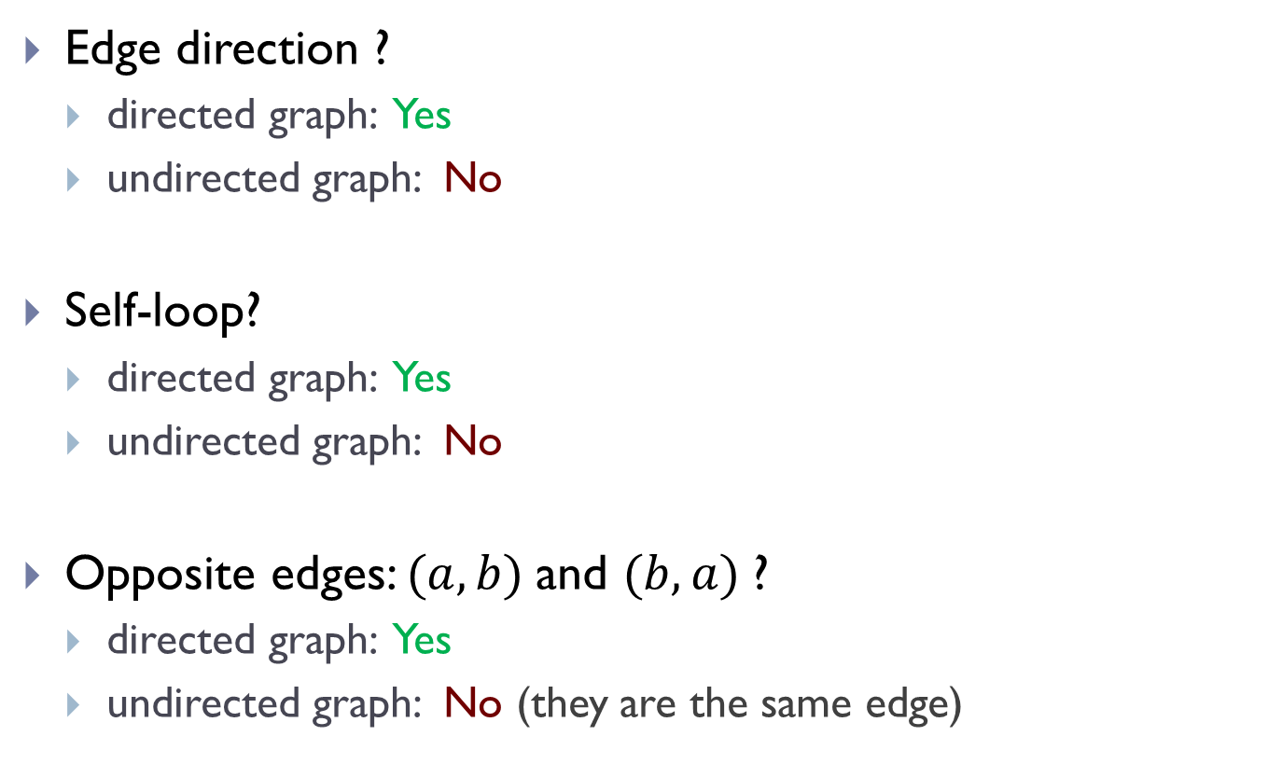
Summary
Edge direction ?
  directed graph: Yes
  undirected graph: No
Self-loop?
  directed graph: Yes
  undirected graph: No
Opposite edges: $(a, b)$and $(b, a)$?
  directed graph: Yes
  undirected graph: No (they are the same edge)

Slide 12
Graphs: More notations

Slide 13
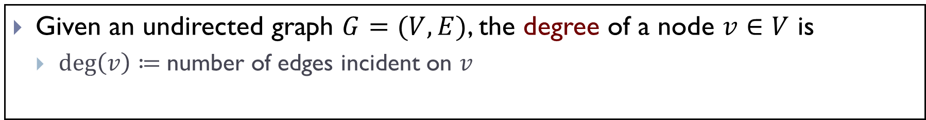
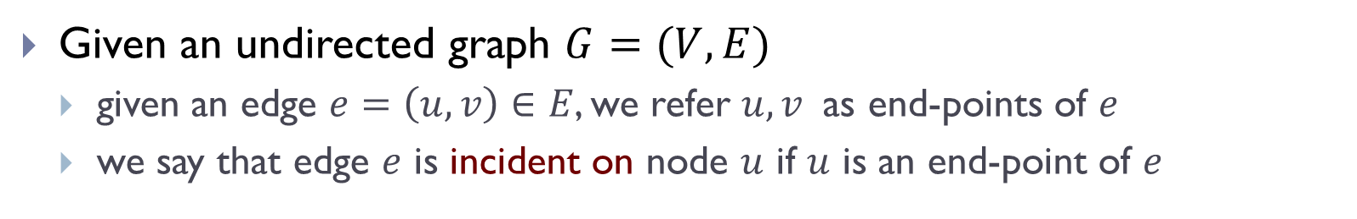
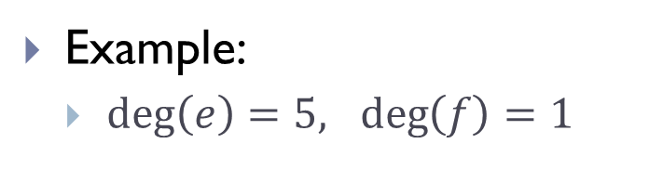
Node degree in undirected graph
Given an undirected graph $G=(V, E)$
  given an edge $e=\left(u, v\right)∈E$, we refer $u, v$as end-points of $e$
  we say that edge $e$ is incident on node $u$ if $u$ is an end-point of $e$
Given an undirected graph $G=(V, E)$, the degree of a node $v∈V$ is
  $\deg\left(v\right)≔$number of edges incident on $v$
a
b
c
Example:
  $\deg\left(e\right)=5, \deg\left(f\right)=1$
d
e
f

Slide 14
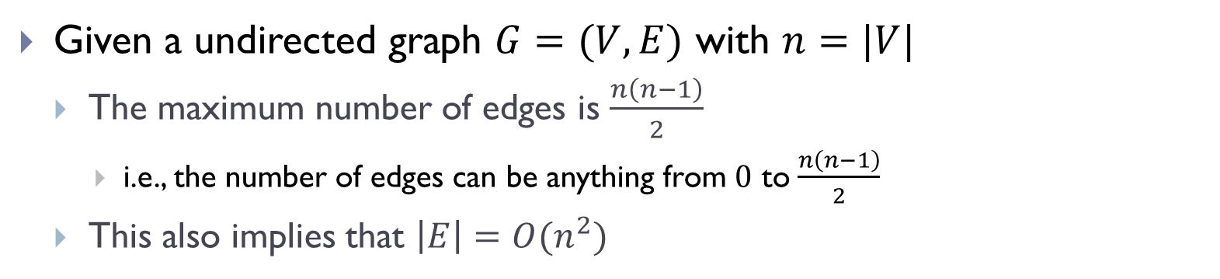
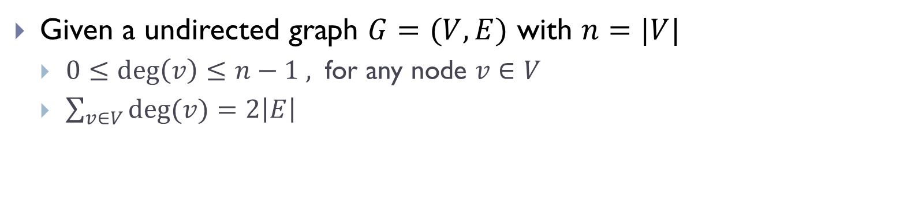
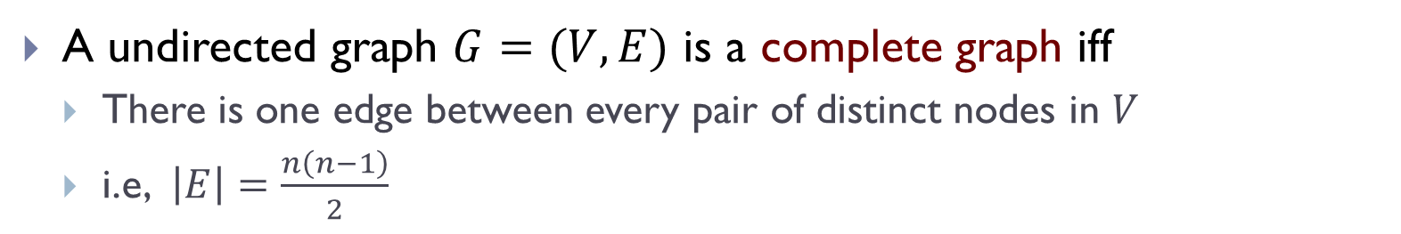
Observations
Given a undirected graph $G=(V, E)$ with $n=|V|$
  $0≤deg\left(v\right)≤n−1 ,$ for any node $v∈V$
  $\sum_{v∈V}{deg⁡(v)}=2\left|E\right|$
Given a undirected graph $G=(V, E)$ with $n=|V|$
  The maximum number of edges is $\frac{n\left(n−1\right)}{2}$
    i.e., the number of edges can be anything from $0$ to $\frac{n\left(n−1\right)}{2}$
  This also implies that $\left|E\right|=O(n^{2})$
A undirected graph $G=(V, E)$ is a complete graph iff
  There is one edge between every pair of distinct nodes in $V$
  i.e, $\left|E\right|=\frac{n\left(n−1\right)}{2}$

Slide 15
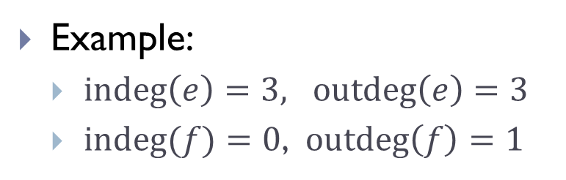
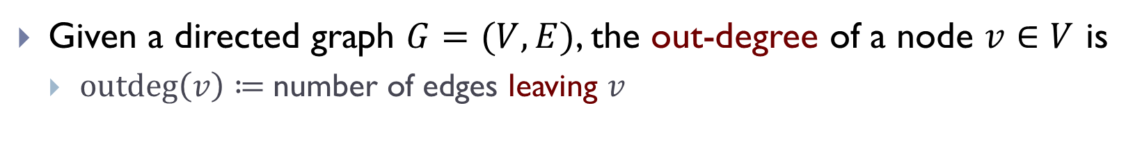
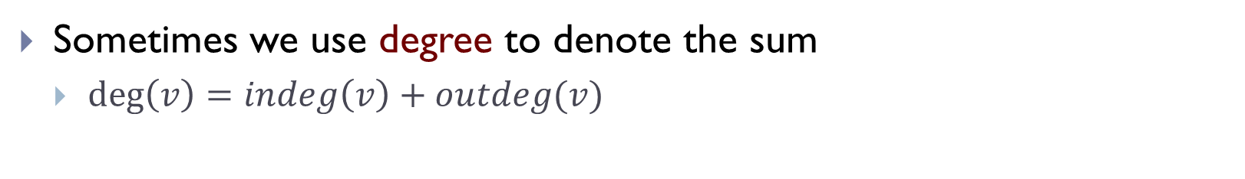
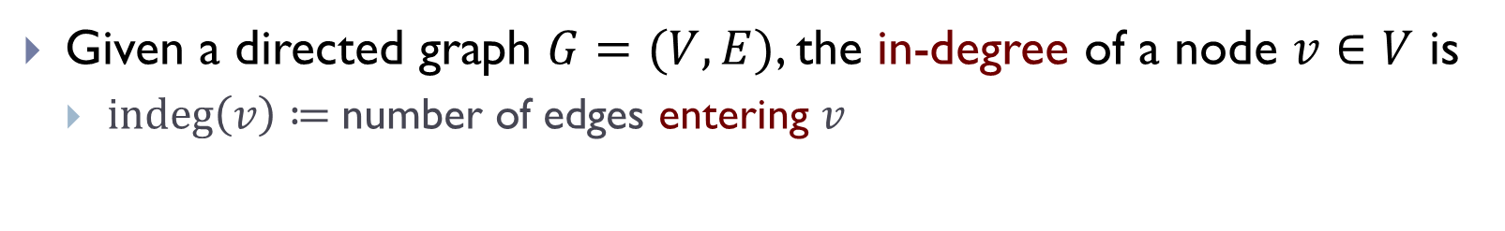
Node degree in directed graph
Given a directed graph $G=(V, E)$, the in-degree of a node $v∈V$ is
  $\operatorname{indeg}\left(v\right)≔$number of edges entering $v$
Given a directed graph $G=(V, E)$, the out-degree of a node $v∈V$ is
  $\operatorname{outdeg}\left(v\right)≔$number of edges leaving $v$
Sometimes we use degree to denote the sum
  $\deg\left(v\right)=indeg\left(v\right)+outdeg(v)$
a
b
c
Example:
  $\operatorname{indeg}\left(e\right)=3, \operatorname{outdeg}\left(e\right)=3$
  $\operatorname{indeg}{(f)}=0$, $\operatorname{outdeg}\left(f\right)=1$
d
e
f

Slide 16

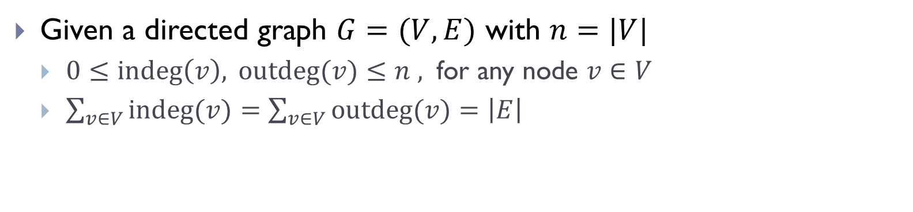
Observations
Given a directed graph $G=(V, E)$ with $n=|V|$
  $0≤indeg\left(v\right), outdeg(v)≤n ,$ for any node $v∈V$
  $\sum_{v∈V}{indeg⁡(v)}=\sum_{v∈V}{outdeg⁡(v)}=\left|E\right|$
Given a directed graph $G=(V, E)$ with $n=|V|$
  The maximum number of edges is $n^{2}$
  This also implies that $\left|E\right|=O(n^{2})$

Slide 17
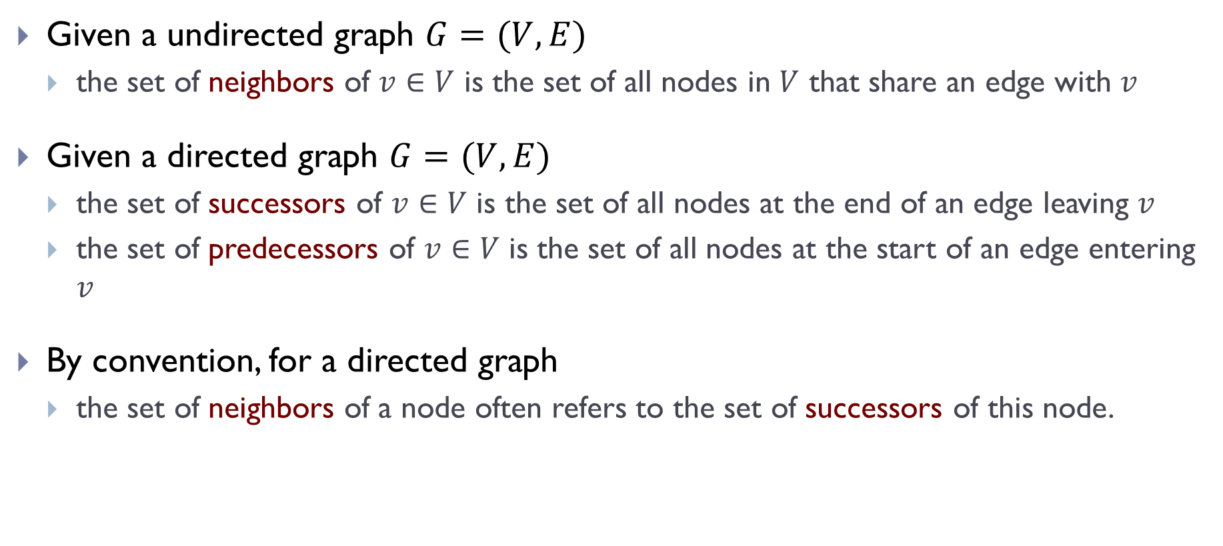
More notations
Given a undirected graph $G=(V,E)$
  the set of neighbors of $v∈V$ is the set of all nodes in $V$ that share an edge with $v$
Given a directed graph $G=(V,E)$
  the set of successors of $v∈V$ is the set of all nodes at the end of an edge leaving $v$
  the set of predecessors of $v∈V$ is the set of all nodes at the start of an edge entering $v$
By convention, for a directed graph
  the set of neighbors of a node often refers to the set of successors of this node.

Slide 18
Paths, reachability and connectivity

Slide 19
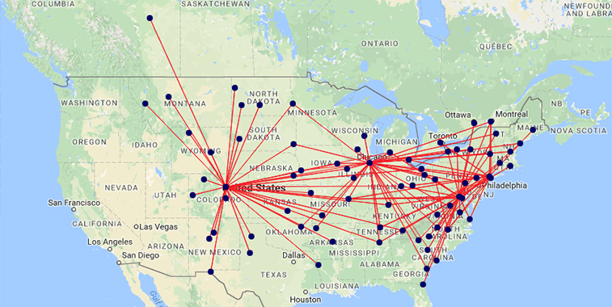
Example
Can we fly from Columbus, Ohio to Denver, Colorado?

Slide 20

Paths
A path from 𝑢 to $u′$ in a (directed or undirected) graph 𝐺 = (𝑉, 𝐸) is a sequence of one or more nodes $u=v_{0}, v_{1},…, v_{k}=u^{′}$ such that there is an edge between each consecutive pair of nodes in the sequence.
a
b
c
d
e
f

Slide 21

Paths
The length of a path = # of nodes $−1$ = # of edges in a path
  The length of a path could be $0$
A path is simple if it visits each node only once
  In this class, we usually consider only simple paths.
A cycle is a path where the first and last nodes are the same
a
b
c
d
e
f

Slide 22
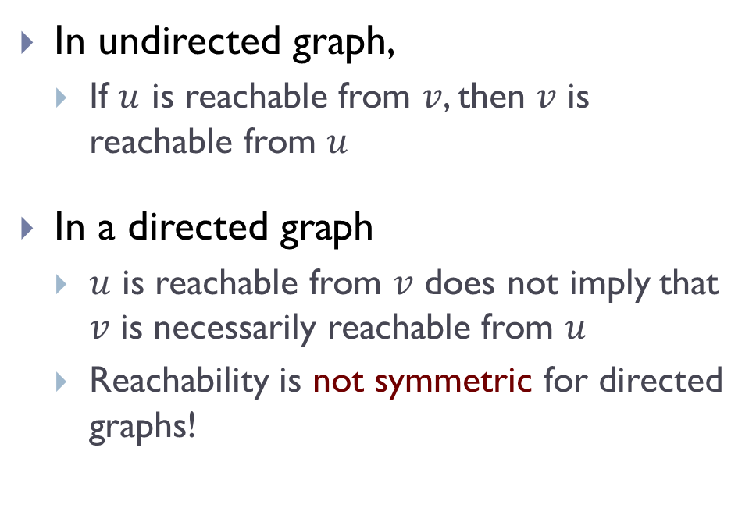


Reachability
Node $u$ is reachable from node $v$ if there is a path from $v$ to $u$
In undirected graph,
  If $u$ is reachable from $v$, then $v$ is reachable from $u$
In a directed graph
  $u$ is reachable from $v$ does not imply that $v$ is necessarily reachable from $u$
  Reachability is not symmetric for directed graphs!
a
b
c
$$G_{1}$$
d
e
f
a
b
c
$$G_{2}$$
d
e
f

Slide 23

Connectivity
This concept is for undirected graphs.
A undirected graph is connected if every node is reachable from every other node. Otherwise, it is disconnected.
A graph is disconnected means that there exists at least one pair of nodes $u$, $v$ such that $u$ is not reachable from $v$.

Slide 24
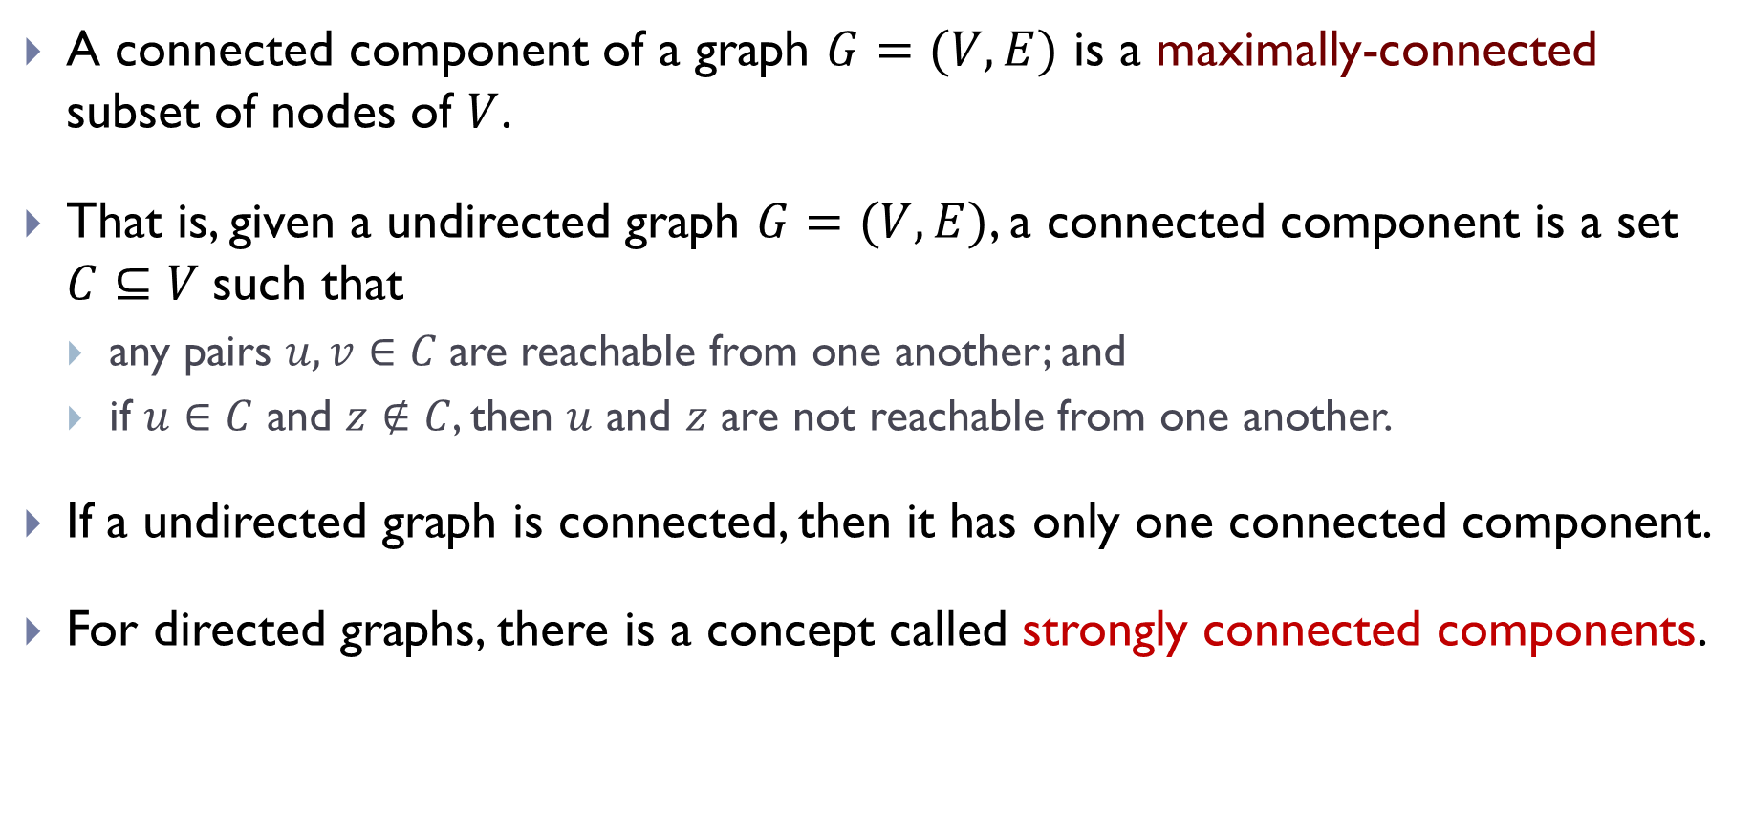
Connected components
A connected component of a graph $G=(V, E)$ is a maximally-connected subset of nodes of $V$.
That is, given a undirected graph $G=(V, E)$, a connected component is a set $C⊆V$such that
  any pairs $u, v∈C$are reachable from one another; and
  if $u∈C$ and $z∉C$, then $u$ and $z$ are not reachable from one another.
If a undirected graph is connected, then it has only one connected component.
For directed graphs, there is a concept called strongly connected components.

Slide 25
Representations of graphs

Slide 26
Representation of graphs
How do we represent a graph in the computer
  e.g, to be used as input to an algorithm
Three representations
  Adjacency matrix
  Adjacency list
  Dictionary set

Slide 27
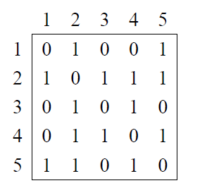
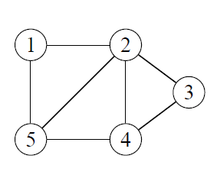
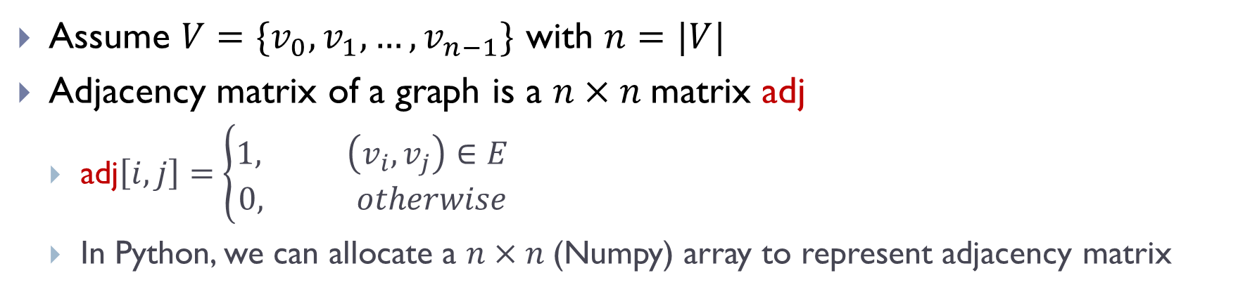
Adjacency matrix representation
Assume $V=\{v_{0},v_{1},…, v_{n−1}\}$ with $n=|V|$
Adjacency matrix of a graph is a $n×n$matrix adj
  $\text{adj}\left[i,j\right]=$ $\left\{\begin{aligned}1, \left(v_{i}, v_{j}\right)∈E \\ &0, otherwise\end{aligned}\right.$
  In Python, we can allocate a $n×n$(Numpy) array to represent adjacency matrix

Slide 28
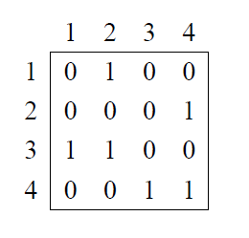
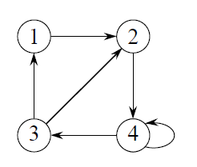
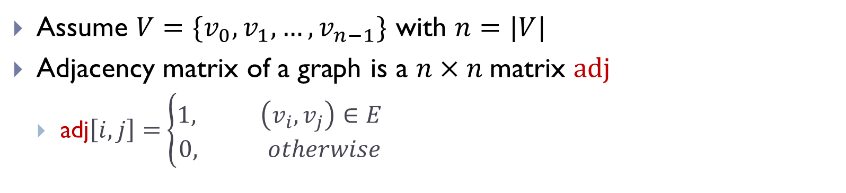
Adjacency matrix representation
Assume $V=\{v_{0},v_{1},…, v_{n−1}\}$ with $n=|V|$
Adjacency matrix of a graph is a $n×n$matrix $adj$
  adj$\left[i,j\right]=$ $\left\{\begin{aligned}1, \left(v_{i}, v_{j}\right)∈E \\ &0, otherwise\end{aligned}\right.$

Slide 29
Adjacency matrix representation
Assume $V=\{v_{0},v_{1},…, v_{n−1}\}$ with $n=|V|$
Adjacency matrix of a graph is a $n×n$matrix $adj$
  adj$\left[i,j\right]=$ $\left\{\begin{aligned}1, \left(v_{i}, v_{j}\right)∈E \\ &0, otherwise\end{aligned}\right.$
Observation:
If the graph is undirected, then this matrix is a symmetric matrix
If the graph is directed, then the adjacency matrix is not necessarily symmetric

Slide 30
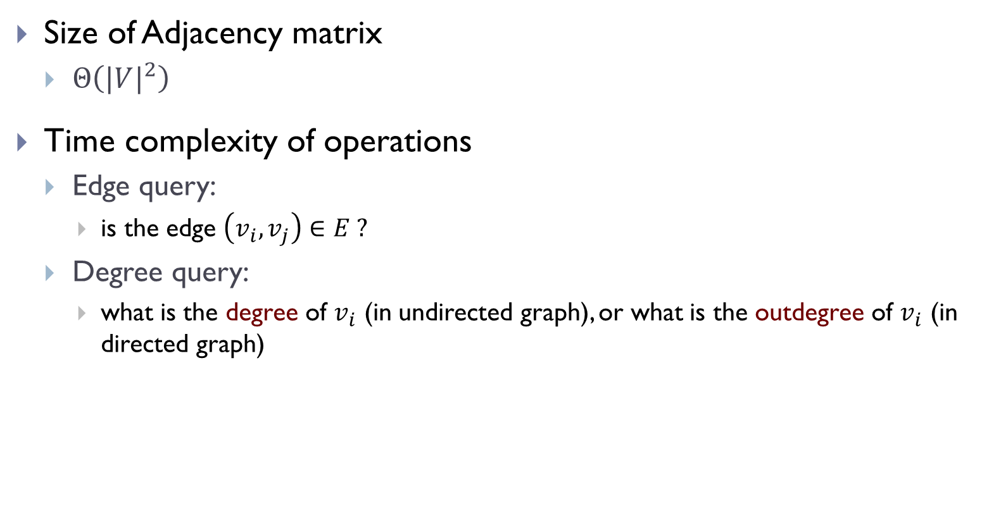
Complexity
Size of Adjacency matrix
  $Θ\left({|V|}^{2}\right)$
Time complexity of operations
  Edge query:
    is the edge $\left(v_{i}, v_{j}\right)∈E ?$
  Degree query:
    what is the degree of $v_{i}$ (in undirected graph), or what is the outdegree of $v_{i}$ (in directed graph)

Slide 31
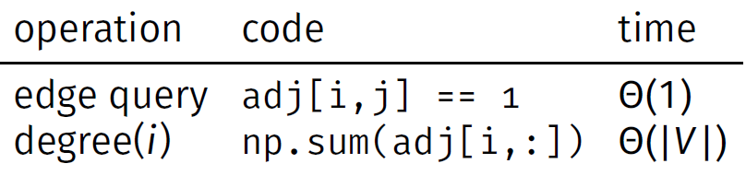
Complexity
Size of Adjacency matrix
  $Θ\left({|V|}^{2}\right)$
Time complexity of operations
  Edge query:
    is the edge $\left(v_{i}, v_{j}\right)∈E ?$
  Degree query:
    what is the degree of $v_{i}$ (in undirected graph), or what is the outdegree of $v_{i}$ (in directed graph)

Slide 32

Remarks
Pros:
  Support very efficient edge queries
  Simple and easy to use
    only need to allocate a $\left|V\right|×\left|V\right|$(Numpy) array
  Easy to manipulate via linear algebra
    e.g, (i,j)-th entry of $A^{2}$ gives number of hops of length 2 between $v_{i}$ and $v_{j}$

Slide 33
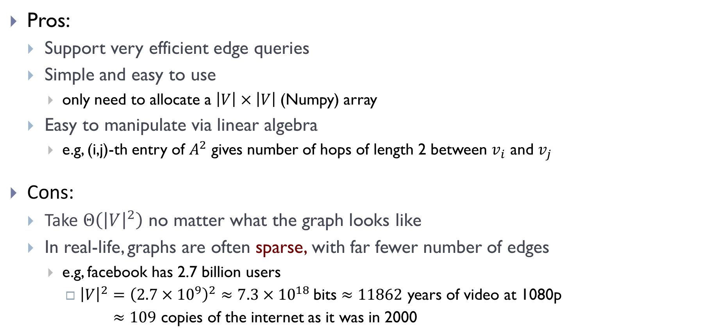
Remarks
Pros:
  Support very efficient edge queries
  Simple and easy to use
    only need to allocate a $\left|V\right|×\left|V\right|$(Numpy) array
  Easy to manipulate via linear algebra
    e.g, (i,j)-th entry of $A^{2}$ gives number of hops of length 2 between $v_{i}$ and $v_{j}$
Cons:
  Take $Θ\left({\left|V\right|}^{2}\right)$ no matter what the graph looks like
  In real-life, graphs are often sparse, with far fewer number of edges
    e.g, facebook has 2.7 billion users
      ${\left|V\right|}^{2}={\left(2.7×{10}^{9}\right)}^{2}≈7.3×{10}^{18}$bits $≈11862$ years of video at 1080p
      $≈109$ copies of the internet as it was in 2000

Slide 34
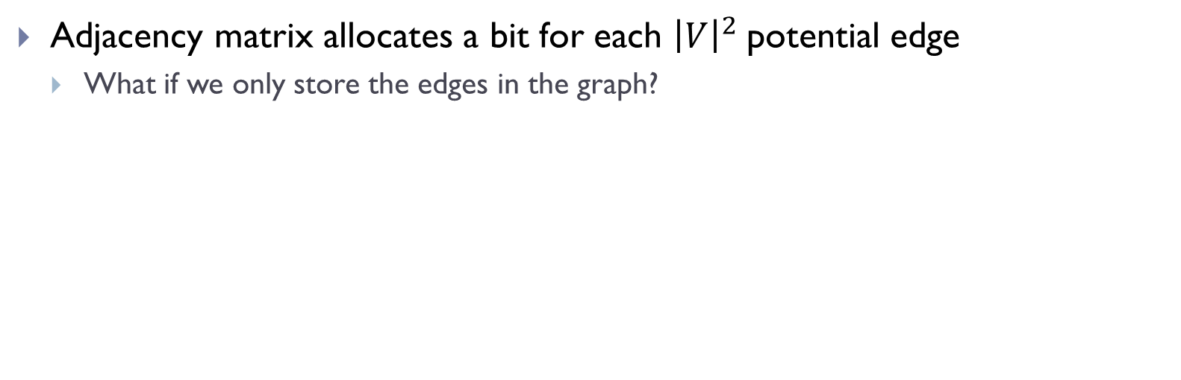
Adjacency list representation
Adjacency matrix allocates a bit for each ${\left|V\right|}^{2}$potential edge
  What if we only store the edges in the graph?

Slide 35
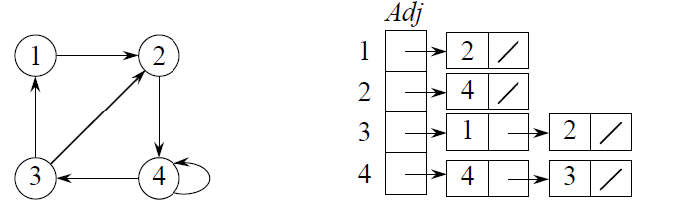
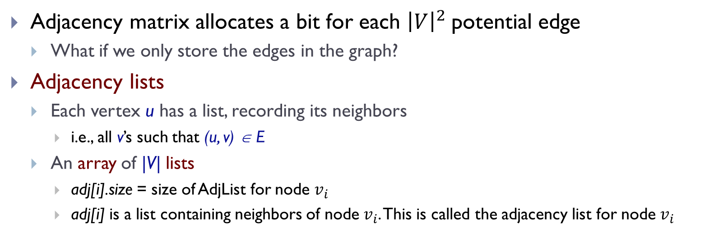
Adjacency list representation
Adjacency matrix allocates a bit for each ${\left|V\right|}^{2}$potential edge
  What if we only store the edges in the graph?
Adjacency lists
  Each vertex u has a list, recording its neighbors
    i.e., all v’s such that (u, v) ∈ E
  An array of |V| lists
    adj[i].size = size of AdjList for node $v_{i}$
    adj[i] is a list containing neighbors of node $v_{i}$. This is called the adjacency list for node $v_{i}$
adj

Slide 36
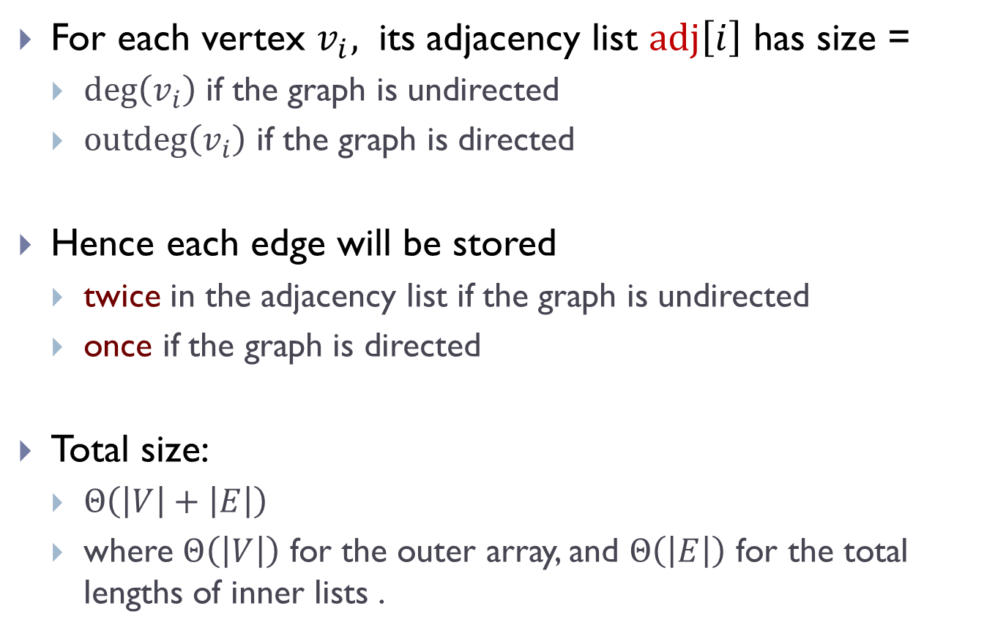
Size complexity
For each vertex $v_{i},$ its adjacency list $adj\left[i\right]$ has size =
  $\deg\left(v_{i}\right)$ if the graph is undirected
  $\operatorname{outdeg}\left(v_{i}\right)$ if the graph is directed
Hence each edge will be stored
  twice in the adjacency list if the graph is undirected
  once if the graph is directed
Total size:
  $Θ\left(\left|V\right|+\left|E\right|\right)$
  where $Θ\left(\left|V\right|\right)$ for the outer array, and $Θ\left(\left|E\right|\right)$ for the total lengths of inner lists .

Slide 37
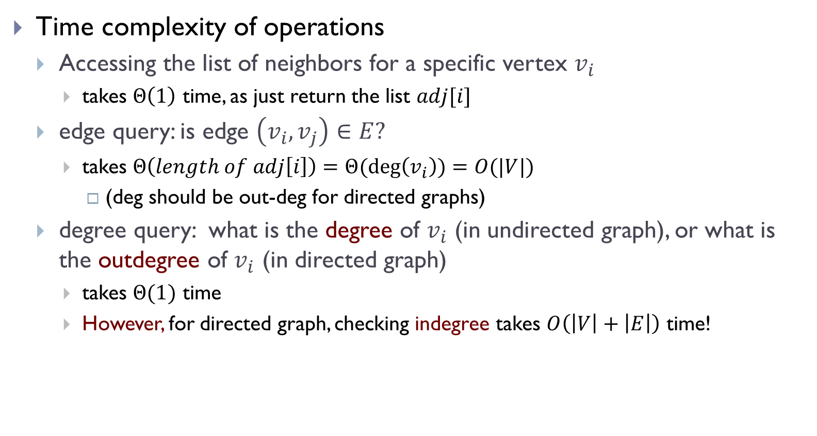
Time complexity
Time complexity of operations
  Accessing the list of neighbors for a specific vertex $v_{i}$
    takes $Θ\left(1\right)$ time, as just return the list $adj[i]$
  edge query: is edge $\left(v_{i}, v_{j}\right)∈E?$
    takes $Θ\left(length of adj\left[i\right]\right)=Θ(\deg\left(v_{i}\right))=O(|V|)$
      (deg should be out-deg for directed graphs)
  degree query: what is the degree of $v_{i}$ (in undirected graph), or what is the outdegree of $v_{i}$ (in directed graph)
    takes $Θ(1)$ time
    However, for directed graph, checking indegree takes $O\left(\left|V\right|+\left|E\right|\right)$ time!

Slide 38
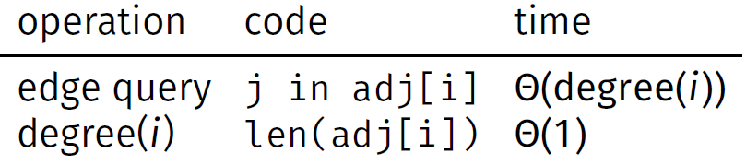
Summary of time complexity:
  Note: below “degree” refers to the “degree” of a node for an undirected graph, but “out-degree” of a node for a directed graph!

Slide 39
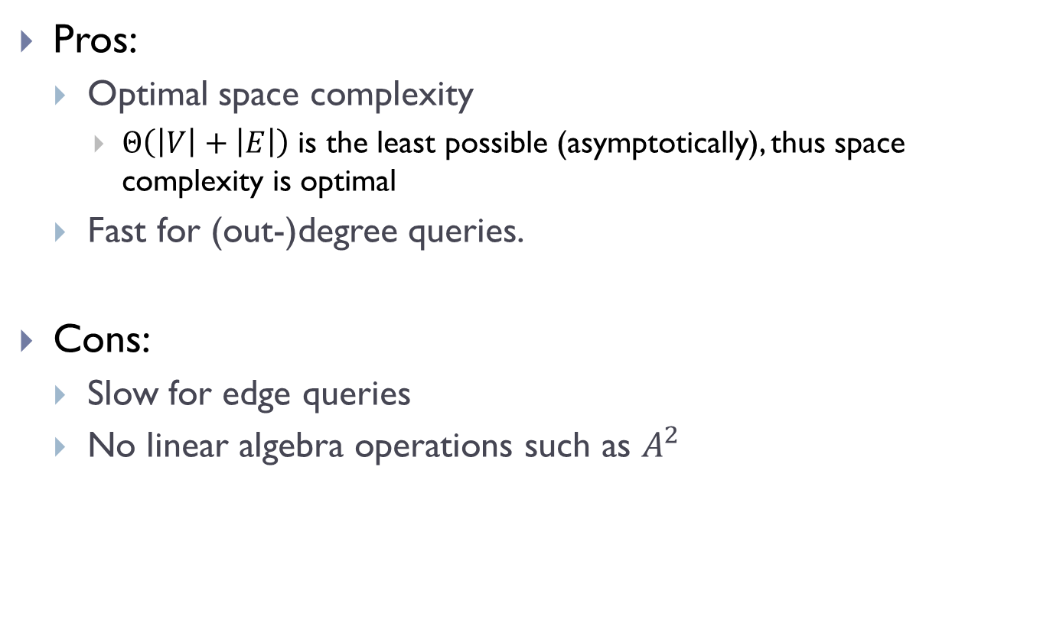
Remarks
Pros:
  Optimal space complexity
    $Θ\left(\left|V\right|+\left|E\right|\right)$ is the least possible (asymptotically), thus space complexity is optimal
  Fast for (out-)degree queries.
Cons:
  Slow for edge queries
  No linear algebra operations such as $A^{2}$

Slide 40
Adjacency matrix:
  Fast edge queries, potentially large space
Adjacency list:
  Slow edge queries, but efficient in space
Can we take the advantage of both?

Slide 41
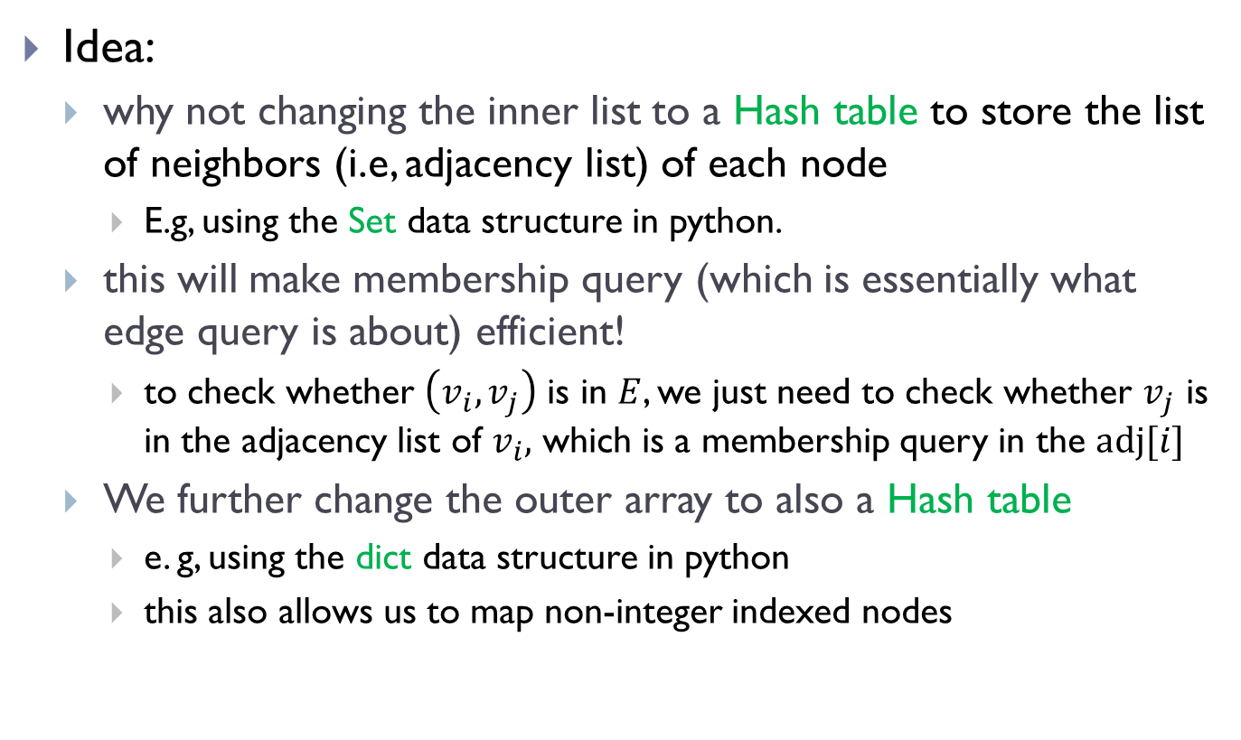
Dictionary-set representation
Idea:
  why not changing the inner list to a Hash table to store the list of neighbors (i.e, adjacency list) of each node
    E.g, using the Set data structure in python.
  this will make membership query (which is essentially what edge query is about) efficient!
    to check whether $\left(v_{i},v_{j}\right)$ is in $E$, we just need to check whether $v_{j}$ is in the adjacency list of $v_{i},$ which is a membership query in the $adj[i]$
  We further change the outer array to also a Hash table
    e. g, using the dict data structure in python
    this also allows us to map non-integer indexed nodes

Slide 42




Dictionary-of-set implementation
Dictionary-of-set implementation
  Using an outer hash table (dict) to represent all non-empty adjacency list for all nodes
  For each node with non-zero neighbors, using a hash table (set) to store all its neighbors
$${ v}_{0}$$
$${ v}_{1}$$
$${ v}_{2}$$
$${ v}_{3}$$

Slide 43
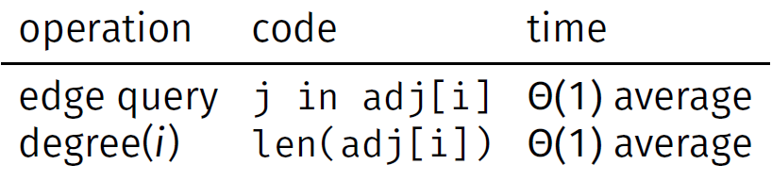
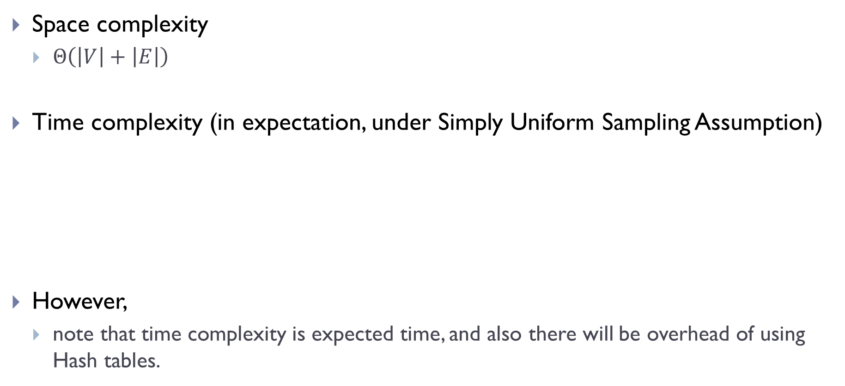
Complexity
Space complexity
  $Θ\left(\left|V\right|+\left|E\right|\right)$
Time complexity (in expectation, under Simply Uniform Sampling Assumption)
However,
  note that time complexity is expected time, and also there will be overhead of using Hash tables.

Slide 44
Dictionary-of-set implementation
Install with pip install dsc40graph
  Or you can also download it and put in the same directory of you code. See Docs below
Import with:
  import dsc40graph
Docs:
  https://eldridgejm.github.io/dsc40graph/
Source code:
  https://github.com/eldridgejm/dsc40graph
Will be used in HW coding problems
Notes:
The code is available in PyPI

Slide 45
FIN

