Slide 1
DSC40B:
Theoretical Foundations of Data Science II
Lecture 11: Breadth-first-search (BFS) in graphs: part I
Instructor: Yusu Wang

Slide 2
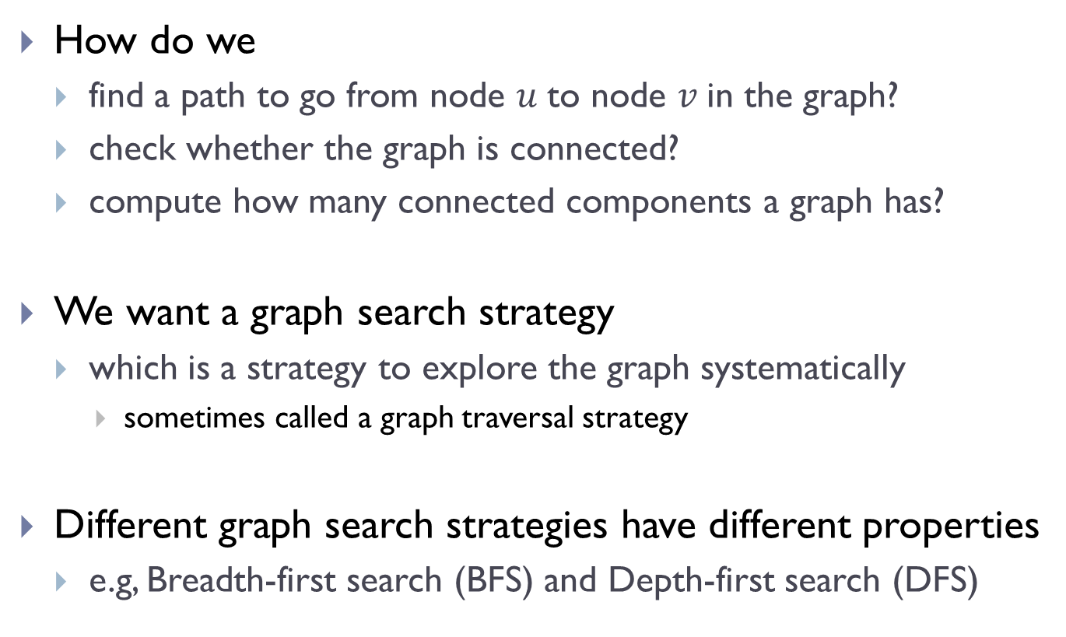
Graph search strategies
How do we
  find a path to go from node $u$to node $v$in the graph?
  check whether the graph is connected?
  compute how many connected components a graph has?
We want a graph search strategy
  which is a strategy to explore the graph systematically
    sometimes called a graph traversal strategy
Different graph search strategies have different properties
  e.g, Breadth-first search (BFS) and Depth-first search (DFS)

Slide 3
General high-level ideas
At any point during a search, each node is in exactly one of three states:
  undiscovered
  pending (discovered, but has not finished exploring it)
    we say that a node is ``discovered” when seeing it first time, at which point its status is changed from undiscovered to pending.
  visited (done with exploring all its neighbors)
At the beginning, all nodes are undiscovered
At every step,
  the search strategy will choose the next node to visit (explore) from the list of pending nodes
  if a node is “visited”, then all its neighbors should be in “pending” or “visited”

Slide 4
How do we decide which is the next node to visit?
  Breadth-first search (BFS):
    choose the ``oldest” pending node
    namely, the one was discovered earliest among all pending nodes
  Depth-first search (DFS):
    choose the “newest” pending node
    namely, the one that was discovered last among all pending nodes
Both BFS and DFS can explore the entire graph, but they have different properties making them useful in different scenarios.

Slide 5
Breadth-first search (BFS): the algorithm

Slide 6
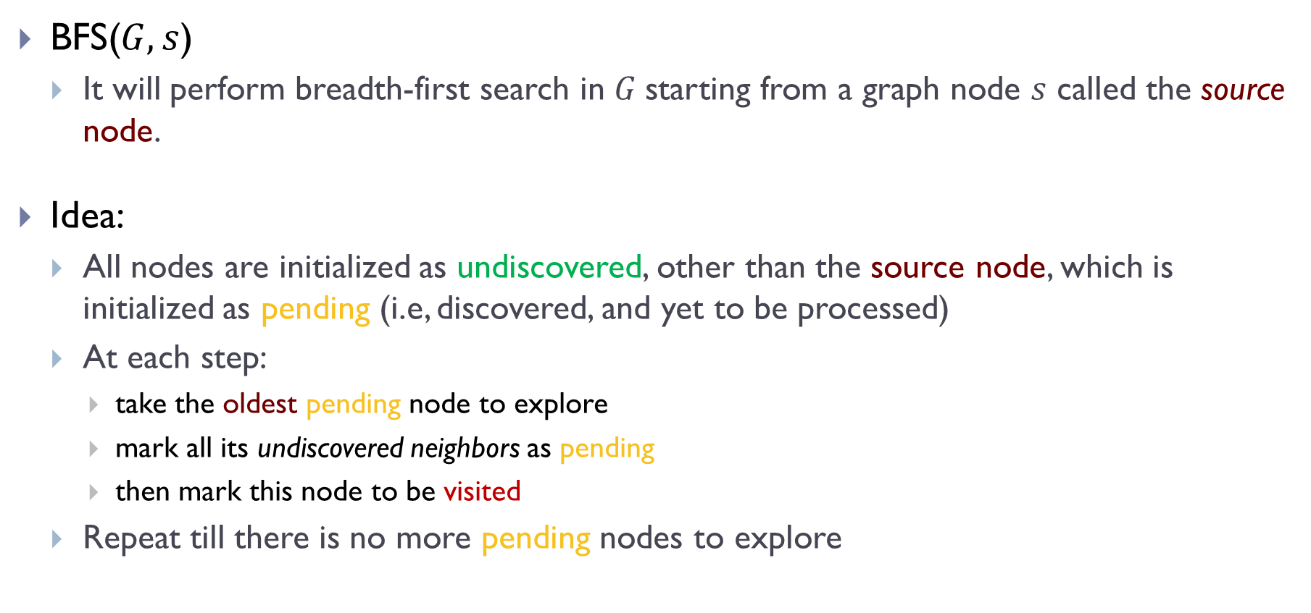
Breadth-first search
BFS($G, s$)
  It will perform breadth-first search in $G$starting from a graph node $s$ called the source node.
Idea:
  All nodes are initialized as undiscovered, other than the source node, which is initialized as pending (i.e, discovered, and yet to be processed)
  At each step:
    take the oldest pending node to explore
    mark all its undiscovered neighbors as pending
    then mark this node to be visited
  Repeat till there is no more pending nodes to explore

Slide 7
Breadth-first search
BFS($G, s$)
  It will perform breadth-first search in $G$starting from a graph node $s$ called the source node.
Idea:
  All nodes are initialized as undiscovered, other than the source node, which is initialized as pending (i.e, discovered, and yet to be processed)
  At each step:
    take the oldest pending node to explore
    mark all its undiscovered neighbors as pending
    then mark this node to be visited
  Repeat till there is no more pending nodes to explore
Convention:
In this class, neighbors are produced in sorted order. (In general, depending on your implementation, they don’t have to be.)

Slide 8








Example
$$f$$
$$b$$
$$a$$
$$e$$
$$d$$
$$g$$
$$c$$
$$h$$
undiscovered
pending
visited

Slide 9
How to implement the idea?
Recall: the key to BFS is at any moment, it will choose the oldest pending node to explore
Need to maintain pending nodes:
Need to maintain status:

Slide 10
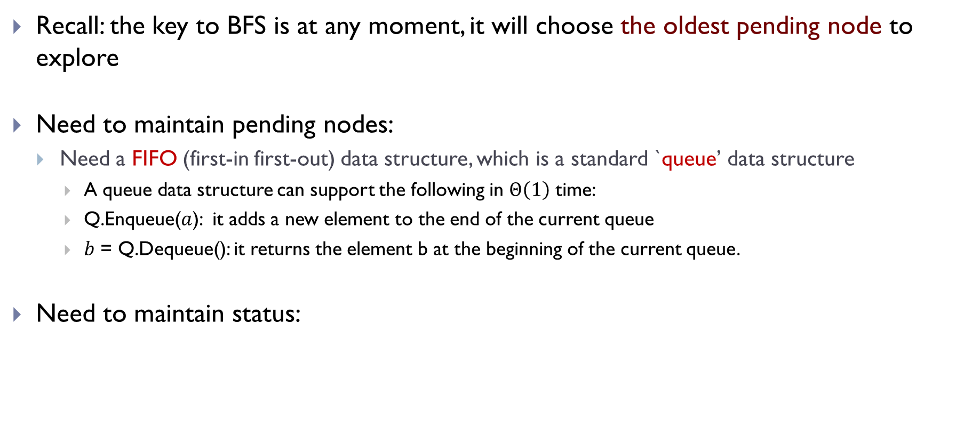
How to implement the idea?
Recall: the key to BFS is at any moment, it will choose the oldest pending node to explore
Need to maintain pending nodes:
  Need a FIFO (first-in first-out) data structure, which is a standard `queue’ data structure
    A queue data structure can support the following in $Θ\left(1\right)$ time:
    Q.Enqueue($a$): it adds a new element to the end of the current queue
    $b$ = Q.Dequeue(): it returns the element b at the beginning of the current queue.
Need to maintain status:

Slide 11
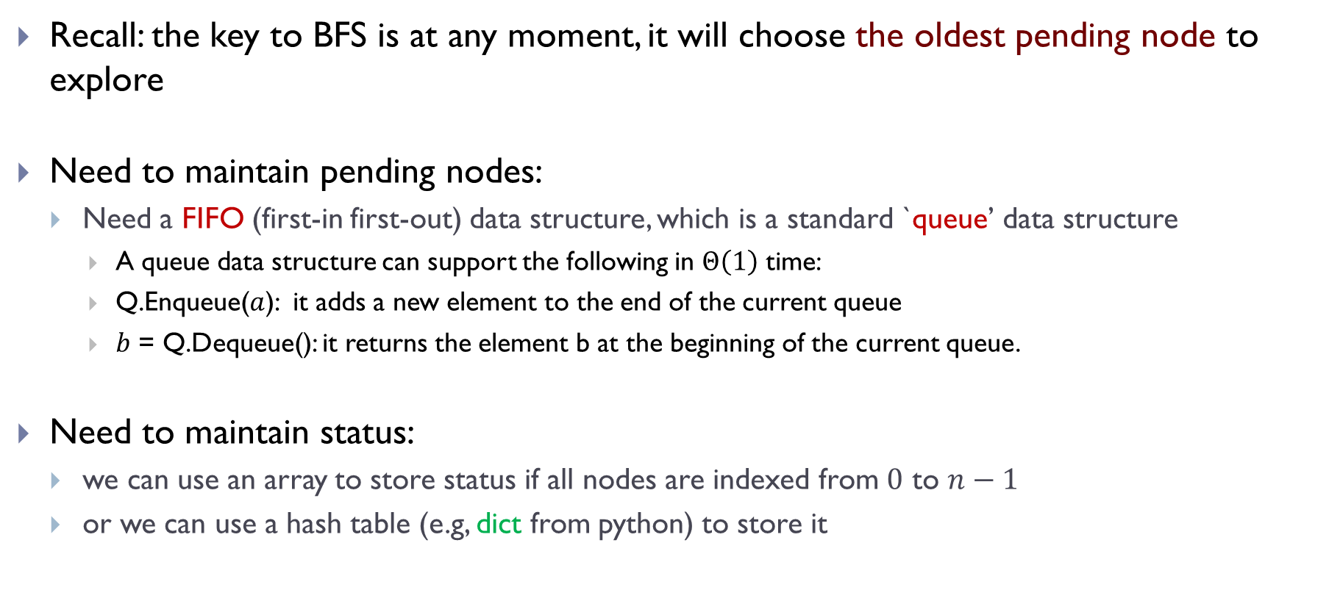
How to implement the idea?
Recall: the key to BFS is at any moment, it will choose the oldest pending node to explore
Need to maintain pending nodes:
  Need a FIFO (first-in first-out) data structure, which is a standard `queue’ data structure
    A queue data structure can support the following in $Θ\left(1\right)$ time:
    Q.Enqueue($a$): it adds a new element to the end of the current queue
    $b$ = Q.Dequeue(): it returns the element b at the beginning of the current queue.
Need to maintain status:
  we can use an array to store status if all nodes are indexed from $0$ to $n−1$
  or we can use a hash table (e.g, dict from python) to store it

Slide 12
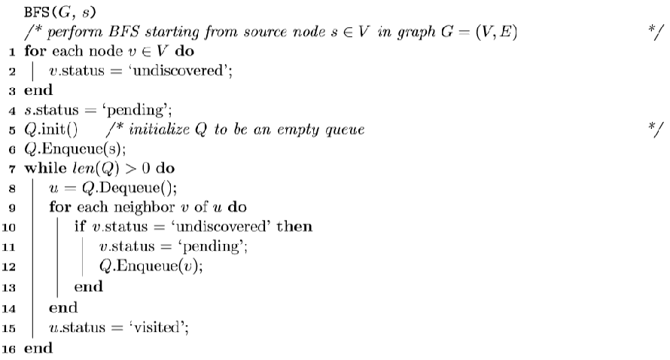
Pseudocode of BFS

Slide 13
Implementation of BFS in python
To get the standard `queue’ data structure
  In python, we need to use deque
    from collections import deque (“deck”).
    .popleft(), .pop(), .append()
    list doesn’t have right time complexity!
    import queue isn’t what you want!
To maintain `status’ of nodes
  we can use a hash table (e.g, dict from python) to store it

Slide 14
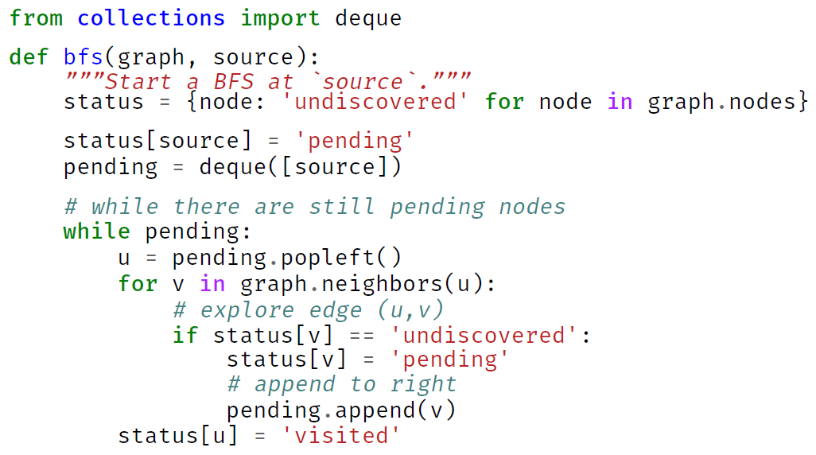
Python code for BFS

Slide 15
Python code for BFS
Conventions:
All nodes in graph.neighbors(u) are sorted in increasing (alphabetical) orders

Slide 16

Remarks
The same algorithm works for both undirected and directed graphs
Claim:
  BFS($G, s)$will visit exactly the set of nodes that are reachable from the source $s$ in the graph $G$
  Why?

Slide 17
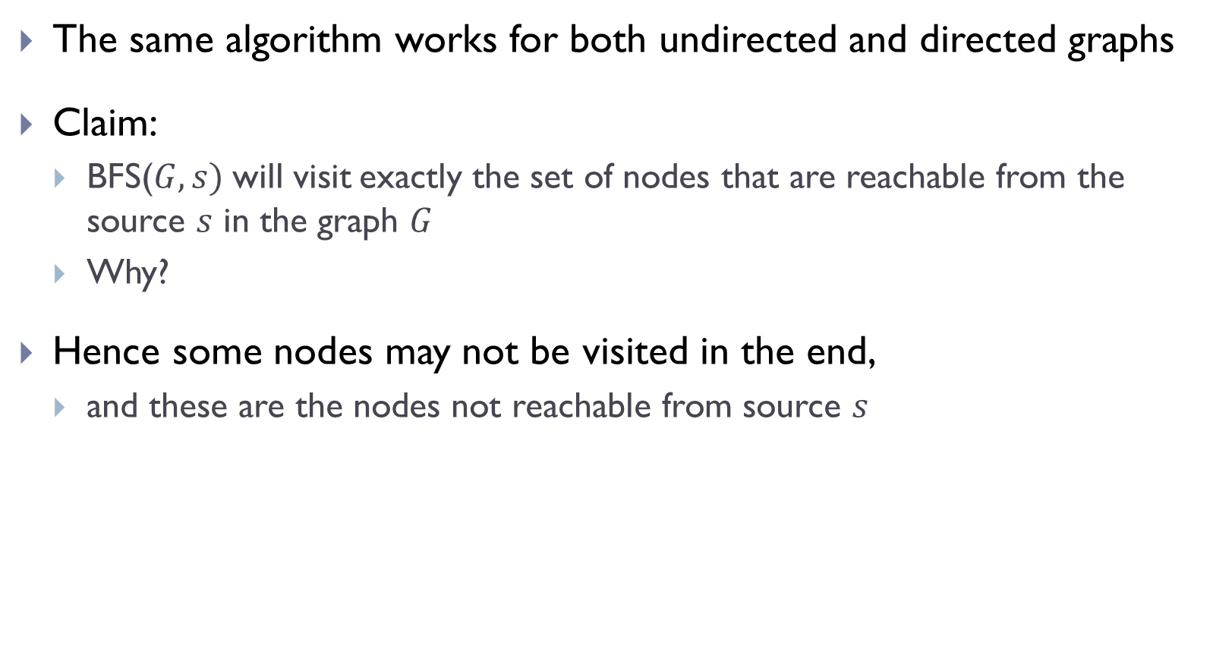
Remarks
The same algorithm works for both undirected and directed graphs
Claim:
  BFS($G, s)$will visit exactly the set of nodes that are reachable from the source $s$ in the graph $G$
  Why?
Hence some nodes may not be visited in the end,
  and these are the nodes not reachable from source $s$

Slide 18
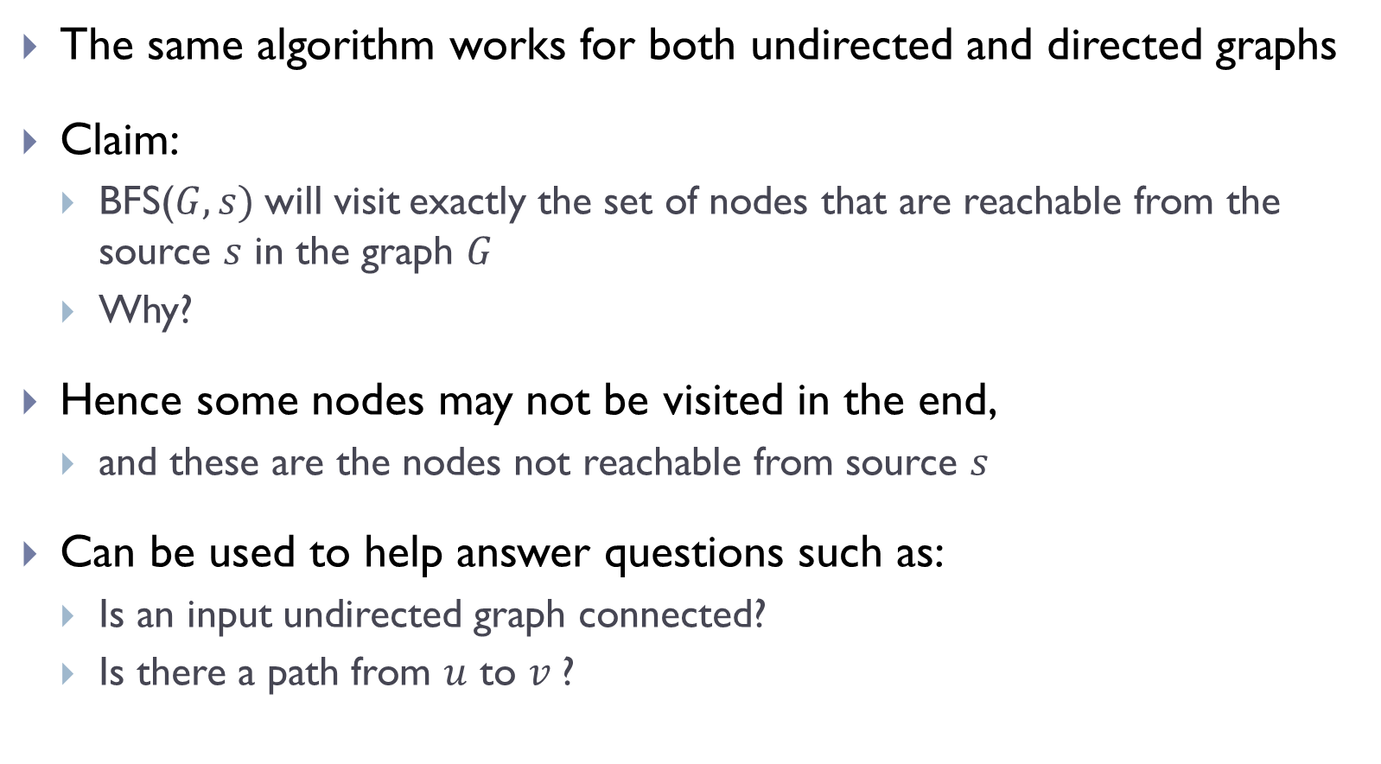
Remarks
The same algorithm works for both undirected and directed graphs
Claim:
  BFS($G, s)$will visit exactly the set of nodes that are reachable from the source $s$ in the graph $G$
  Why?
Hence some nodes may not be visited in the end,
  and these are the nodes not reachable from source $s$
Can be used to help answer questions such as:
  Is an input undirected graph connected?
  Is there a path from $u$ to $v$?

Slide 19
Full BFS and analysis

Slide 20

Note that BFS($G, s$) only visits nodes reachable from $s$
So if $G$ is disconnected, then it will not visit all nodes
How to explore all nodes?

Slide 21
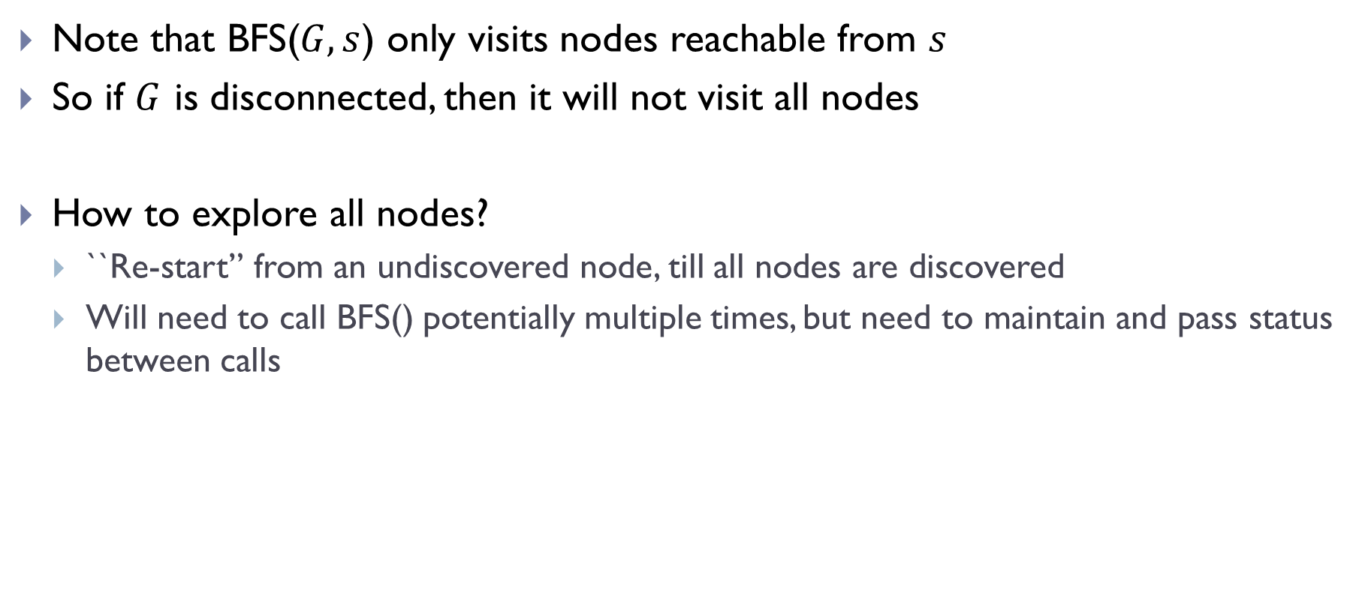
Note that BFS($G, s$) only visits nodes reachable from $s$
So if $G$ is disconnected, then it will not visit all nodes
How to explore all nodes?
  ``Re-start” from an undiscovered node, till all nodes are discovered
  Will need to call BFS() potentially multiple times, but need to maintain and pass status between calls

Slide 22
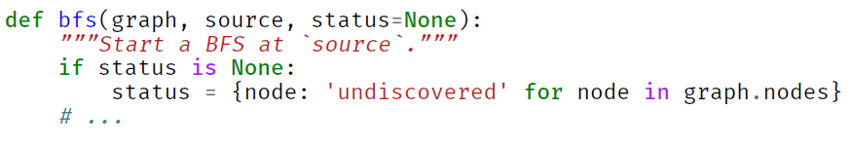
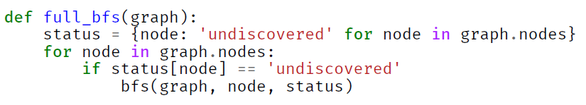
Full-BFS to visit all nodes
Modify BFS() to accept statuses as well:
Full-BFS() procedure to visit all nodes

Slide 23
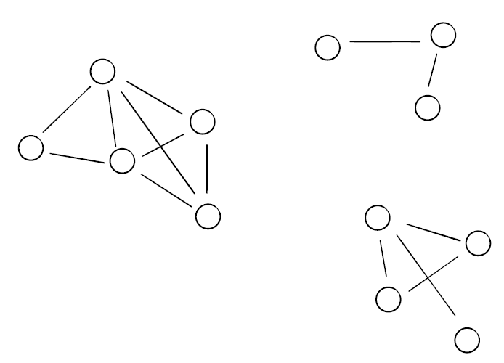












Example
$$6$$
$$7$$
$$0$$
$$11$$
$$2$$
$$8$$
$$1$$
$$4$$
$$3$$
$$9$$
$$5$$
$$10$$

Slide 24
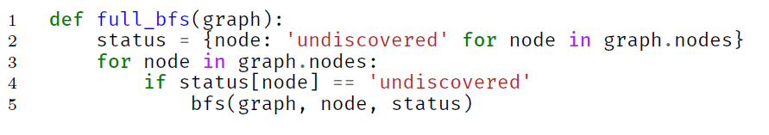
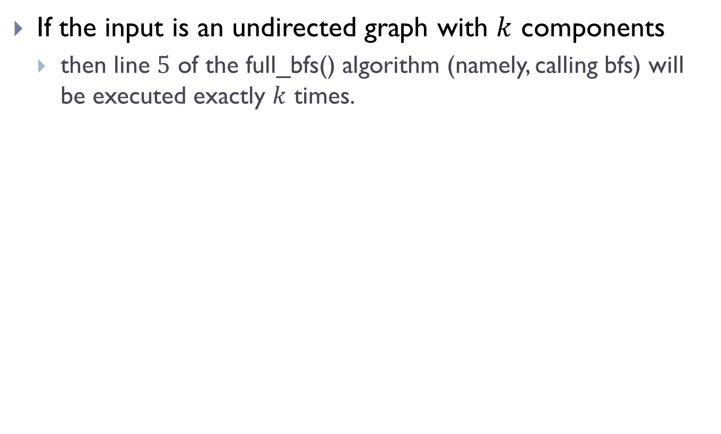
Observation
If the input is an undirected graph with $k$ components
  then line $5$ of the full_bfs() algorithm (namely, calling bfs) will be executed exactly $k$ times.

Slide 25
Time complexity analysis
Analyzing full-BFS is conceptually easier than BFS
  We can use a global argument to count the operations
Note that time complexity on full-BFS obviously will be upper-bound for the time complexity of BFS

Slide 26
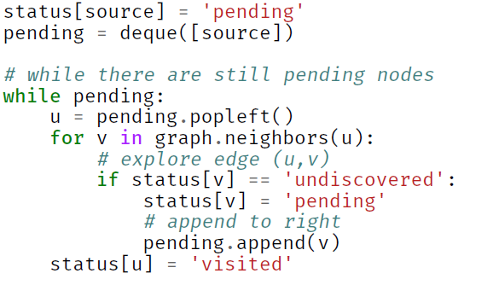
Overall algorithms

Slide 27
Time complexity for full-BFS
Each node can be added to the queue exactly once
Each edge will be explored exactly

Slide 28

Time complexity for full-BFS
Each node can be added to the queue exactly once
Each edge will be explored exactly
  twice if the input is a undirected graph
  once if the input is a directed graph
Initializing status takes $Θ(\left|V\right|)$ time at the beginning

Slide 29
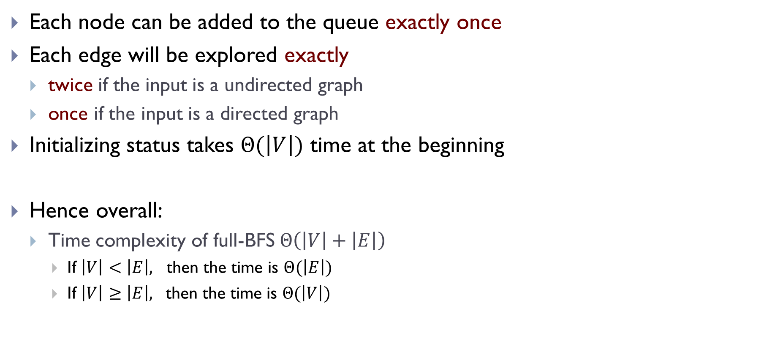
Time complexity for full-BFS
Each node can be added to the queue exactly once
Each edge will be explored exactly
  twice if the input is a undirected graph
  once if the input is a directed graph
Initializing status takes $Θ(\left|V\right|)$ time at the beginning
Hence overall:
  Time complexity of full-BFS $Θ\left(\left|V\right|+\left|E\right|\right)$
    If $\left|V\right|<\left|E\right|,$ then the time is $Θ(\left|E\right|)$
    If $\left|V\right|≥\left|E\right|,$ then the time is $Θ(\left|V\right|)$

Slide 30

As a graph traversal strategy (namely we want to have a way to systematically visit all nodes in the graph)
  The time complexity is optimal
  as $\left|V\right|+\left|E\right|$ is the size needed to even represent input graph.

Slide 31
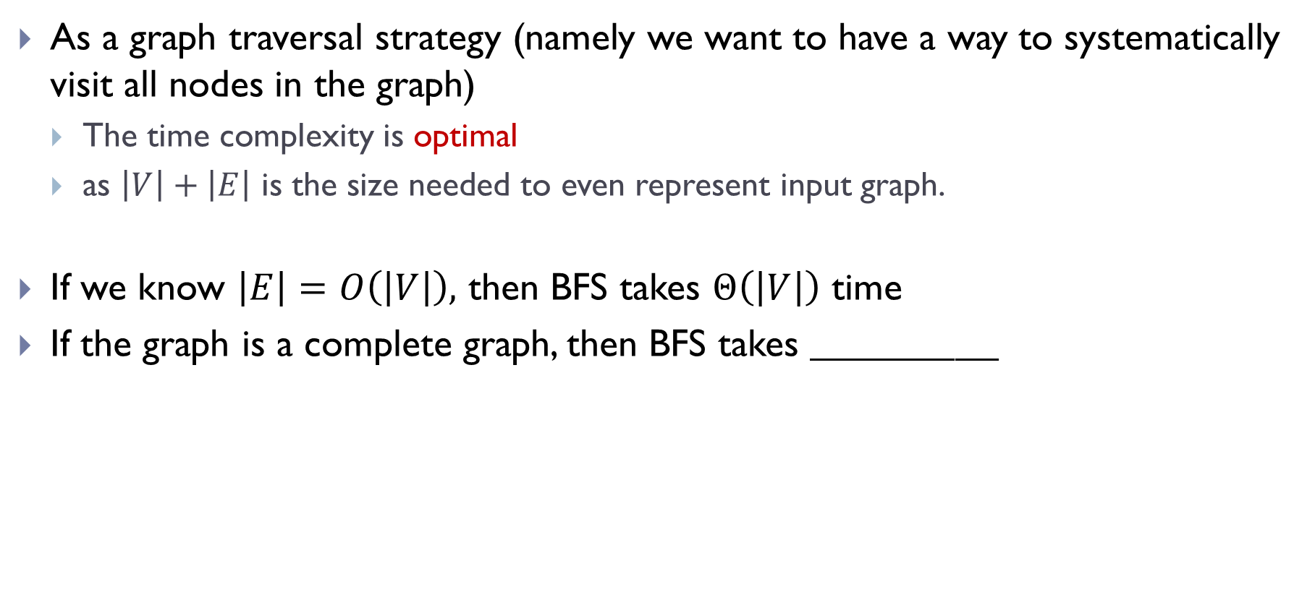
As a graph traversal strategy (namely we want to have a way to systematically visit all nodes in the graph)
  The time complexity is optimal
  as $\left|V\right|+\left|E\right|$ is the size needed to even represent input graph.
If we know $\left|E\right|=O\left(\left|V\right|\right),$ then BFS takes $Θ\left(\left|V\right|\right)$ time
If the graph is a complete graph, then BFS takes $_____________$

Slide 32
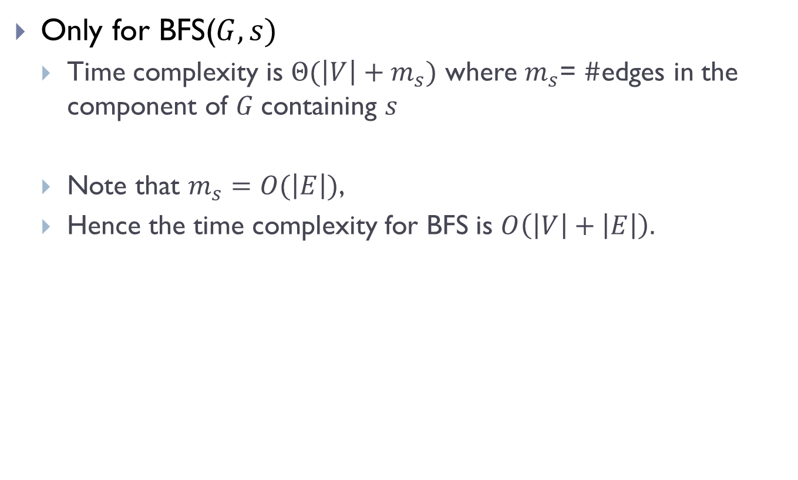
Time complexity for BFS
Only for BFS($G, s)$
  Time complexity is $Θ(\left|V\right|+m_{s})$ where $m_{s}$= $\#$edges in the component of $G$containing $s$
  Note that $m_{s}=O(\left|E\right|)$,
  Hence the time complexity for BFS is $O\left(\left|V\right|+\left|E\right|\right).$

Slide 33
FIN

