Slide 1
DSC40B:
Theoretical Foundations of Data Science II
Lecture 13: Depth-First Search (DFS)
Instructor: Yusu Wang

Slide 2
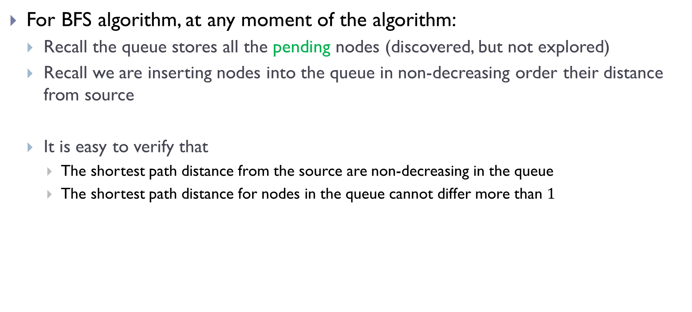
One more property about BFS
For BFS algorithm, at any moment of the algorithm:
  Recall the queue stores all the pending nodes (discovered, but not explored)
  Recall we are inserting nodes into the queue in non-decreasing order their distance from source
  It is easy to verify that
    The shortest path distance from the source are non-decreasing in the queue
    The shortest path distance for nodes in the queue cannot differ more than $1$

Slide 3
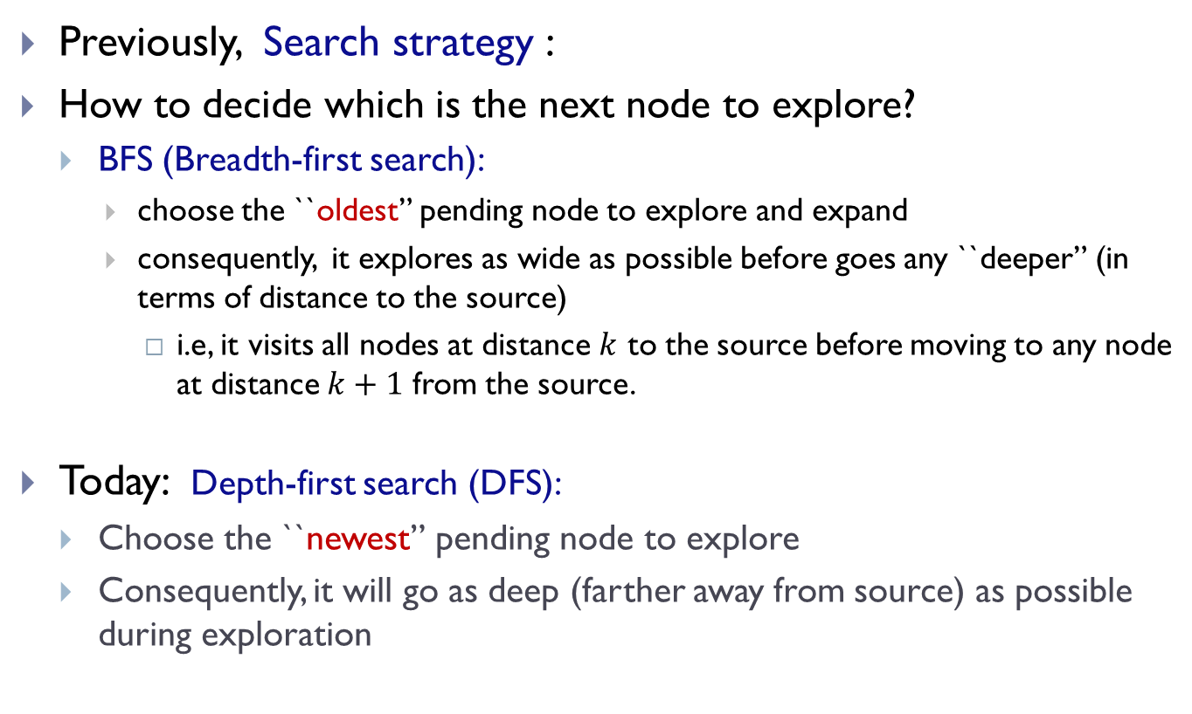
Prelude
Previously, Search strategy :
How to decide which is the next node to explore?
  BFS (Breadth-first search):
    choose the ``oldest” pending node to explore and expand
    consequently, it explores as wide as possible before goes any ``deeper” (in terms of distance to the source)
      i.e, it visits all nodes at distance $k$ to the source before moving to any node at distance $k+1$ from the source.
Today: Depth-first search (DFS):
  Choose the ``newest” pending node to explore
  Consequently, it will go as deep (farther away from source) as possible during exploration

Slide 4
DFS algorithm and time complexity

Slide 5
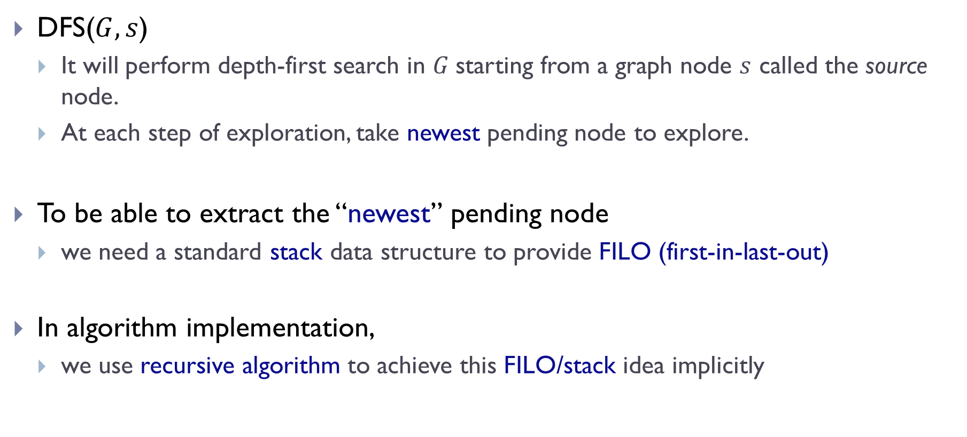
Depth-first Search (DFS)
DFS($G, s$)
  It will perform depth-first search in $G$starting from a graph node $s$ called the source node.
  At each step of exploration, take newest pending node to explore.
To be able to extract the “newest” pending node
  we need a standard stack data structure to provide FILO (first-in-last-out)
In algorithm implementation,
  we use recursive algorithm to achieve this FILO/stack idea implicitly

Slide 6
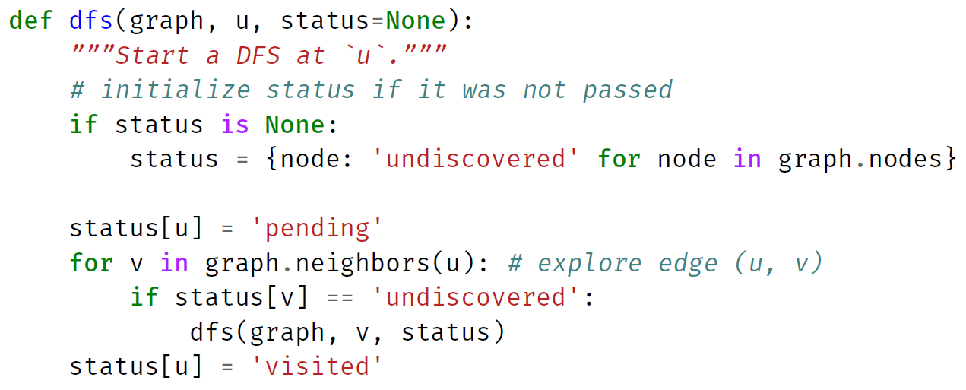
Implementation in Python

Slide 7
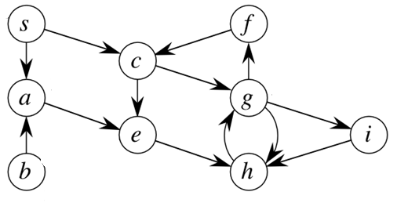
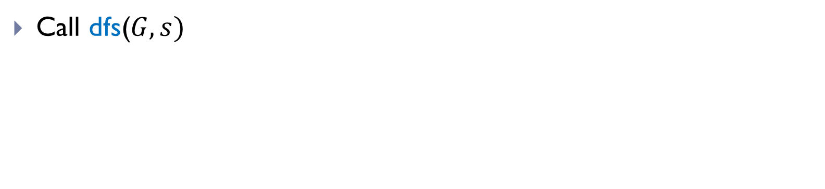

Example
$G$:
Call dfs($G, s)$

Slide 8
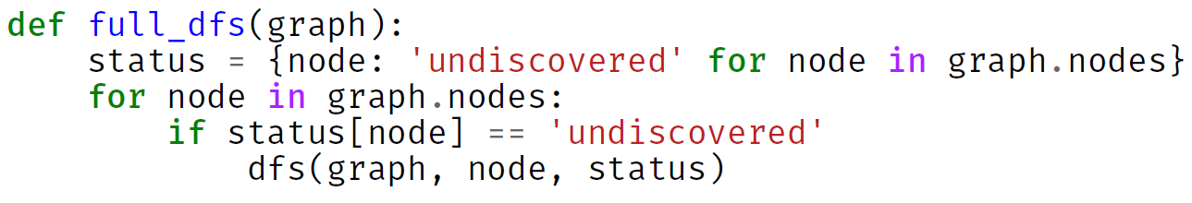
Full DFS
DFS will visit all nodes reachable from the source node
  If the input graph is connected, then it will visit all nodes in the same connected component as the source
To visit all nodes in a graph
  Needs full-DFS
    which requires we restart from undiscovered nodes.

Slide 9
Complete code

Slide 10
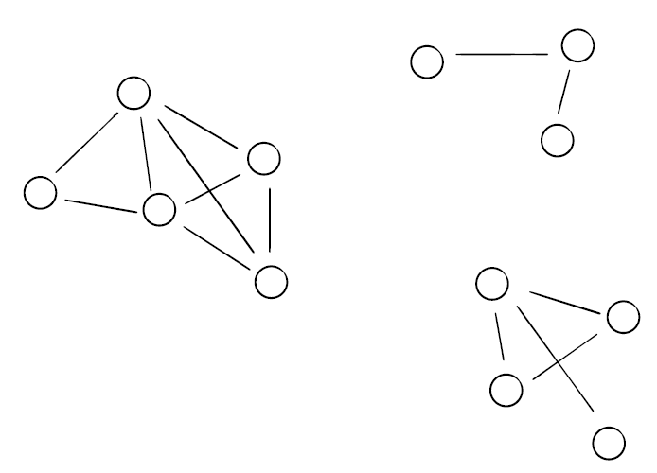












Example
$$6$$
$$7$$
$$0$$
$$11$$
$$2$$
$$8$$
$$1$$
$$4$$
$$3$$
$$9$$
$$5$$
$$10$$

Slide 11
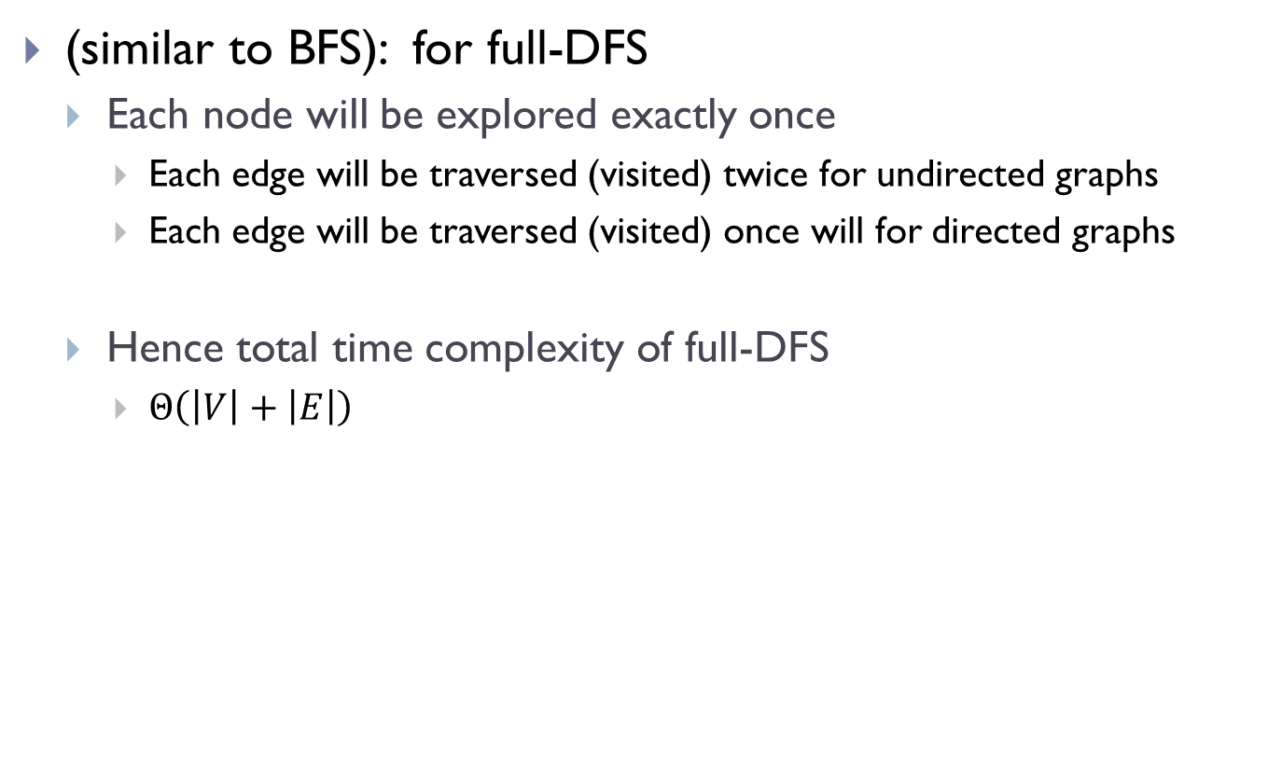
Time complexity analysis
(similar to BFS): for full-DFS
  Each node will be explored exactly once
    Each edge will be traversed (visited) twice for undirected graphs
    Each edge will be traversed (visited) once will for directed graphs
  Hence total time complexity of full-DFS
    $Θ\left(\left|V\right|+\left|E\right|\right)$

Slide 12
DFS Tree, start and finish times

Slide 13
full_DFS

Slide 14
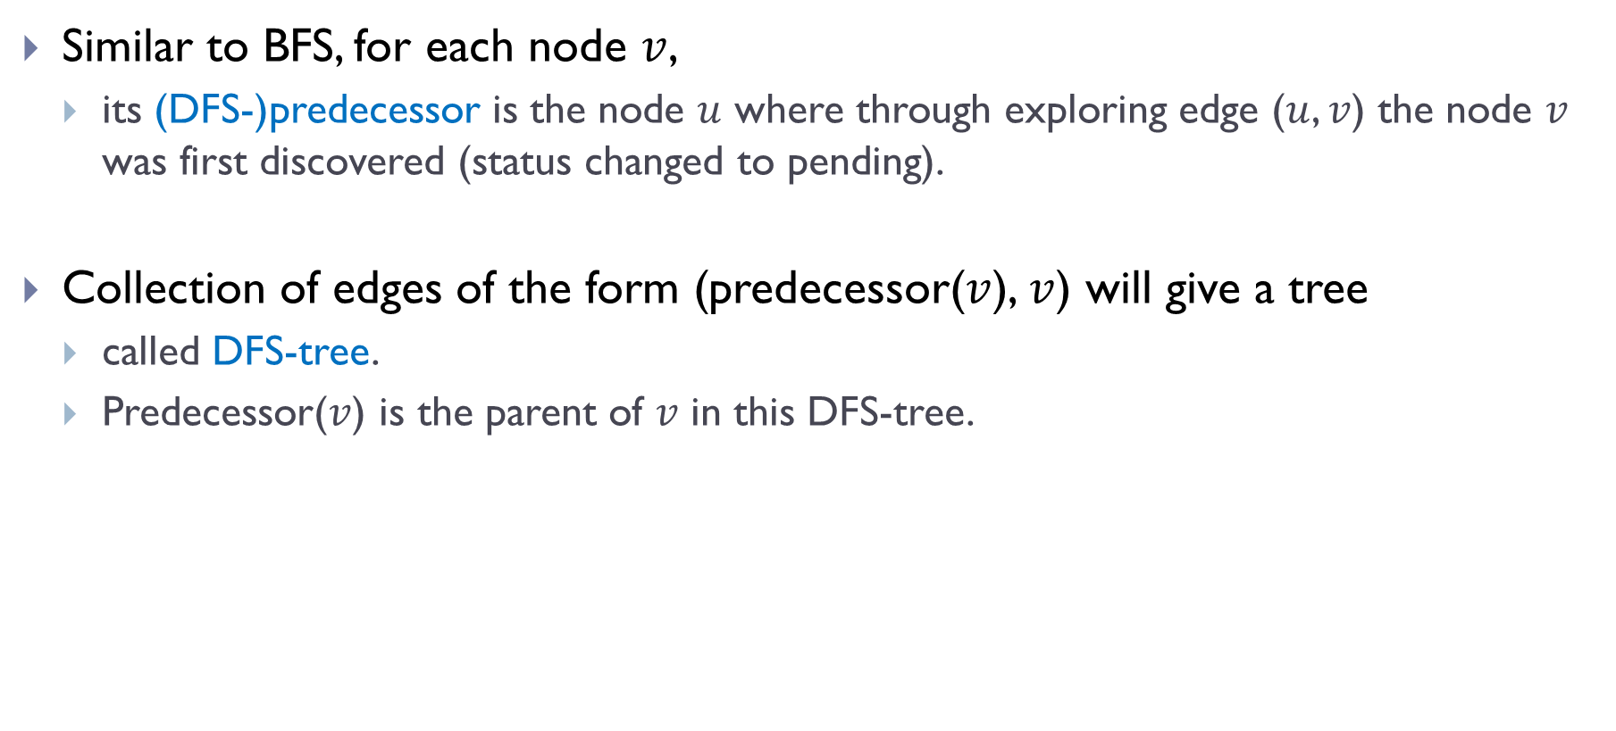
“Parent” (Predecessor) information
Similar to BFS, for each node $v$,
  its (DFS-)predecessor is the node $u$ where through exploring edge ($u$, $v$) the node $v$ was first discovered (status changed to pending).
Collection of edges of the form (predecessor($v$), $v$) will give a tree
  called DFS-tree.
  Predecessor($v$) is the parent of $v$ in this DFS-tree.

Slide 15

Observations
Between marking a node as pending and visited, many other nodes are marked pending or visited.
$G$:

Slide 16
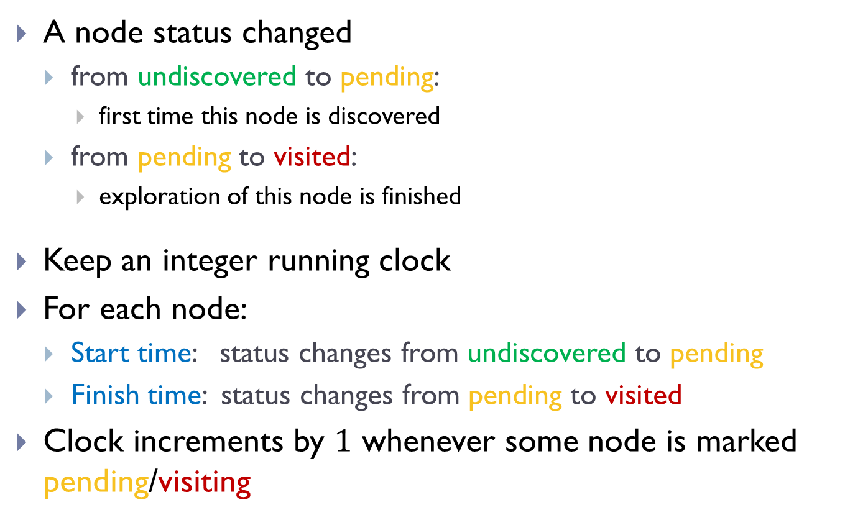
Start and Finish times
A node status changed
  from undiscovered to pending:
    first time this node is discovered
  from pending to visited:
    exploration of this node is finished
Keep an integer running clock
For each node:
  Start time: status changes from undiscovered to pending
  Finish time: status changes from pending to visited
Clock increments by $1$ whenever some node is marked pending/visiting

Slide 17

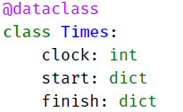
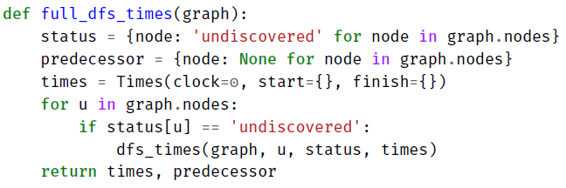
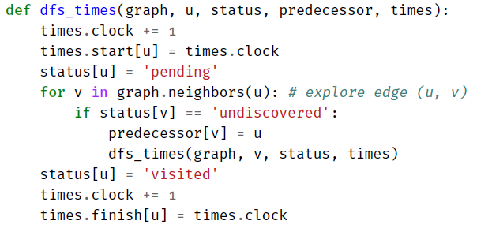
full_DFS_times implementation

Slide 18

Example
$G$:

Slide 19
Nesting properties in DFS

Slide 20
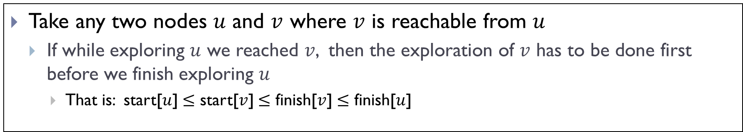
DFS Key Property 1
Take any two nodes $u$ and $v$ where $v$ is reachable from $u$
  If while exploring $u$ we reached $v$, then the exploration of $v$ has to be done first before we finish exploring $u$
    That is: start[$u$] $≤$ start[$v$] $≤$ finish[$v$] $≤$ finish[$u$]

Slide 21
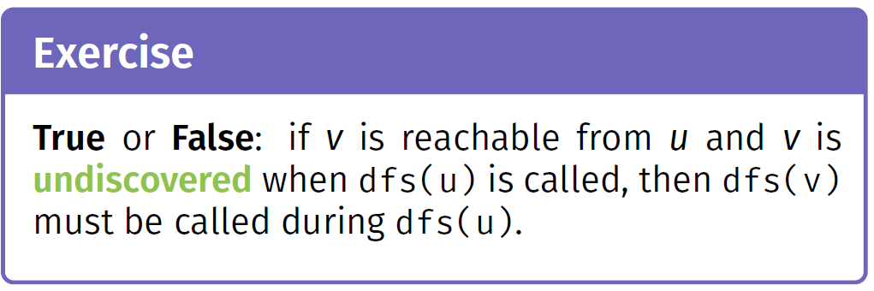

Slide 22
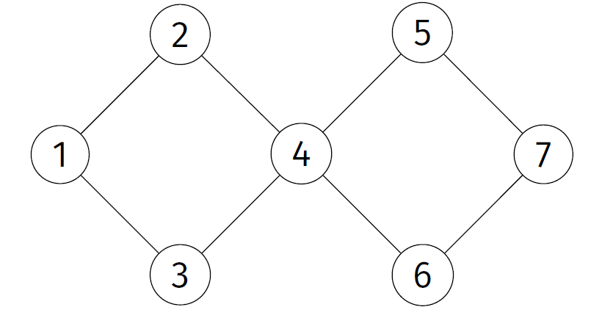

Slide 23
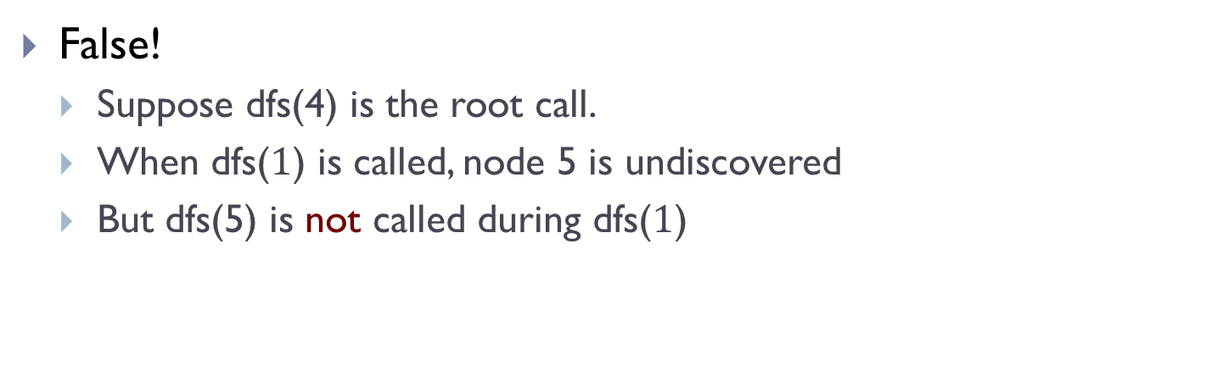
False!
  Suppose dfs(4) is the root call.
  When dfs($1$) is called, node 5 is undiscovered
  But dfs(5) is not called during dfs($1$)

Slide 24
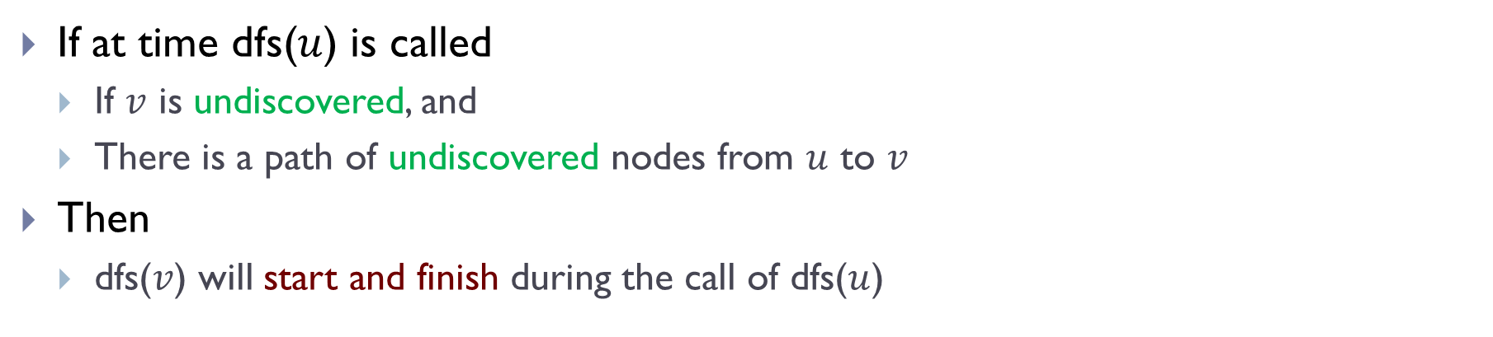
DFS Key Property 2
If at time dfs($u$) is called
  If $v$ is undiscovered, and
  There is a path of undiscovered nodes from $u$ to $v$
Then
  dfs($v$) will start and finish during the call of dfs($u$)

Slide 25
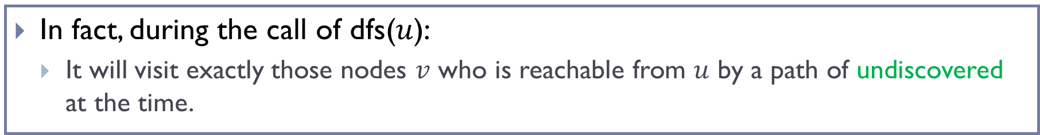
DFS Key Property 2
If at time dfs($u$) is called
  If $v$ is undiscovered, and
  There is a path of undiscovered nodes from $u$ to $v$
Then
  dfs($v$) will start and finish during the call of dfs($u$)
In fact, during the call of dfs($u$):
  It will visit exactly those nodes $v$ who is reachable from $u$ by a path of undiscovered at the time.

Slide 26
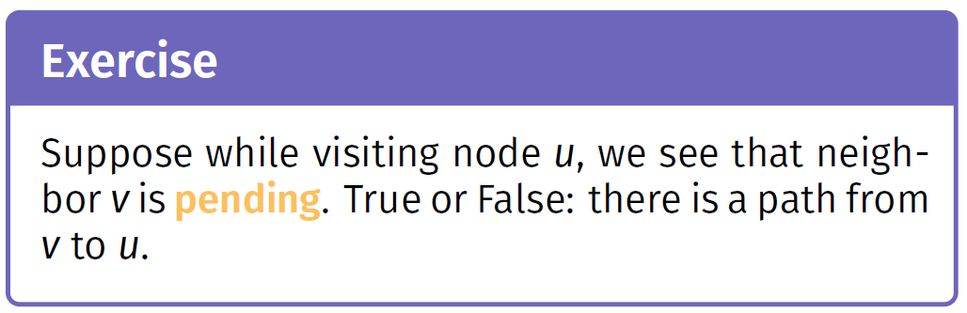

Slide 27
True!

Slide 28
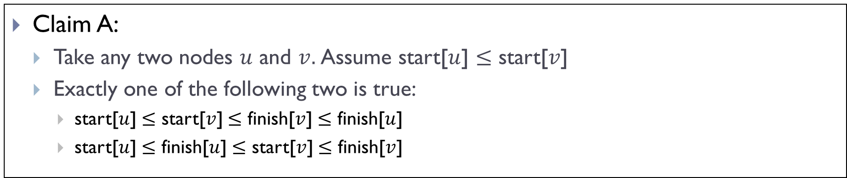
Nesting Property of DFS
Claim A:
  Take any two nodes $u$ and $v.$Assume start[$u$] $≤$ start[$v$]
  Exactly one of the following two is true:
    start[$u$] $≤$ start[$v$] $≤$ finish[$v$] $≤$ finish[$u$]
    start[$u$] $≤$ finish[$u$] $≤$ start[$v$] $≤$ finish[$v$]

Slide 29
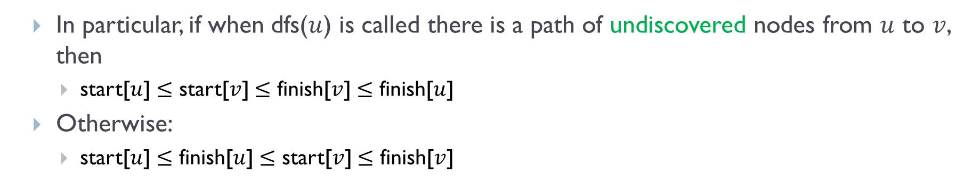
Nesting Property of DFS
Claim A:
  Take any two nodes $u$ and $v.$Assume start[$u$] $≤$ start[$v$]
  Exactly one of the following two is true:
    start[$u$] $≤$ start[$v$] $≤$ finish[$v$] $≤$ finish[$u$]
    start[$u$] $≤$ finish[$u$] $≤$ start[$v$] $≤$ finish[$v$]
  In particular, if when dfs($u$) is called there is a path of undiscovered nodes from $u$ to $v$, then
    start[$u$] $≤$ start[$v$] $≤$ finish[$v$] $≤$ finish[$u$]
  Otherwise:
    start[$u$] $≤$ finish[$u$] $≤$ start[$v$] $≤$ finish[$v$]

Slide 30
DAGs and topological sort

Slide 31
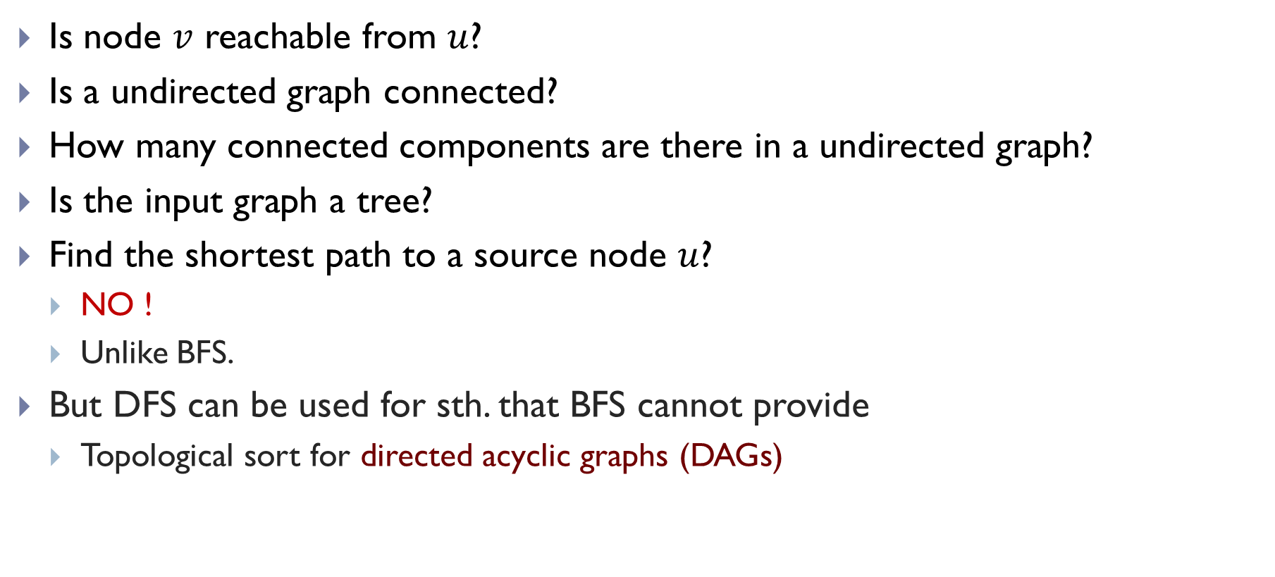
Applications of DFS
Is node $v$ reachable from $u$?
Is a undirected graph connected?
How many connected components are there in a undirected graph?
Is the input graph a tree?
Find the shortest path to a source node $u$?
  NO !
  Unlike BFS.
But DFS can be used for sth. that BFS cannot provide
  Topological sort for directed acyclic graphs (DAGs)

Slide 32
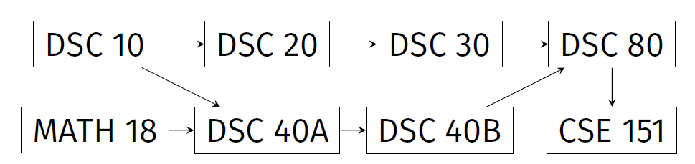
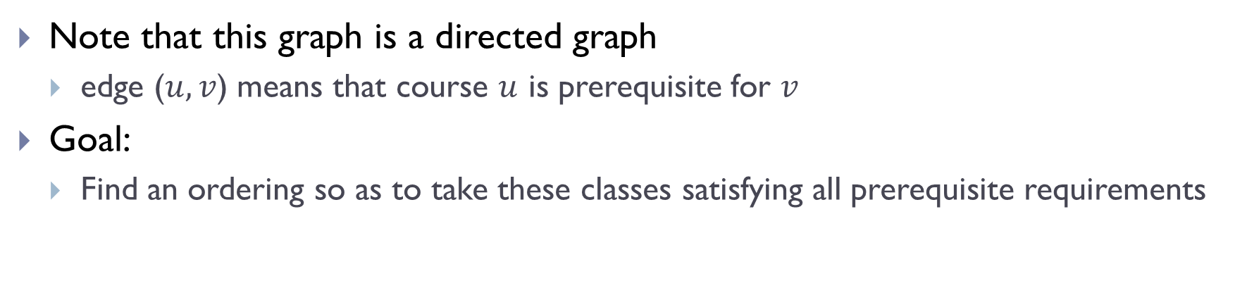
Prerequisite graphs
Note that this graph is a directed graph
  edge ($u, v$) means that course $u$ is prerequisite for $v$
Goal:
  Find an ordering so as to take these classes satisfying all prerequisite requirements

Slide 33

Directed Acyclic Graphs (DAGs)
Recall: A cycle is a path from a node to itself.
A directed acyclic graph (DAG) is a directed graph that does not contain any (directed) cycles
$G$:

Slide 34
Directed Acyclic Graphs (DAGs)
Recall: A cycle is a path from a node to itself.
A directed acyclic graph (DAG) is a directed graph that does not contain any (directed) cycles
Not a DAG!
$G$:
A DAG!

Slide 35

Topological Sorts
Given a DAG $G=(V, E)$, a topological sort of $G$ is an ordering of $V$ such that
  for any edge $\left(u, v\right)∈E$, then $u$ comes before $v$ in this ordering

Slide 36
Topological Sorts
Given a DAG $G=(V, E)$, a topological sort of $G$ is an ordering of $V$ such that
  for any edge $\left(u, v\right)∈E$, then $u$ comes before $v$ in this ordering
A topological sort:
DSC10, Math18, DSC20, DSC40A, DSC30, DSC40B, DSC80, DSC151

Slide 37
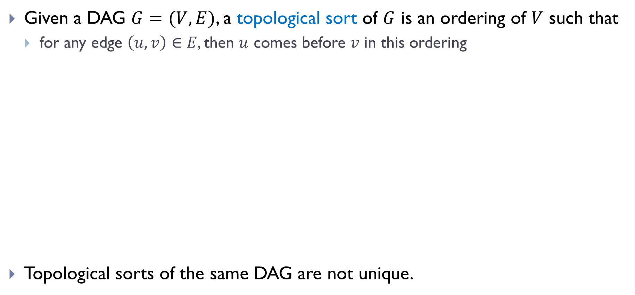
Topological Sorts
Given a DAG $G=(V, E)$, a topological sort of $G$ is an ordering of $V$ such that
  for any edge $\left(u, v\right)∈E$, then $u$ comes before $v$ in this ordering
Topological sorts of the same DAG are not unique.
A topological sort:
DSC10, Math18, DSC20, DSC40A, DSC30, DSC40B, DSC80, DSC151
Another topological sort:
Math18, DSC10, DSC20, DSC30, DSC40A, DSC40B, DSC80, DSC151

Slide 38
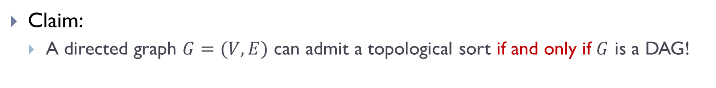
Why DAG?
Claim:
  A directed graph $G=(V,E)$ can admit a topological sort if and only if $G$ is a DAG!
$G$:

Slide 39

Why DAG?
Claim:
  A directed graph $G=(V,E)$ can admit a topological sort if and only if $G$ is a DAG!
Why?
  If there is a cycle, then there is no valid ordering for nodes in that cycle!
  If it is a DAG, then we will give an algorithm to show we can compute topological sort.
$G$:

Slide 40

Given a DAG $G = \left(V, E\right),$we aim to have an algorithm to compute a topological sort of $G$

Slide 41
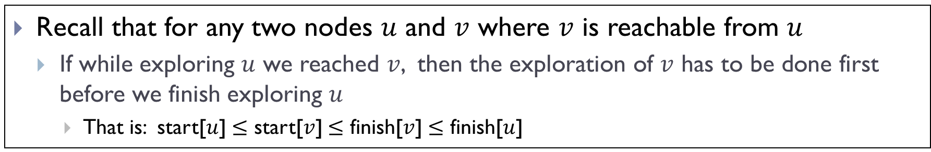
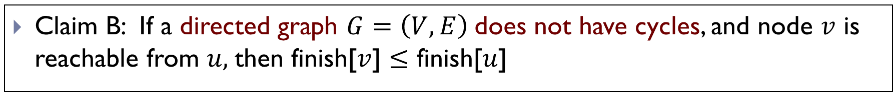
DFS Key Property 3
Recall that for any two nodes $u$ and $v$ where $v$ is reachable from $u$
  If while exploring $u$ we reached $v$, then the exploration of $v$ has to be done first before we finish exploring $u$
    That is: start[$u$] $≤$ start[$v$] $≤$ finish[$v$] $≤$ finish[$u$]
Claim B: If a directed graph $G=\left(V, E\right)$does not have cycles, and node $v$ is reachable from $u,$then finish[$v$] $≤$ finish[$u$]

Slide 42
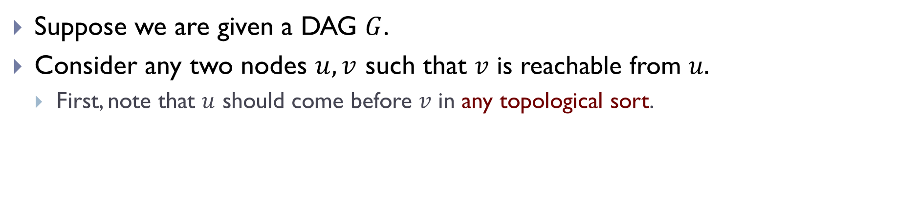
An algorithm to compute topo-sort
Suppose we are given a DAG $G$.
Consider any two nodes $u, v$ such that $v$ is reachable from $u.$
  First, note that $u$ should come before $v$ in any topological sort.

Slide 43
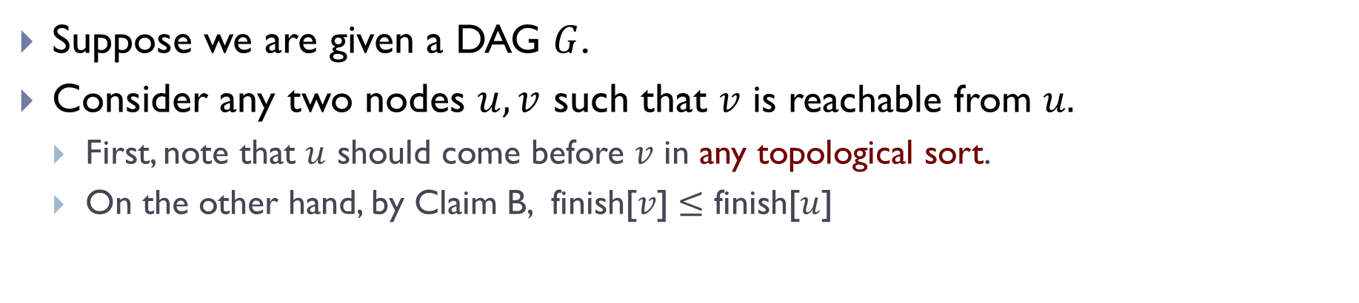
An algorithm to compute topo-sort
Suppose we are given a DAG $G$.
Consider any two nodes $u, v$ such that $v$ is reachable from $u.$
  First, note that $u$ should come before $v$ in any topological sort.
  On the other hand, by Claim B, finish[$v$] $≤$ finish[$u$]

Slide 44
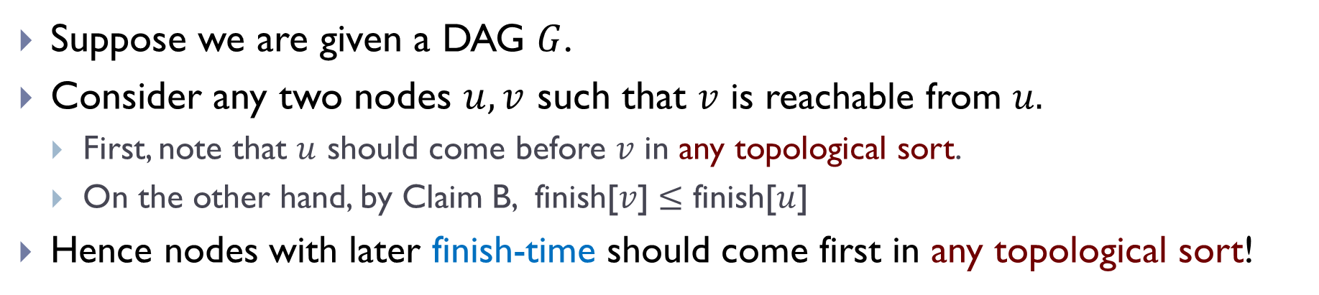
An algorithm to compute topo-sort
Suppose we are given a DAG $G$.
Consider any two nodes $u, v$ such that $v$ is reachable from $u.$
  First, note that $u$ should come before $v$ in any topological sort.
  On the other hand, by Claim B, finish[$v$] $≤$ finish[$u$]
Hence nodes with later finish-time should come first in any topological sort!

Slide 45
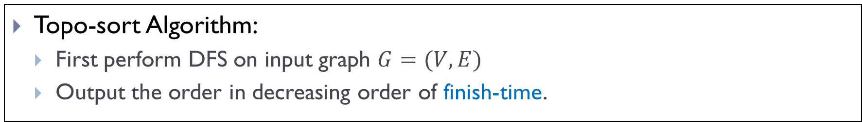
An algorithm to compute topo-sort
Suppose we are given a DAG $G$.
Consider any two nodes $u, v$ such that $v$ is reachable from $u.$
  First, note that $u$ should come before $v$ in any topological sort.
  On the other hand, by Claim B, finish[$v$] $≤$ finish[$u$]
Hence nodes with later finish-time should come first in any topological sort!
Topo-sort Algorithm:
  First perform DFS on input graph $G=(V,E)$
  Output the order in decreasing order of finish-time.

Slide 46
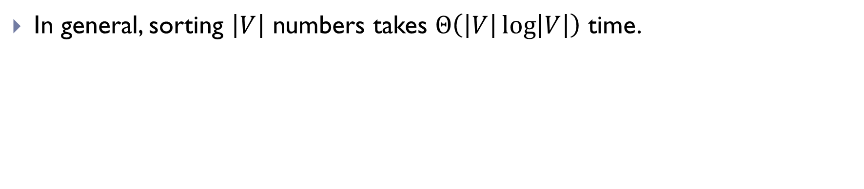
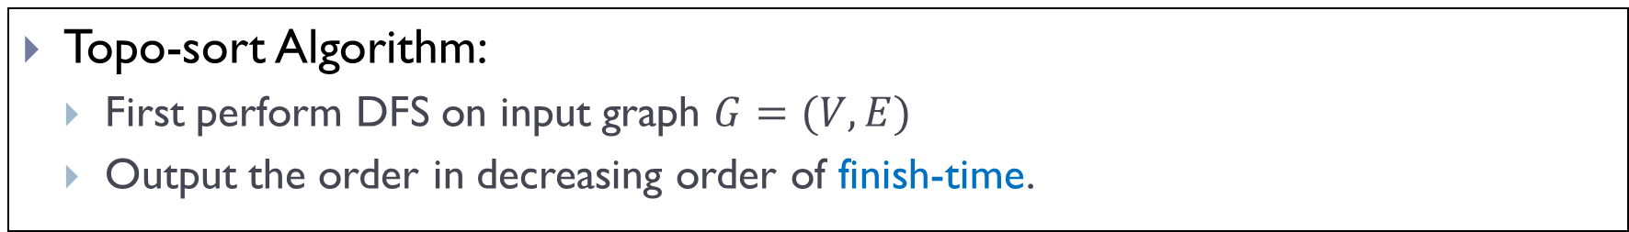
Time Complexity of Topo-Sort Algorithm
Topo-sort Algorithm:
  First perform DFS on input graph $G=(V,E)$
  Output the order in decreasing order of finish-time.
In general, sorting $\left|V\right|$ numbers takes $Θ\left(\left|V\right|\log\left|V\right|\right)$ time.

Slide 47
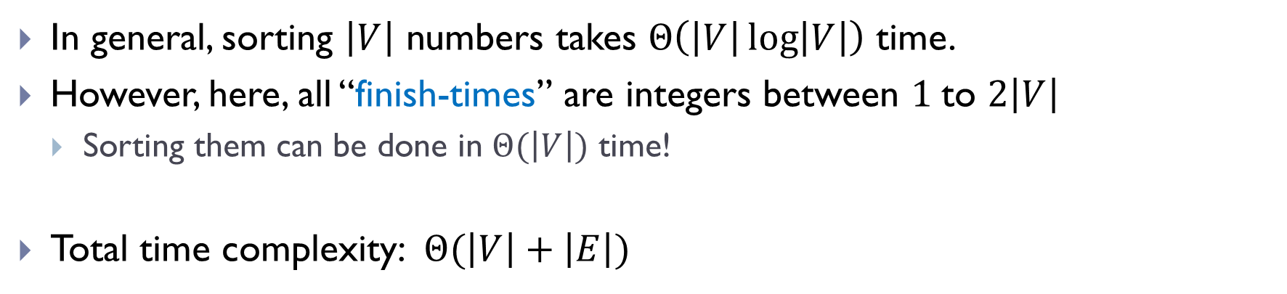
Time Complexity of Topo-Sort Algorithm
Topo-sort Algorithm:
  First perform DFS on input graph $G=(V,E)$
  Output the order in decreasing order of finish-time.
In general, sorting $\left|V\right|$ numbers takes $Θ\left(\left|V\right|\log\left|V\right|\right)$ time.
However, here, all “finish-times” are integers between $1$to $2\left|V\right|$
  Sorting them can be done in $Θ(\left|V\right|)$ time!
Total time complexity: $Θ(\left|V\right|+\left|E\right|)$

Slide 48
Example

Slide 49
Remark:
There are many other ways to compute a topological sort for a DAG in the same time complexity, without using DFS.

Slide 50
Summary
DFS:
  Yet another graph search strategy
  Similarly to BFS, as a graph search strategy, can help solve many problems, such as checking for connectivity, reachability, finding a path and so on.
  But has some different properties as BFS
    BFS: useful for finding shortest path to the source
    DFS: has nesting properties in terms of start/finish times.
      An application: Topological sort in DAG

Slide 51
FIN

