Slide 1
DSC40B: Theoretical Foundations of Data Science II
Lecture 16: Minimum Spanning Tree, properties, and general greedy algorithms
Instructor: Yusu Wang

Slide 2
Previously
Given directed or undirected graphs
Graph search / traversal strategies (DFS / BFS)
Single source shortest paths in weighted graphs
Bellman-Ford algorithm for general graphs
Dijkstra algorithm for graphs with positive edge weights
Today:
Computing a minimum spanning tree (MST) of an undirected graph

Slide 3
First: Shortest Path Trees
Recall: BFS-tree and DFS-tree
Formed by the collection of edges from a node’s BFS or DFS predecessor to the node itself.
BFS-tree encodes shortest paths info (as well as shortest path distance) from the source node.
Similarly:
Both Bellman-Ford algorithm and Dijkstra algorithm will produce a tree, which we call shortest path trees:
consisting of all edges of the form (u, v) where u is the predecessor of v recorded by the algorithm that gives rise to the current distance estimate at v.
Hence u must be a shortest-path predecessor for v.

Slide 4
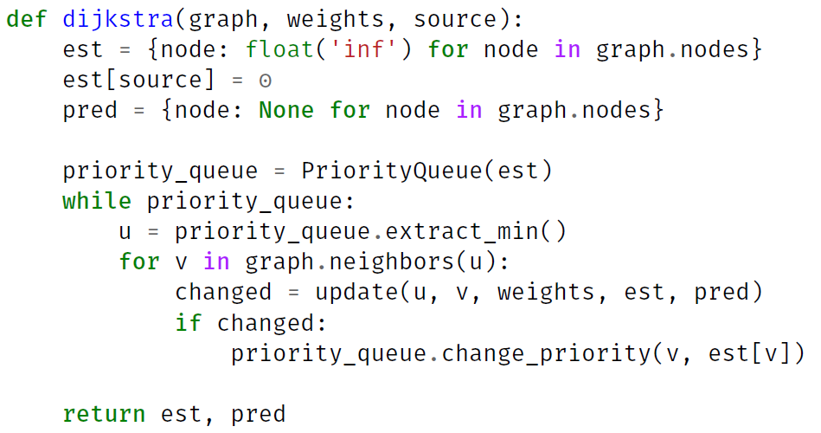
Dijkstra using priority queue

Slide 5
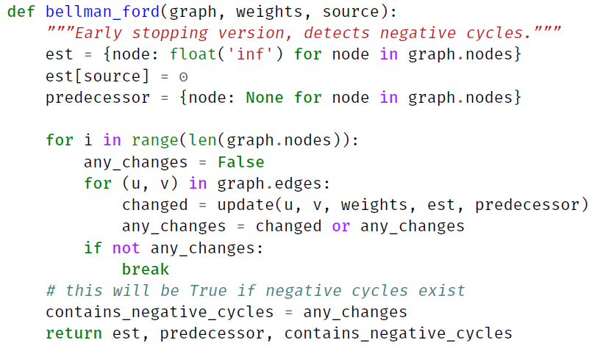
Modified Bellman-Ford with early stopping and negative cycle detection

Slide 6
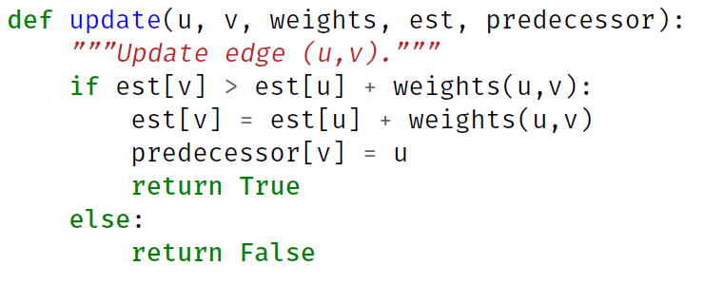
Implementing update() in python

Slide 7
Trees, spanning trees, and minimum spanning tree

Slide 8
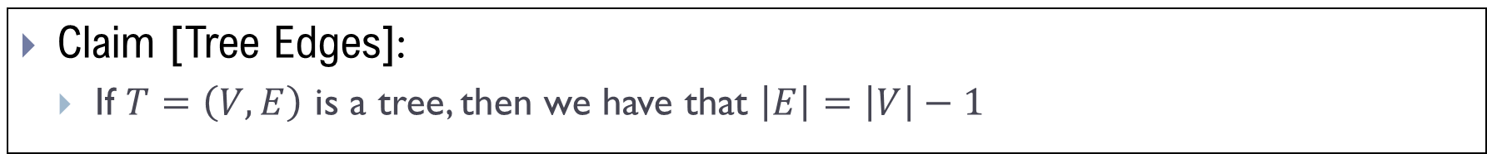
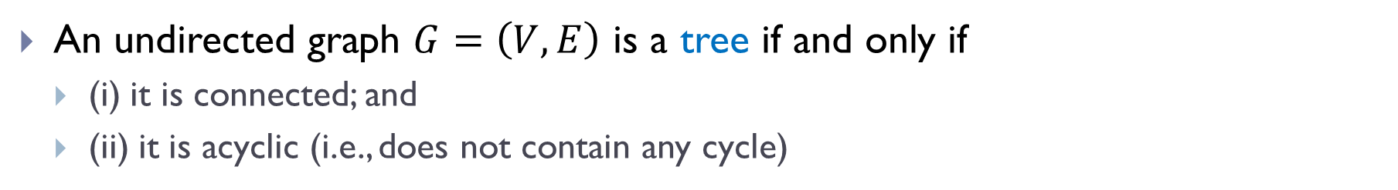
Trees
An undirected graph $G=\left(V, E\right)$ is a tree if and only if
(i) it is connected; and
(ii) it is acyclic (i.e., does not contain any cycle)
Claim [Tree Edges]:
If $T=\left(V, E\right)$ is a tree, then we have that $\left|E\right|=\left|V\right|−1$

Slide 9
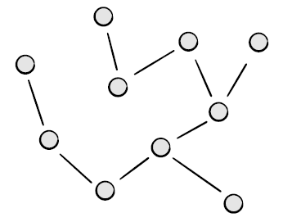
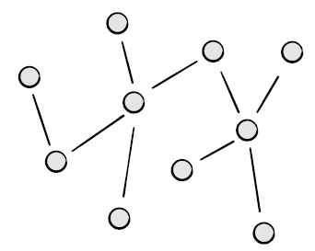
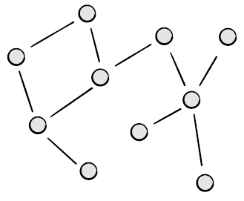
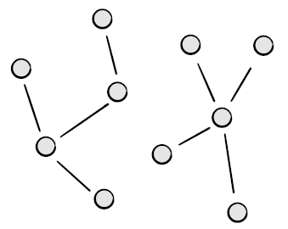
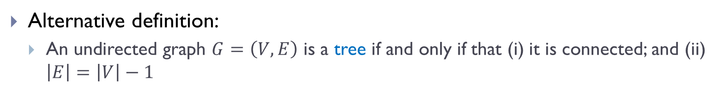
Alternative definition
Alternative definition:
An undirected graph $G=\left(V, E\right)$ is a tree if and only if that (i) it is connected; and (ii) $\left|E\right|=\left|V\right|−1$

Slide 10
Alternative definition
Alternative definition:
An undirected graph $G=\left(V, E\right)$ is a tree if and only if that (i) it is connected; and (ii) $\left|E\right|=\left|V\right|−1$
A tree
A tree
NOT a tree
NOT a tree

Slide 11

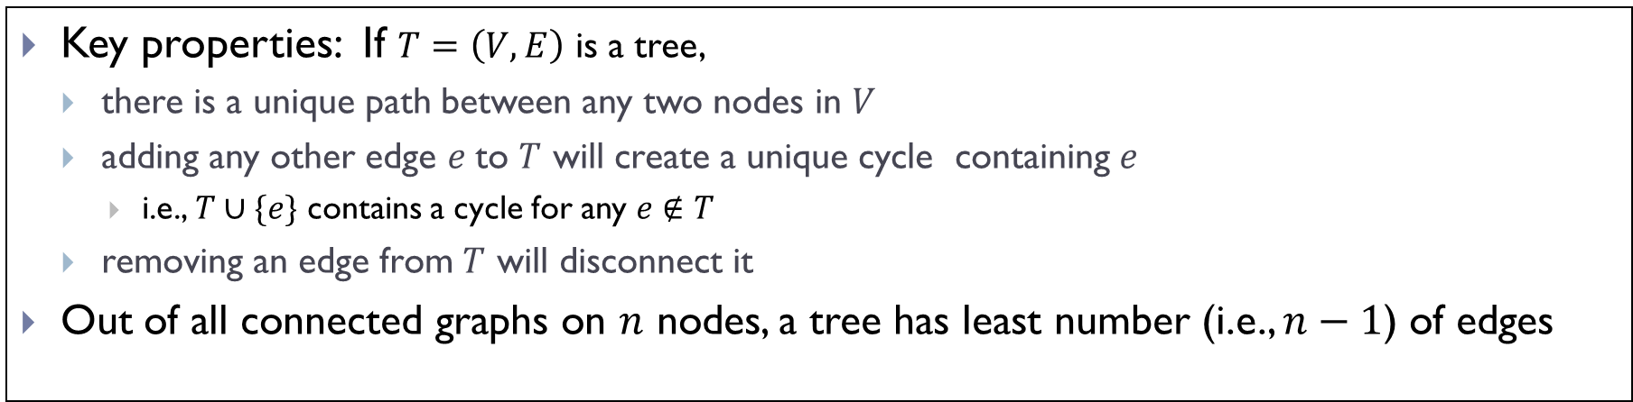


Remarks
Key properties: If $T=\left(V, E\right)$ is a tree,
there is a unique path between any two nodes in $V$
adding any other edge $e$to $T$ will create a unique cycle containing $e$
i.e., $T∪\{e\}$ contains a cycle for any $e∉T$
removing an edge from $T$ will disconnect it
Out of all connected graphs on $n$ nodes, a tree has least number (i.e., $n−1$) of edges
$$T$$
$$T∪\{e\}$$
$$e$$

Slide 12
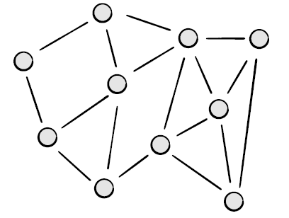
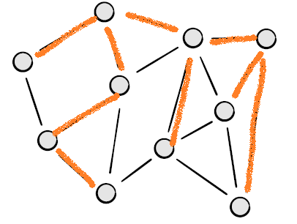
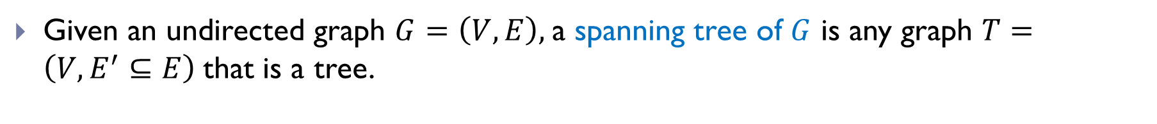
Spanning Tree
Given an undirected graph $G=\left(V, E\right),$a spanning tree of $G$ is any graph $T=\left(V, E^{′}⊆E\right)$that is a tree.
Example of spanning trees for the graph on the right.

Slide 13
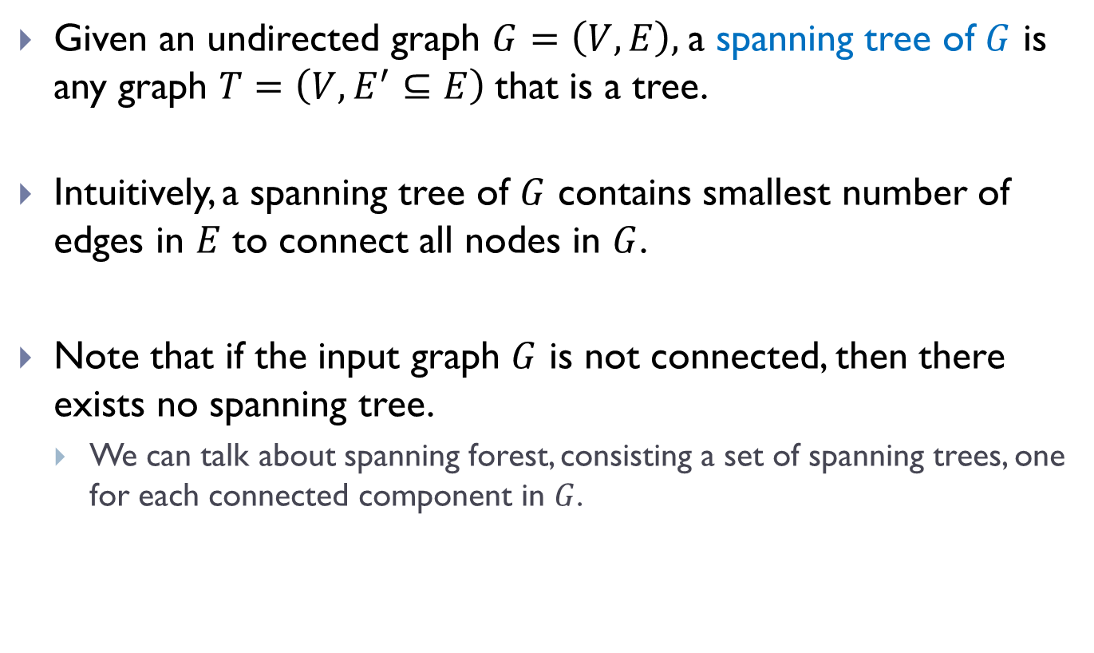
Spanning Tree
Given an undirected graph $G=\left(V, E\right),$a spanning tree of $G$ is any graph $T=\left(V, E^{′}⊆E\right)$that is a tree.
Intuitively, a spanning tree of $G$ contains smallest number of edges in $E$ to connect all nodes in $G$.
Note that if the input graph $G$ is not connected, then there exists no spanning tree.
We can talk about spanning forest, consisting a set of spanning trees, one for each connected component in $G$.

Slide 14
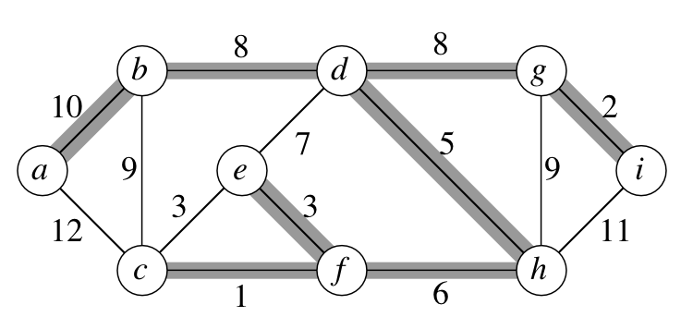

Minimum spanning tree (MST)
Weight of spanning tree $T$ of a weighted graph $G=\left(V, E\right)$ is
the total weights of all edges in $T$, i.e., $ω\left(T\right)=\sum_{e∈T}{ω(e)},$
where $ω:E→R$ is the edge weights associated to $G.$
Weight of this spanning tree: 43

Slide 15

Minimum spanning tree (MST)
Weight of spanning tree $T$ of a weighted graph $G=\left(V, E\right)$ is
the total weights of all edges in $T$, i.e., $ω\left(T\right)=\sum_{e∈T}{ω(e)},$
where $ω:E→R$ is the edge weights associated to $G.$
A minimum spanning tree (MST) of a weighted graph $G=\left(V, E\right)$ is a spanning tree with smallest possible weight.
Weight of this spanning tree: 43
Turns out this is also a minimum spanning tree.

Slide 16
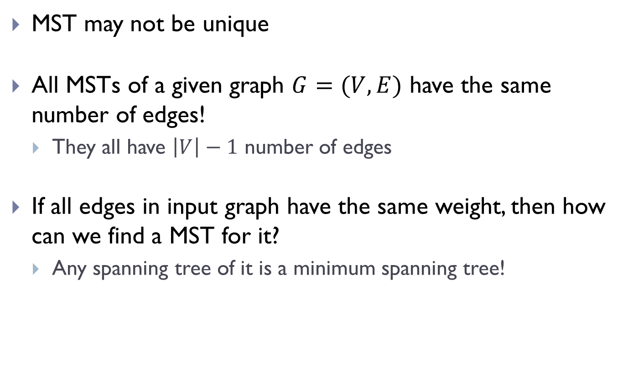
MSTs
MST may not be unique
All MSTs of a given graph $G=(V,E)$ have the same number of edges!
They all have $\left|V\right|−1$ number of edges
If all edges in input graph have the same weight, then how can we find a MST for it?
Any spanning tree of it is a minimum spanning tree!

Slide 17
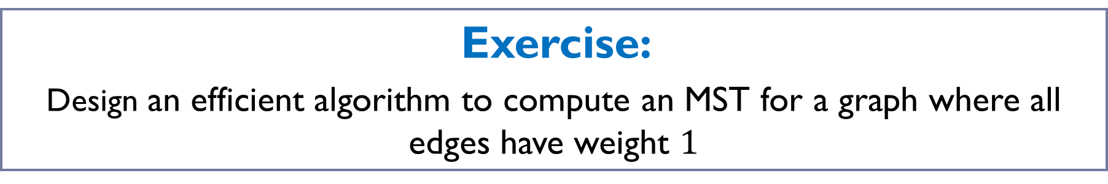
Exercise:
Design an efficient algorithm to compute an MST for a graph where all edges have weight $1$

Slide 18
Exercise:
Design an efficient algorithm to compute an MST for a graph where all edges have weight $1$
This can be done in time $Θ\left(\left|V\right|+\left|E\right|\right) !$

Slide 19
Motivation and properties of MST

Slide 20
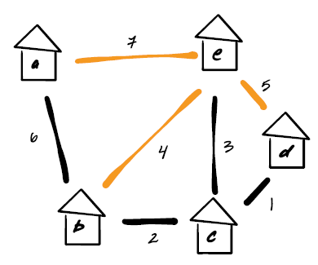
Motivation
Among all possible road segment choices, build a set of road segments so that all houses are connected and the total cost is minimized
Solution: Find the MST of the input weighted graph where edge weight represents the cost of build that road segment.

Slide 21
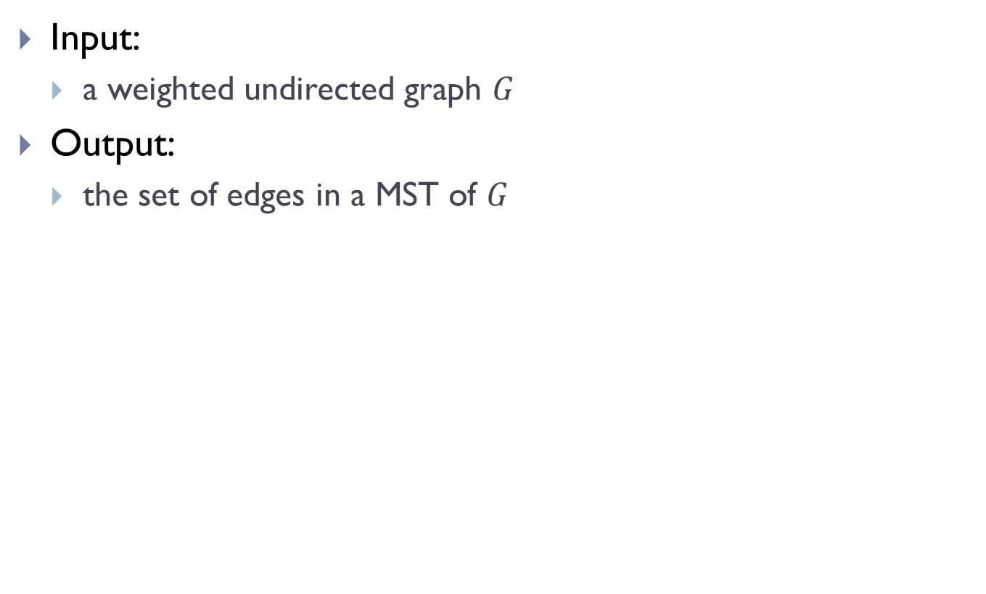
MST Problem
Input:
a weighted undirected graph $G$
Output:
the set of edges in a MST of $G$

Slide 22
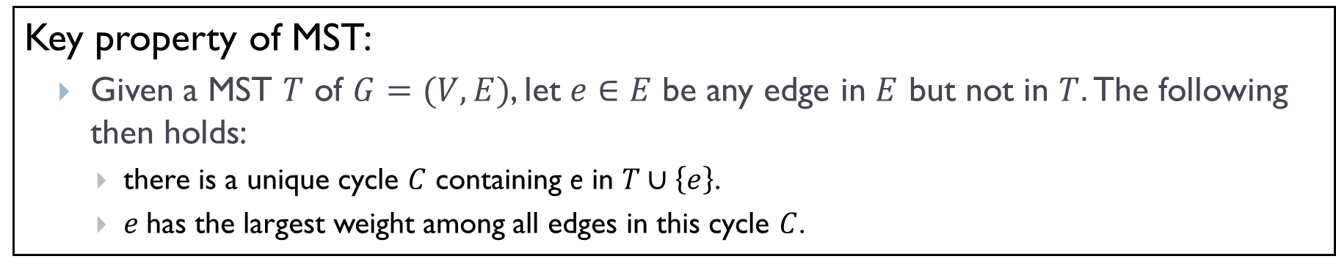
Key property
Key property of MST:
Given a MST $T$ of $G=(V,E)$, let $e∈E$ be any edge in $E$ but not in $T.$ The following then holds:
there is a unique cycle $C$ containing e in $T∪\left\{e\right\}$.
$e$has the largest weight among all edges in this cycle $C$.

Slide 23
Key property
Key property of MST:
Given a MST $T$ of $G=(V,E)$, let $e∈E$ be any edge in $E$ but not in $T.$ The following then holds:
there is a unique cycle $C$ containing e in $T∪\left\{e\right\}$.
$e$has the largest weight among all edges in this cycle $C$.

Slide 24
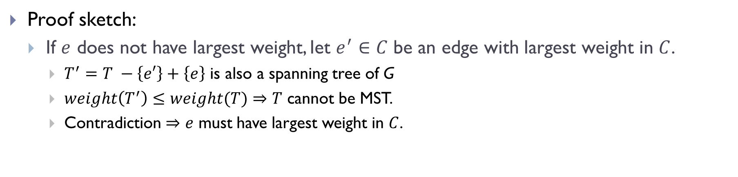
Key property
Key property of MST:
Given a MST $T$ of $G=(V,E)$, let $e∈E$ be any edge in $E$ but not in $T.$ The following then holds:
there is a unique cycle $C$ containing e in $T∪\left\{e\right\}$.
$e$has the largest weight among all edges in this cycle $C$.
Proof sketch:
If $e$ does not have largest weight, let $e^{′}∈C$ be an edge with largest weight in $C$.
$T^{′}=T −\left\{e′\right\}+\left\{e\right\}$ is also a spanning tree of G
$weight\left(T^{′}\right)≤weight(T)$ $⇒$ $T$ cannot be MST.
Contradiction $⇒e$ must have largest weight in $C$.

Slide 25
First greedy algorithm for MST: Prim’s algorithm

Slide 26
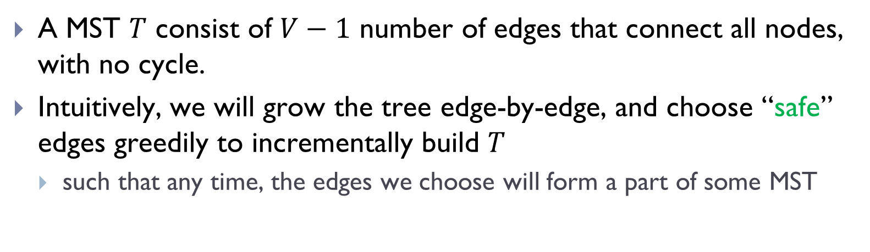
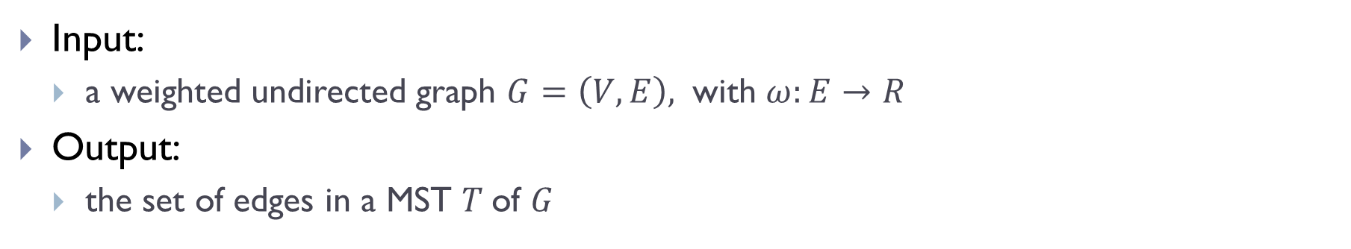
General greedy idea:
Input:
a weighted undirected graph $G=\left(V,E\right),$ with $ω:E→R$
Output:
the set of edges in a MST $T$of $G$
A MST $T$ consist of $V−1$ number of edges that connect all nodes, with no cycle.
Intuitively, we will grow the tree edge-by-edge, and choose “safe” edges greedily to incrementally build $T$
such that any time, the edges we choose will form a part of some MST

Slide 27
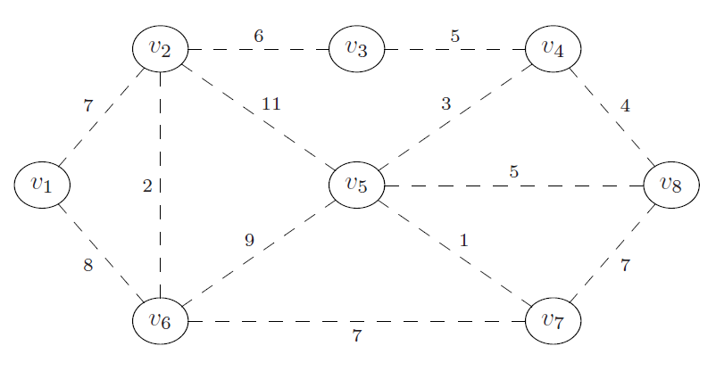
Example
What is a “safe” edge to add first?

Slide 28
Two greedy algorithms
Two greedy algorithms
Today: Prim’s algorithm
Next class: Kruskal’s algorithm
They differ in the order of edges they visit and thus ``safe” edges they add

Slide 29
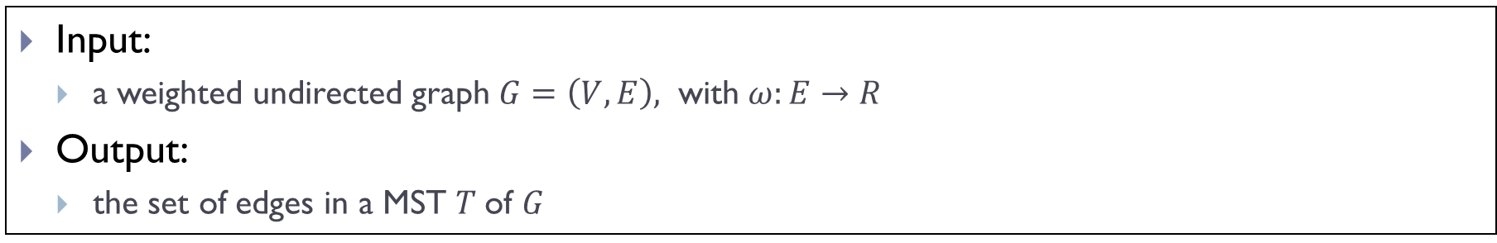
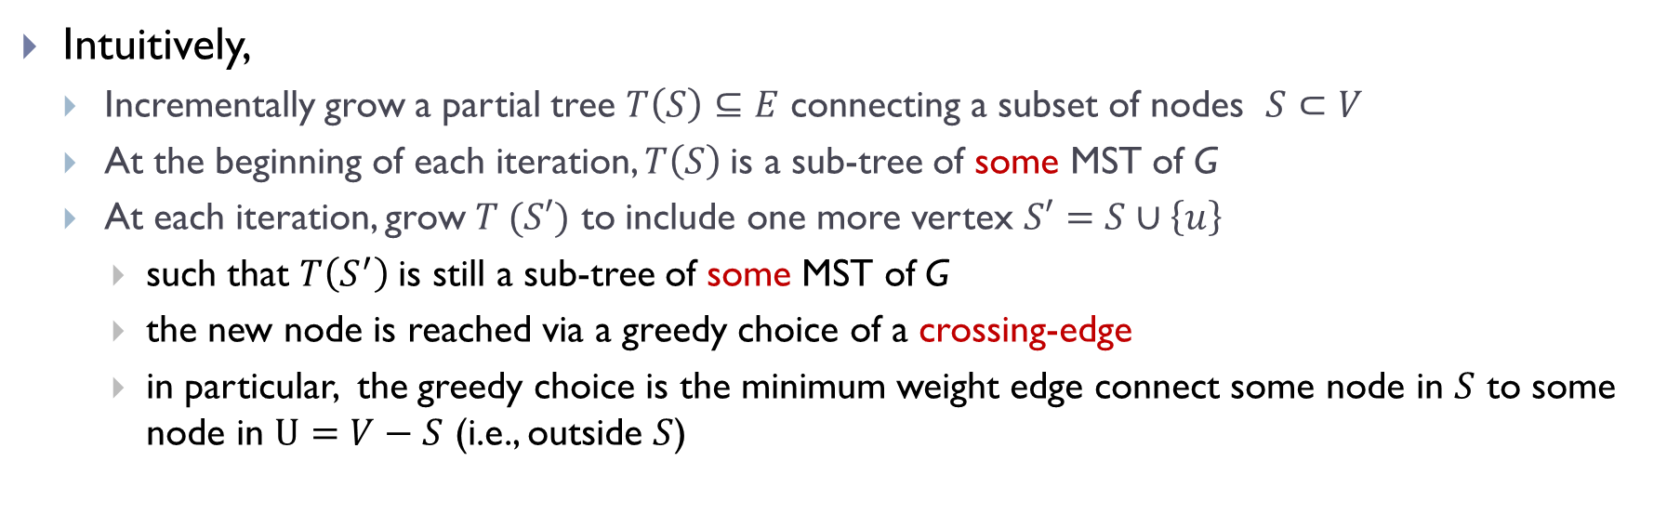
Idea for Prim’s algorithm
Input:
a weighted undirected graph $G=\left(V,E\right),$ with $ω:E→R$
Output:
the set of edges in a MST $T$of $G$
Intuitively,
Incrementally grow a partial tree $T\left(S\right)⊆E$ connecting a subset of nodes $S⊂V$
At the beginning of each iteration, $T\left(S\right)$is a sub-tree of some MST of G
At each iteration, grow $T (S′)$ to include one more vertex $S′=S∪\left\{u\right\}$
such that $T\left(S^{′}\right)$is still a sub-tree of some MST of G
the new node is reached via a greedy choice of a crossing-edge
in particular, the greedy choice is the minimum weight edge connect some node in $S$ to some node in $U=V−S$ (i.e., outside $S$)

Slide 30
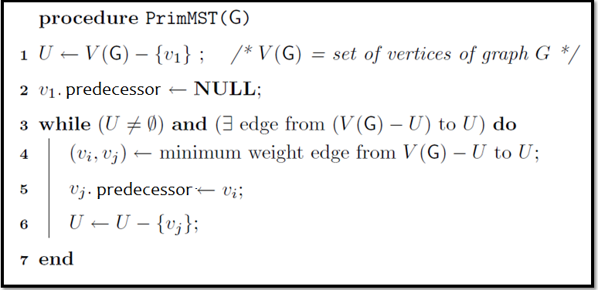
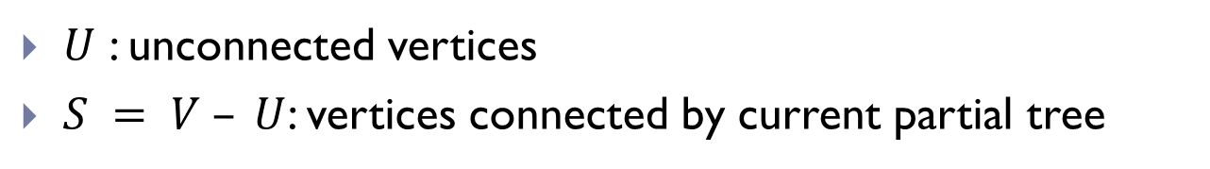
High level outline (not code)
$U$ : unconnected vertices
$S = V – U$: vertices connected by current partial tree

Slide 31
High level outline (not code)
$U$ : unconnected vertices
$S = V – U$: vertices connected by current partial tree

Slide 32
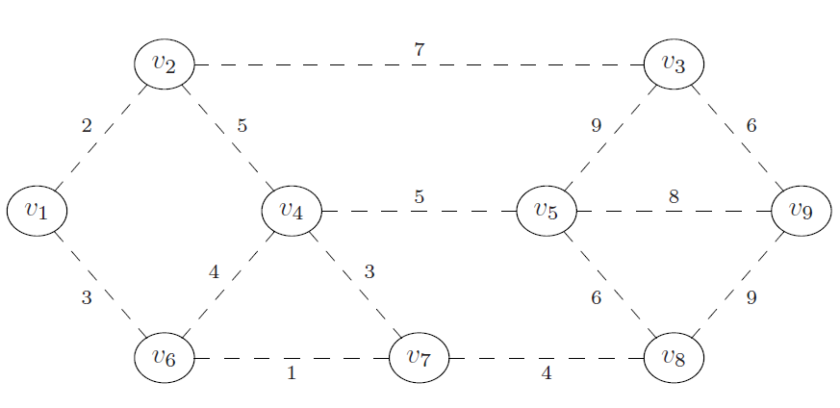
Example
Suppose we grow the tree starting from $v_{1}$

Slide 33
Example
Suppose we grow the tree starting from $v_{1}$

Slide 34
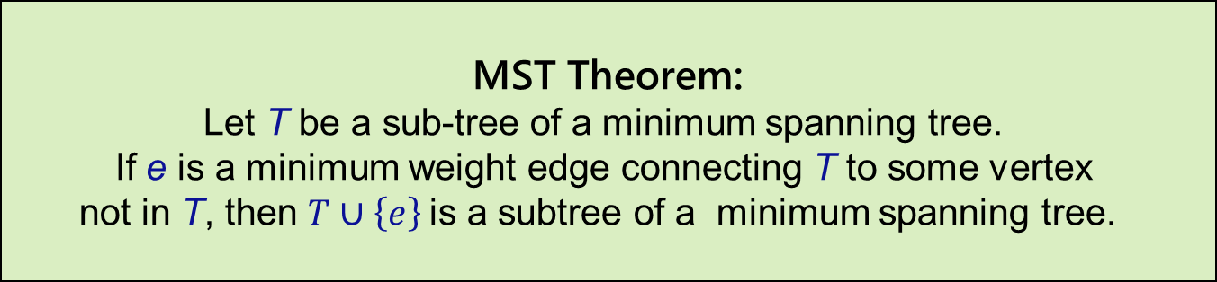
Correctness
MST Theorem:
Let T be a sub-tree of a minimum spanning tree.
If e is a minimum weight edge connecting T to some vertex
not in T, then $T∪\left\{e\right\}$is a subtree of a minimum spanning tree.
Key to the correctness of PrimMST algorithm.
Loop invariant:
each time PrimMST() algorithm grows the partial tree (i.e, adds another edge to it), the invariant is that the new tree is still a subtree of some minimum spanning tree of input graph G.
Termination:
when all nodes are connected, we obtain a MST of G.
(or if we cannot reach all nodes, then the input graph is not connected)

Slide 35
Idea for proving loop invariant

Slide 36
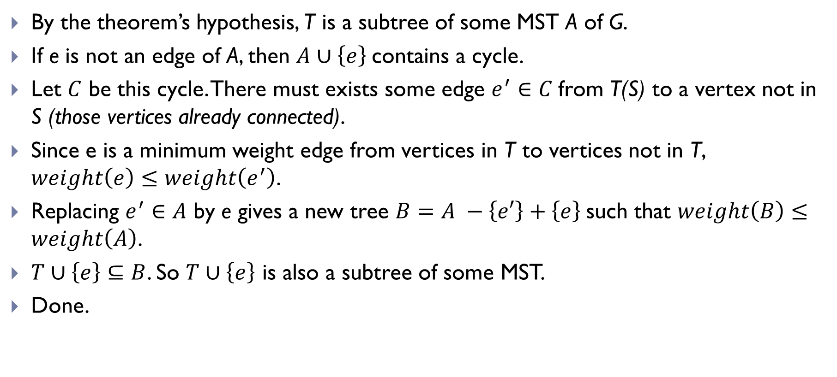
Idea for proving loop invariant
By the theorem’s hypothesis, T is a subtree of some MST A of G.
If e is not an edge of A, then $A∪\left\{e\right\}$contains a cycle.
Let $C$ be this cycle. There must exists some edge $e^{′}∈C$from T(S) to a vertex not in S (those vertices already connected).
Since e is a minimum weight edge from vertices in T to vertices not in T, $weight\left(e\right)≤weight\left(e^{′}\right)$.
Replacing $e^{′}∈A$ by e gives a new tree $B=A −\left\{e′\right\}+\left\{e\right\}$such that $weight\left(B\right)≤weight\left(A\right)$.
$T∪\left\{e\right\}⊆B$. So $T∪\left\{e\right\}$ is also a subtree of some MST.
Done.

Slide 37
Implementation of Prim’s algorithm

Slide 38
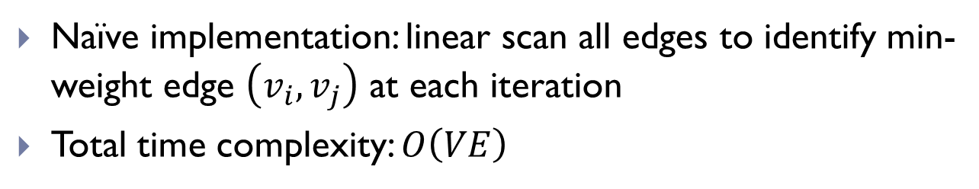
Naïve implementation of Prim’s Alg
Naïve implementation: linear scan all edges to identify min-weight edge $\left(v_{i}, v_{j}\right)$ at each iteration
Total time complexity: $O\left(VE\right)$

Slide 39
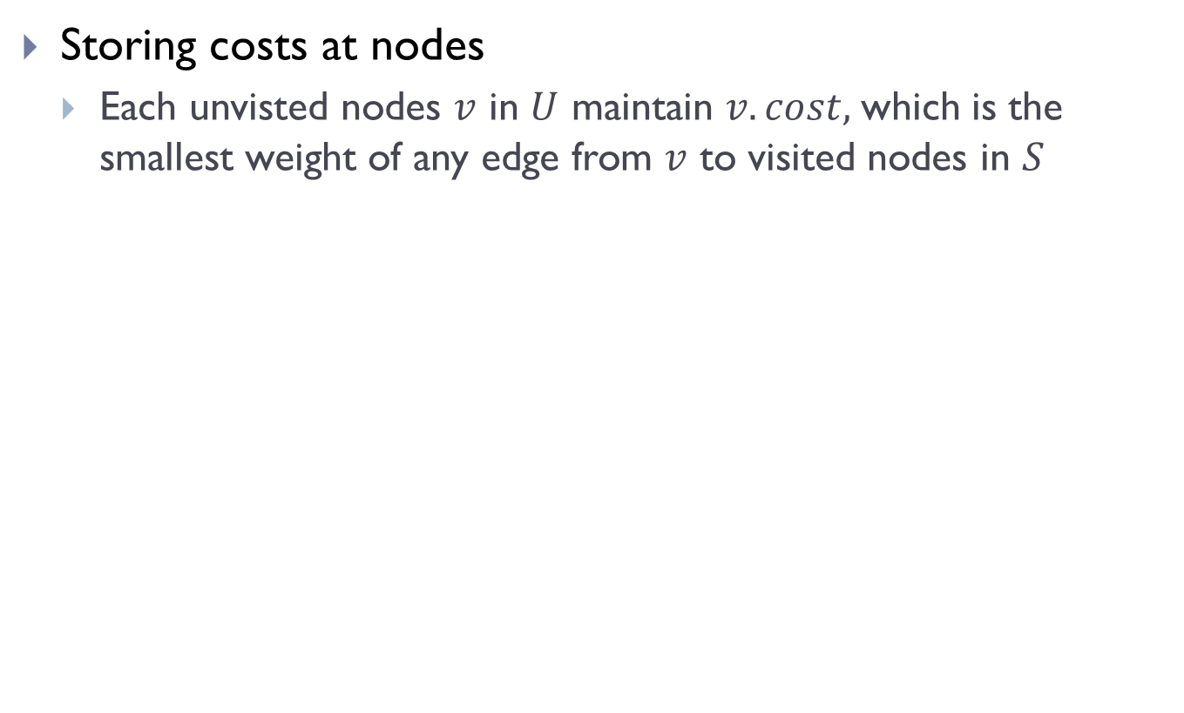
First improvement
Storing costs at nodes
Each unvisted nodes $v$ in $U$ maintain $v.cost,$which is the smallest weight of any edge from $v$ to visited nodes in $S$

Slide 40
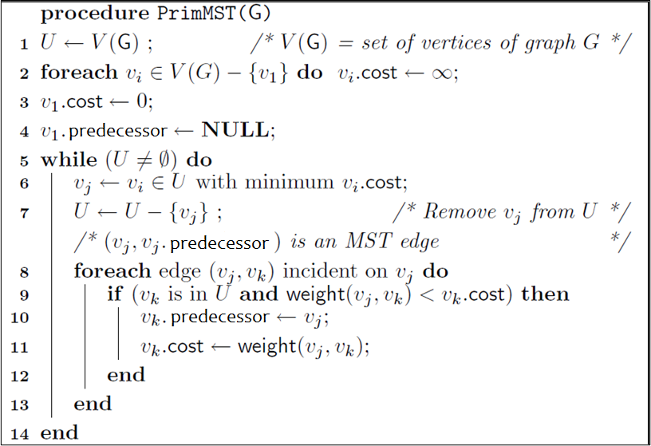
Outline of first improvement

Slide 41
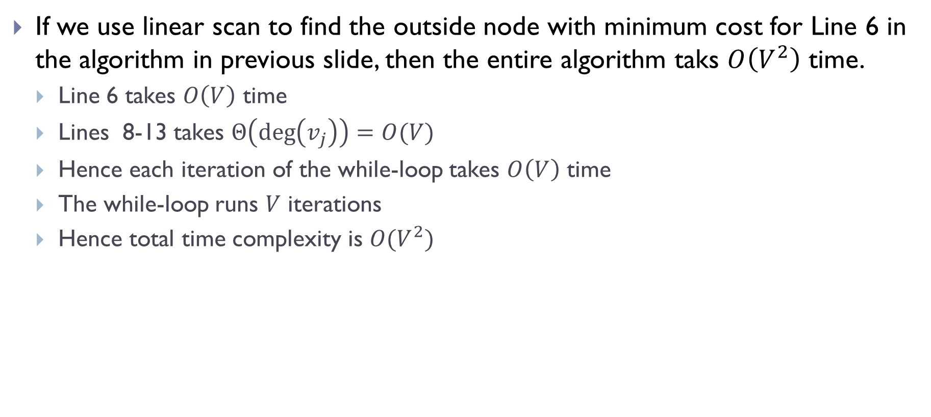
If we use linear scan to find the outside node with minimum cost for Line 6 in the algorithm in previous slide, then the entire algorithm taks $O\left(V^{2}\right)$ time.
Line 6 takes $O\left(V\right)$ time
Lines 8-13 takes $Θ\left(\deg\left(v_{j}\right)\right)=O(V)$
Hence each iteration of the while-loop takes $O\left(V\right)$ time
The while-loop runs $V$ iterations
Hence total time complexity is $O(V^{2})$

Slide 42
Better implementation
Similar to Dijkstra algorithm, we can use priority-queue to significantly speed up the time complexity!
In particular, we need a data structure to maintain the costs of unvisited nodes, which supports:
deleting the node with minimum cost (.extract_min !)
update (decrease) the cost value stored at a node (change_priority !)
In our case, a priority queue stores (key, value) pairs, where key refers to identity of some node, while value is the cost of this node.

Slide 43
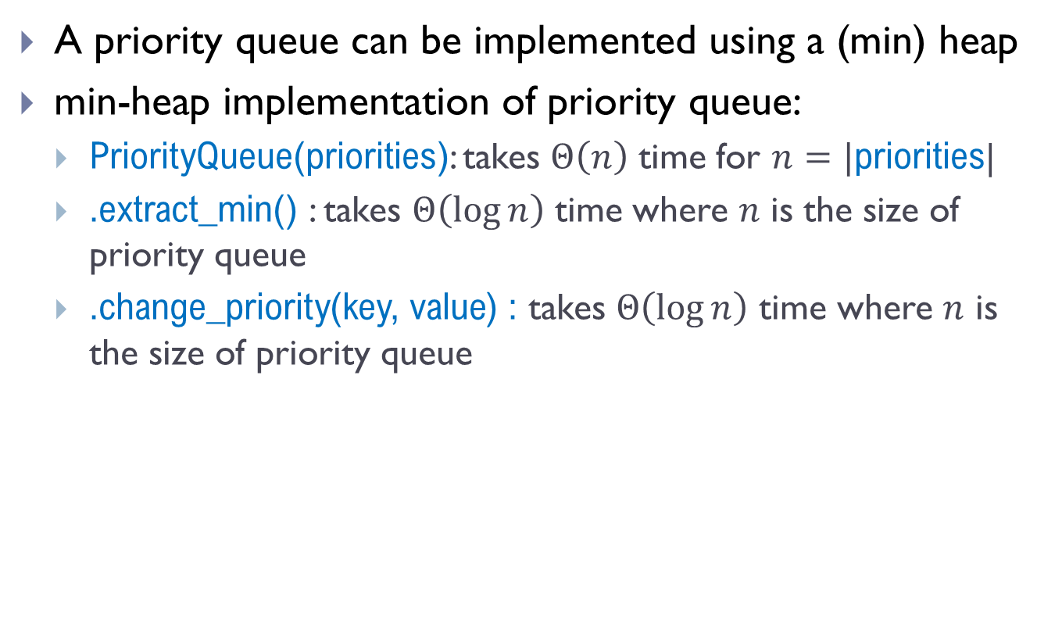
Recall Heap implementation
A priority queue can be implemented using a (min) heap
min-heap implementation of priority queue:
PriorityQueue(priorities): takes $Θ\left(n\right)$ time for $n=|$priorities|
.extract_min() : takes $Θ\left(\log{n}\right)$ time where $n$ is the size of priority queue
.change_priority(key, value) : takes $Θ\left(\log{n}\right)$ time where $n$ is the size of priority queue

Slide 44
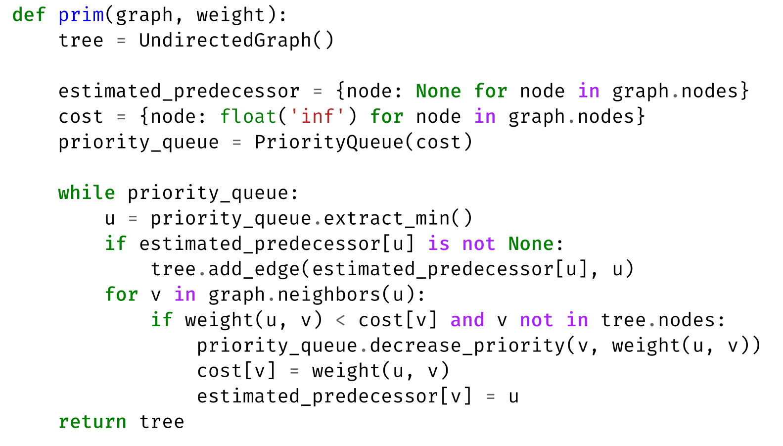
Final implementation of Prim’s Alg

Slide 45
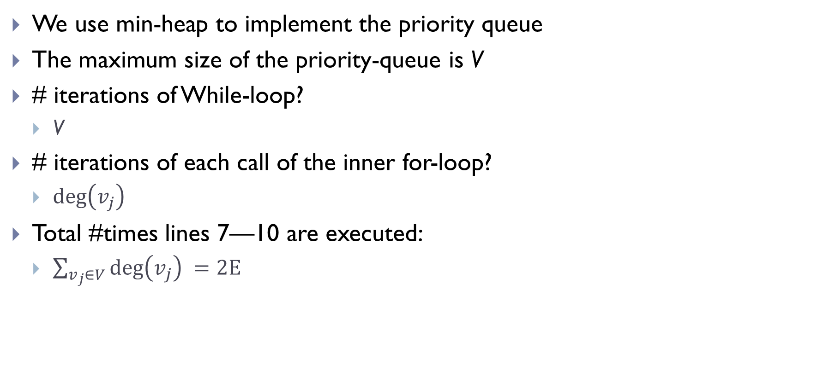
Time complexity analysis
We use min-heap to implement the priority queue
The maximum size of the priority-queue is V
# iterations of While-loop?
V
# iterations of each call of the inner for-loop?
$\deg\left(v_{j}\right)$
Total #times lines 7—10 are executed:
$\sum_{v_{j}∈V}{\deg\left(v_{j}\right) }=2E$

Slide 46

Time complexity analysis
We use min-heap to implement the priority queue
The maximum size of the priority-queue is ____
# iterations of While-loop?
# iterations of each call of the inner for-loop?
Total #times lines 7—10 are executed:

Slide 47
Time complexity analysis
We use min-heap to implement the priority queue
The maximum size of the priority-queue is V
# iterations of While-loop?
V
# iterations of each call of the inner for-loop?
$\deg\left(v_{j}\right)$
Total #times lines 7—10 are executed:
$\sum_{v_{j}∈V}{\deg\left(v_{j}\right) }=2E$

Slide 48
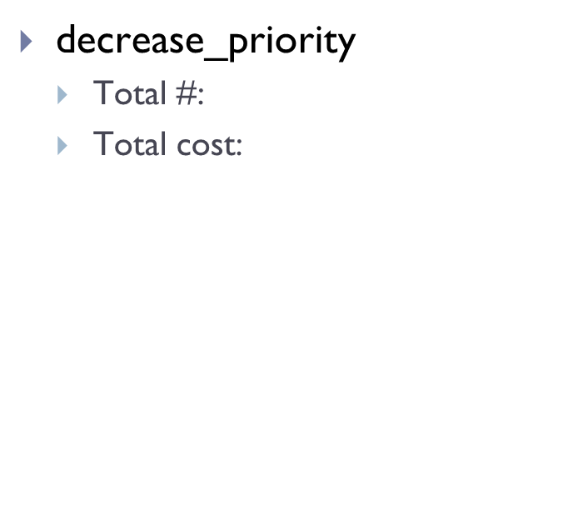
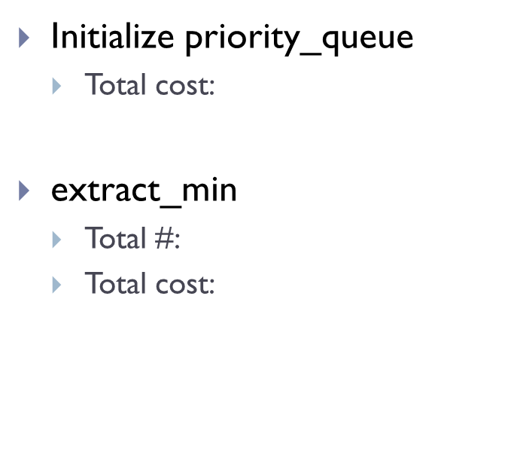
Initialize priority_queue
Total cost:
extract_min
Total #:
Total cost:
decrease_priority
Total #:
Total cost:

Slide 49

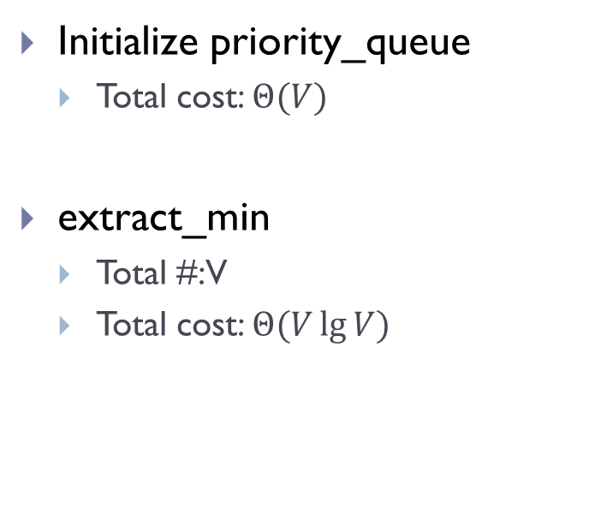
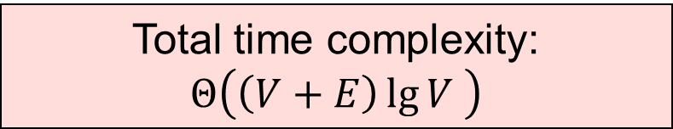
Initialize priority_queue
Total cost: $Θ(V)$
extract_min
Total #: V
Total cost: $Θ(V\lg{V) }$
decrease_priority
Total #: at most 2E
Total cost: $O(E\lg{V)}$
Total time complexity:
$$Θ\left(\left(V+E\right)\lg{V }\right)$$

Slide 50
Example

Slide 51
Example

Slide 52
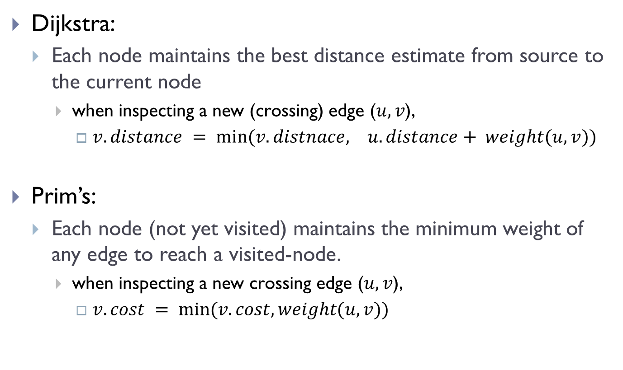
Comparison with Dijkstra algorithm
Dijkstra:
Each node maintains the best distance estimate from source to the current node
when inspecting a new (crossing) edge ($u,v$),
$v.distance = min⁡(v.distnace, u.distance+ weight(u,v))$
Prim’s:
Each node (not yet visited) maintains the minimum weight of any edge to reach a visited-node.
when inspecting a new crossing edge ($u,v$),
$v.cost = min⁡(v.cost, weight(u,v))$

Slide 53
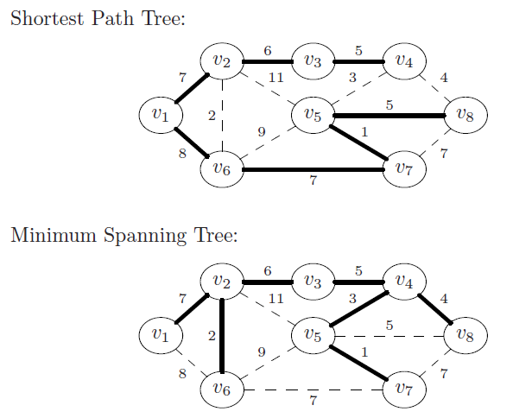
Comparison with Dijkstra

Slide 54
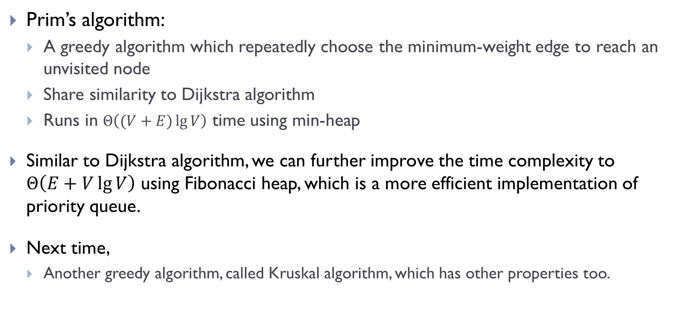
Summary and remarks
Prim’s algorithm:
A greedy algorithm which repeatedly choose the minimum-weight edge to reach an unvisited node
Share similarity to Dijkstra algorithm
Runs in $Θ\left((V+E)\lg{V}\right)$ time using min-heap
Similar to Dijkstra algorithm, we can further improve the time complexity to $Θ\left(E+V\lg{V}\right)$ using Fibonacci heap, which is a more efficient implementation of priority queue.
Next time,
Another greedy algorithm, called Kruskal algorithm, which has other properties too.

Slide 55
FIN

